Slide 1
THE BIG BANG CHALLENGE
TEACHER RESOURCE

Slide 2
About The Big Bang Challenge
The Big Bang Challenge
The Big Bang Challenge is an inspiring project resource, for students aged 11 – 18, of all abilities, to guide them through the stages of STEM project work. By taking part in this extra-curricular or in-school programme, young people will have the opportunity to build their skills and confidence in project-based work. Each Big Bang Challenge focuses on a particular theme and asks young people questions, to inspire them and encourage their creative thinking within the set Challenge.
Each Challenge has a different theme which ties in with real world applications. Each theme gives some ideas for possible areas of research and gives young people some food thought to get them started on a STEM project that is of interest to them.
Support and excite your students as they take part in the Challenge by using our gameboard to track progress, and reward students with certificates as they become big thinkers, problem solvers and inventors – just like real engineers and scientists!

Slide 3
The Big Bang Challenge
Each Challenge is setup with the following three sessions-
1. Project Concept
A required base block that students will need to complete to have taken part in the challenge
Students will be guided through the steps to research and investigate a question on the theme for the chosen Big Bang Challenge
Students should spend between 1 -2 hours on this research to complete the challenge
After completing this stage students will have project work that they can enter into The Big Bang Project Gallery
2. Project Process (optional)
This stage is an optional add-on for those that want to take their project a step further
Students will be guided through the steps to develop their concept and explore their ideas further
Students should spend between 1.5 – 2.5 hours on this stage
After completing this stage students will have project work that they can enter into The Big Bang Project Gallery and The Big Bang Competition
3. Project Outcomes (optional)
This stage is an optional add-on for those wanting to take their project even further
Students will be guided through the steps they should consider when building their project and drawing conclusions
Students should spend between 1.5 – 2.5 hours on this stage
After completing this stage students will have project work that they can enter into The Big Bang Project Gallery and The Big Bang Competition

Slide 4
About this resource
About this presentation
This presentation introduces the Challenge to teachers and can be used as a supplement to the student PDF resource which outlines the Challenge.
Using this Presentation
The slides and slide notes include all the subject knowledge you’ll need to teach this topic with confidence.
Slides 2-6: in white Overview for teachers.
Hidden slides will not display in presentation mode.
Slides 7-16 in blue: Slides to adapt and use with students.
View them in presentation mode to see all content.
Slide notes contain further teacher guidance.

Slide 5
Next steps: Celebrating The Big Bang Challenge
There are a number of ways to celebrate project work that has been completed as part of The Big Bang Challenge-
Enter The Big Bang Project Gallery
Projects will be celebrated in an online gallery on the Big Bang website and young people can show their project work to our followers. Please view The Big Bang Project Gallery here. You can enter The Big Bang Project Gallery here. or via The Big Bang Competition.
Enter The Big Bang Competition
The Big Bang UK Young Scientists & Engineers Competition is a national competition which aims to recognise and reward young people’s achievements in STEM. All entrants will receive judges feedback from a real life scientist or engineer. You can enter The Big Bang Competition here When entering the Competition you will also have the option to enter the project directly into The Big Bang Project Gallery.
Celebrate at School
Certificates – Provide a certificate for each student to acknowledge that they have completed a Big Bang Challenge. A certificate template can be downloaded for print from here.
Science Fair - Hold a science fair at a school assembly or in the classroom, with a poster display and exhibition. Give students up to 5 minutes to present their project, followed by a few minute for questions from a teacher(s) or reviewers. This gives students a chance to speak about their project with other students, and also see what creative solutions others in their class have come up with
Awards Ceremony – Host an awards ceremony either as part of the science fair or as separate event, to recognise the achievements of the students. Winners and runners-up could be awarded with a certificate or small trophy

Slide 6
Hosting an Awards Ceremony
Determine the Award categories. Example categories could be-
Best STEM Communicator
Digital Excellence
Most Commercial Potential
Innovation
Coding
Sustainability
Use of Technology
Teamwork
Community Impact
Best Engineering Design
Excellence in STEM Research
Create a score card for judges/reviewers to use
Example questions on the score card could be –
Do the students explain the project aim clearly?
Does their initial aim have a real-world community, commercial or industrial applicability?
Did they identify existing research/products?
Do they reference external sources?
Was the project well planned, organised and methodical
Did the students identify any challenges and suggest potential modifications?
Have they reflected on what skills they have learnt?
Decide who will be your judges/reviewers. This could just be you as the teacher, or with other STEM teachers at the school
Decide when the judges will review the projects This could be as part of the presentations at the science fair, or separately
Using the score card determine the winners and runners-up in the different categories
Announce the winners and runners-up as part of an awards ceremony This is an opportunity to recognise the work of the students and you should feel free to have as many winners and runners-up in each category so that everyone feels included. You can hand out trophies and certificates

Slide 7
What is The Big Bang Challenge?
The Big Bang Challenge is your chance to :
get creative
think like an engineer or scientist
develop important skills such as communication and problem solving
discover an important area of STEM
celebrate and share your work
Notes:
Emphasise that it is not just for students who are already interested/with an aptitude in science or engineering – it’s for everyone.

Slide 8
Taking part in The Big Bang Challenge
You just need to be curious, willing to try and happy to take on a challenge
Use the activity brief as inspiration for a project and see where it takes you
Notes:
Emphasise that it is not just for students who are already interested/with an aptitude in science or engineering – it’s for everyone.

Slide 9
CHALLENGE 1
CAN WE EAT OUR WAY TO A HEALTHIER PLANET?

Slide 10
CAN WE EAT OUR WAY TO A HEALTHIER PLANET?
Project Concept:
To get started, have a think about what you know about food, how it is made, and how that might impact the environment
Perhaps take a few minutes to brainstorm any possible ideas you might want to research
What sparks your imagination? Think about why you want to investigate this question
This might be a problem you want to solve or an idea for an invention
When writing down your aim, make sure you have a clear statement that you can investigate
Notes:
Prompts for possible areas to consider for research:
Could urban farms be a solution?
Are there alternatives to meat? Could these be lab grown meat or completely different products e.g mushrooms or insects to replace meat
Could robotics be used on farms or to package or transport food? Is there an app people could use to lower food waste?
Are there more eco-friendly ways to package food? What could they be?
What about food distribution, how could this be more environmentally friendly? Is it all to do with transport? Or could food be stored for longer before it goes bad?
Students can draw on real-life examples that they may be familiar with e.g. school lunches, packaging, the local supermarket etc.

Slide 11
CAN WE EAT OUR WAY TO A HEALTHIER PLANET?
Project Process:
Before you start any work for this section, make sure you will be able to measure if your project has been a success
Next up, you can design your project, get creative!
Project Outcomes, Next Steps and Reflections:
Use this section to write down how you felt the project went. Was your project a success? Did you learn something? Would you do something different?
Notes:
Before completing project work, from the aim students have chosen, ensure they have defined parameters as to the question they are investigating, and how they will know if they have reached a conclusion.
For project design, this can be as in depth as students have time for.
Some examples could include
- making a collage of elements that would be included in an urban farm - collating a dataset of how robotics are used in farms currently and finding gaps where they could be used
- drawing and designing a new food storage system
- trialing whether other materials are as useful when packing a school lunch etc
When considering what you may have learnt, perhaps you used some of the following skills:
- creativity, research, thinking outside the box, resilience, team work

Slide 12
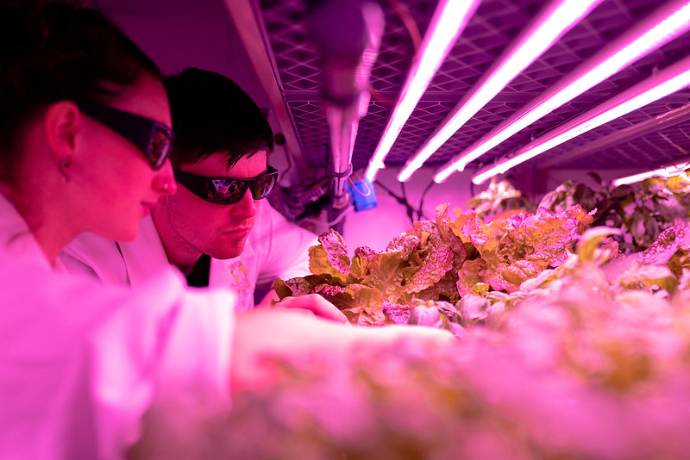
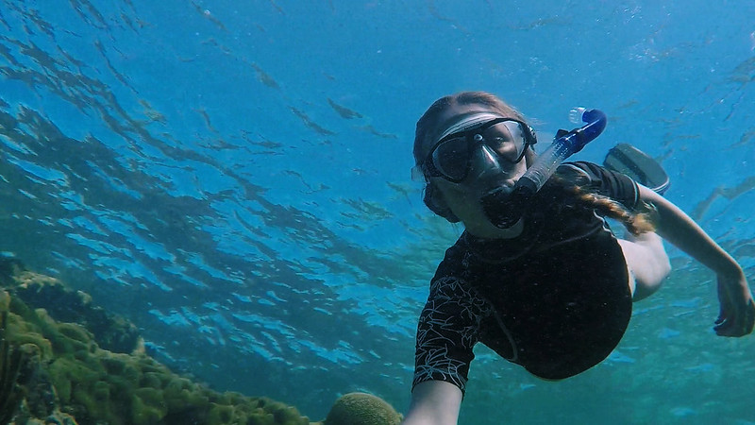
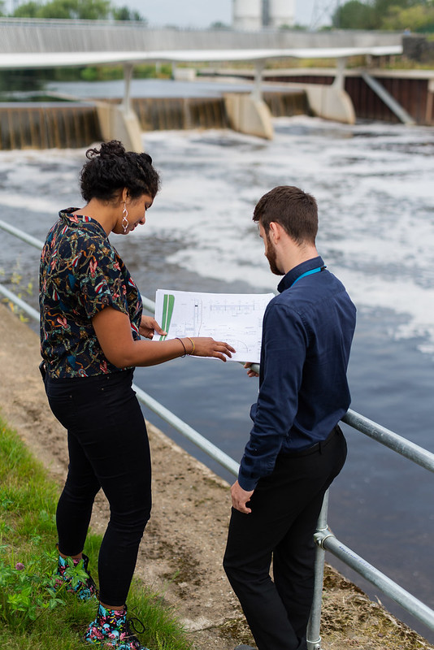
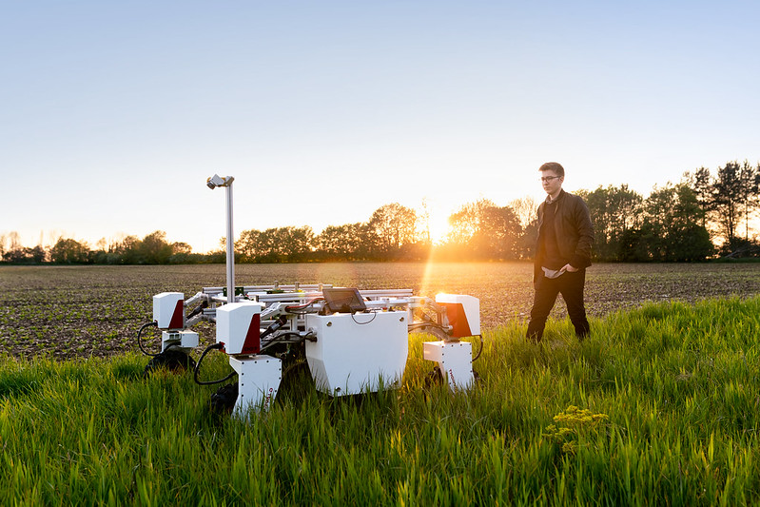
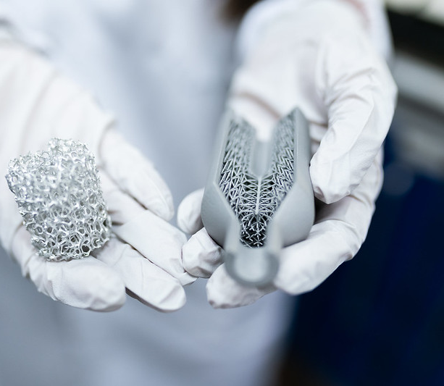
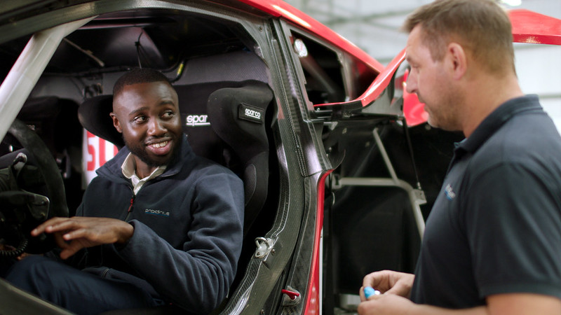

Slide 13
CHALLENGE 2
TECHNOLOGY MAKING A GREENER WORLD

Slide 14
TECHNOLOGY MAKING A GREENER WORLD
Project Concept:
To get started, have a think about what you know about technology, how it is used, and how that might impact the planet
Perhaps take a few minutes to brainstorm any possible ideas you might want to research
What sparks your imagination? Think about why you want to investigate this question
This might be a problem you want to solve or an idea for an invention
When writing down your aim, make sure you have a clear statement that you can investigate
Notes:
Prompts for possible areas to consider for research:
What technology might be needed in cities or rural areas to create a greener community? E.g could robots clean rubbish off the streets, could technology be used to minimise air pollution in cities?
Could technology help to cool the earth?
Could technology help contribute to stopping climate change?
Could robots remove plastic from the ocean or rivers?
Perhaps technology could create eco-friendly transport or fuels?
Could AI be used to distribute green energy during periods of high demand?
Students can draw on real-life examples that they may be familiar with e.g. smart phones, social media, VR glasses etc

Slide 15
TECHNOLOGY MAKING A GREENER WORLD
Project Process:
Before you start any work for this section, make sure you will be able to measure if your project has been a success
Next up, you can design your project, get creative!
Project Outcomes, Next Steps and Reflections:
Use this section to write down how you felt the project went. Was your project a success? Did you learn something? Would you do something different?
Notes:
Before completing project work, from the aim students have chosen, ensure they have defined parameters as to the question they are investigating, and how they will know if they have reached a conclusion.
For project design, this can be as in depth as students have time for.
Creating a model that removes plastic from oceans or rivers
Making an app that monitors pollution in the local area
Drawing a smart city or village
Investigating fuels that are already being used and whether there are any alternatives for green transport
When considering what you may have learnt, perhaps you used some of the following skills:
- creativity, research, thinking outside the box, resilience, team work

Slide 16
