Slide 1
THE BIG BANG CHALLENGE
TEACHER RESOURCE

Slide 2
About this resource
About this presentation
This presentation introduces the Challenge to teachers and can be used as a supplement to the student PDF resource which outlines the Challenge. If you do have any questions after viewing or using it please email competition@thebigbang.org.uk and we will get back to you.
Using this Presentation
The slides and slide notes include all the subject knowledge you’ll need to teach this topic with confidence. Therefore, there is a lot of detail on the slides and in the notes. Please note that the slides are fully editable if you would like to adapt the content for your learners.
Slides 2-8: in white Overview for teachers.
Hidden slides will not display in presentation mode.
Slides 9-10 in blue: an overview of what the Big Bang Challenge is. for the students.
This includes a list of all the seven challenges that students can do.
Slides 11-101 in blue and yellow: Each of the seven Big Bang Challenge has 13 slides.
View them in presentation mode to see all content.
Slide notes contain further teacher guidance, including extra information, web links and suggested differentiation and extension activities.

Slide 3
About The Big Bang Challenge
The Big Bang Challenge
The Big Bang Challenge is an inspiring project resource, for students aged 11 to 18, of all abilities, to guide them through the stages of STEM project work.
By taking part students will practice and develop:
• design thinking skills
• confidence in self-led project-based work
• knowledge of future global issues in STEM
• understanding of the process people working in STEM use
Each Big Bang Challenge focuses on a particular theme and asks young people questions, to inspire them and encourage their creative thinking. These enhance the curriculum through embedding careers, and skills throughout as well as building on subjects being learnt.
Each Challenge has a different theme which ties in with real world applications. Each theme gives some ideas for possible areas of research and gives young people some food thought to get them started on a STEM project that is of interest to them.
Support and excite your students as they take part in the Challenge by using our gameboard to track progress, and reward students with certificates as they become big thinkers, problem solvers and inventors – just like real engineers and scientists!

Slide 4
About The Big Bang Challenge – Curriculum Links
The Big Bang Challenge
Each Challenge meets curriculum links in careers and personal development, which are outlined below. Depending on which challenge you choose there will also be subject curriculum links, from science to technology, geography and English.
Northern Ireland
Thinking skills and personal capabilities
Employability/Learning for Life and Work
The skills and qualities required for a successful career.
The importance of lifelong learning in achieving your personal and professional potential.
Career planning as a lifelong learning process involving:
•Reviewing and evaluating learning, progress and achievements
•Goal setting
•SMART target setting
•Taking action
Wales
Health and wellbeing progression step 4
•I can set appropriate goals, plan a course of action and overcome challenges to achieve them
Careers and work-related experiences
•become increasingly aware of the range of opportunities available to them, broadening their horizons
•develop the attitudes and behaviours required to overcome barriers to employability, career management and lifelong learning
•explore opportunities through a variety of meaningful experiences in learning, work and entrepreneurship
•develop resilience and the ability to be adaptable in response to the challenges, choices and responsibilities of work and life
Scotland
Health and Wellbeing
I am developing the skills and attributes which I will need for learning, life and work. I am gaining understanding of the relevance of my current learning to future opportunities. This is helping me to make informed choices about my life
and learning.
Careers Education Standard Entitlements
Develop skills for learning, life and work as an integral part of their education and be clear about how all their achievements relate to these.
England
PSHE Association Programme of Study KS3
L3. to set realistic yet ambitious targets and goals
L4. the skills and attributes that employers value
L9. the benefits of setting ambitious goals and being open to opportunities in all aspects of life
L12. about different work roles and career pathways, including clarifying their own early aspirations
Gatsby Career Benchmarks
2, 3, 4

Slide 5
The Big Bang Challenge - Structure of Sessions
Each Challenge is setup with the following three sessions. Suggested timings are below, but if you wanted to fit it into one hour you could.
1. Project concept – define your problem
Students will focus on the problem they will solve. This encourages critical analysis and investigative thinking skills
Students will be guided through the steps to create a problem statement on the theme for the chosen Big Bang Challenge
Students should spend between 30 – 45 minutes on this
2. Project process – ideas, prototype, test
Students will develop ideas, create a prototype of their top solution and consider how to test it. This develops research and creative thinking skills
Students will be guided through the steps to research current solutions, develop their ideas, prioritise a solution, prototype and plan testing
Students should spend between 1 – 2 hours on this
After completing this stage students can enter their work into The Big Bang Project Gallery
3. Project outcomes – reflection
Students will reflect on the process, the learning that has taken place and the project. This develops emotional intelligence, and self-awareness
Students will be guided through key questions for this reflection
Students should spend between 30 minutes on this
After completing this stage students will have project work that they can enter into The Big Bang Competition

Slide 6
Ideas for Creative Thinking Activities
During the project process students are asked to think of as many ideas to their problem as possible.
Engineers work in this way and are encouraged to consider many solutions that can be considered and tested.
To help prepare students for this you can do one of the following activities with them, before they think of their own ideas, to warm up their creative thinking skills. This would happen during the ideas phase of the project process.
Alternative uses - creative thinking to challenge perceptions
Pick an ordinary object in the room you are in (e.g. chair, desk, brush)
In the next three minutes think of, or write down, as many alternative uses for that object that you can think of (e.g. obstacle course, clothes storage)
Share what those are and all vote on your favourites
2. Bad ideas - challenging judgmental creative thinking
Pick one of these bad ideas: sandpaper socks, chocolate teapot, paper golf balls
Think of all the possible uses of this ‘bad idea’ in three minutes
Then, pitch the ‘bad idea’ to another person and see if they would use it
3. Using your whole brain - warming up the logical and creative parts of your brain
Each person has two pens / pencils and two pieces of paper. Have one pen / pencil in each hand with paper in front of each
Write your name with both hands at the same time, in opposite directions, so that they mirror each other
Do this three times to compare the difference

Slide 7
Next steps: Celebrating The Big Bang Challenge
There are a number of ways to celebrate project work that has been completed as part of The Big Bang Challenge. If you have any questions about the following please do get in touch on competition@thebigbang.org.uk
Enter The Big Bang Project Gallery
  Projects will be celebrated in an online gallery on the Big Bang website and young people can show their project work to our followers.
  Please view The Big Bang Project Gallery here.
  You can enter The Big Bang Project Gallery here.
  or via The Big Bang Competition.
Enter The Big Bang Competition
  The Big Bang UK Young Scientists & Engineers Competition is a national competition which aims to recognise and reward young people’s achievements in STEM. All entrants will receive judges feedback from a real life scientist or engineer.
  You can enter The Big Bang Competition here
  When entering the Competition you will also have the option to enter the project directly into The Big Bang Project Gallery.
Celebrate at School
Plotting their Success – Provide a gameboard to each student to plot their successes and milestones during the project. A gameboard template can be downloaded for print from here.
Certificates – Provide a certificate for each student to acknowledge that they have completed a Big Bang Challenge. A certificate template can be downloaded for print from here.
Science Fair - Hold a science fair at a school assembly or in the classroom, with a poster display and exhibition. Give students up to 5 minutes to present their project, followed by a few minute for questions from a teacher(s) or reviewers. This gives students a chance to speak about their project with other students, and also see what creative solutions others in their class have come up with
Awards Ceremony – Host an awards ceremony either as part of the science fair or as separate event, to recognise the achievements of the students. Winners and runners-up could be awarded with a certificate or small trophy

Slide 8
Hosting an Awards Ceremony
Determine the Award categories
Example categories could be-
  Best STEM Communicator
  Digital Excellence
  Most Commercial Potential
  Innovation
  Coding
  Sustainability
  Use of Technology
  Teamwork
  Community Impact
  Best Engineering Design
  Excellence in STEM Research
Create a score card for judges/reviewers to use
  Example questions on the score card could be –
  Do the students explain the project aim clearly?
  Does their initial aim have a real-world community, commercial or industrial applicability?
  Did they identify existing research/products?
  Do they reference external sources?
  Was the project well planned, organised and methodical
  Did the students identify any challenges and suggest potential modifications?
  Have they reflected on what skills they have learnt?
Decide who will be your judges/reviewers
This could just be you as the teacher, or with other STEM teachers at the school
Decide when the judges will review the projects
This could be as part of the presentations at the science fair, or separately
Using the score card determine the winners and runners-up in the different categories
Announce the winners and runners-up as part of an awards ceremony
This is an opportunity to recognise the work of the students and you should feel free to have as many winners and runners-up in each category so that everyone feels included. You can hand out trophies and certificates

Slide 9

What is The Big Bang Challenge?
The Big Bang Challenge gives you a problem to investigate and asks you to create a solution to it.
It is your chance to:
Think like a person working in science, technology, engineering or maths (STEM) , through the design thinking process
Get creative
Develop important skills such as communication and problem solving
Discover more on important areas in STEM
Celebrate and share your work
Notes:
Emphasise that it is not just for students who are already interested/with an aptitude in science or engineering – it’s for everyone.

Slide 10
Taking part in The Big Bang Challenge
You just need to be curious, willing to try and happy to take on a challenge.
There are seven challenges for you to choose from:
1. Can we eat our way to a healthier planet? (slides 11 - 23)
2. Technology making a greener world (slides 24 – 36)
3. Game, set, match: transforming sport with STEM (slides 37 – 49)
4. How can Robots and AI help humankind? (slides 50 – 62)
5. Engineering for the extreme (slides 63 – 75)
6. Can we make our air fresh again? (slides 76 – 88)
7. On track to net zero? (slides 89 – 101)
Look through the briefs to begin your challenge and start thinking about your solutions!
Use the activity brief to inspire your solution and see where it takes you
Notes:
The themes and challenges have cross-curricular links and can be taken in any direction the students wish.

Slide 11
CHALLENGE 1
CAN WE EAT OUR WAY TO A HEALTHIER PLANET?
People in STEM work in a linked-up way, and consider the impact one thing has on another. To succeed on this challenge you will have to think about how things connect, reach detailed conclusions and be creative.

Slide 12
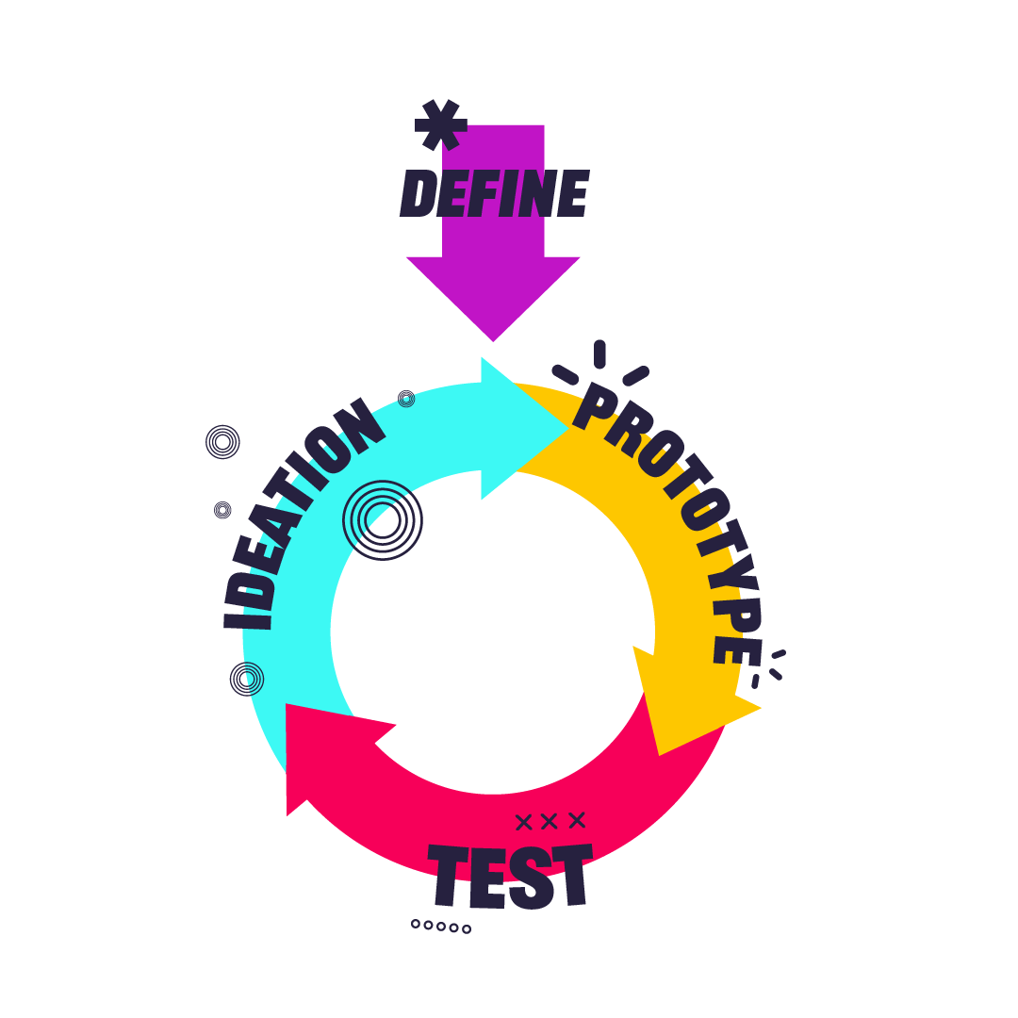
Design thinking
To solve this problem you will use a design thinking process. This is what people working in STEM, and more widely, use to create effective solutions.
It includes the following steps:
Notes:
The design thinking process is used by people working in STEM as a method to solving problems. Major organisations often have a ‘Design Thinking’ Team or ‘Innovation’ Team who work solely in this way, such as Transport for London, Uber Eats, AirBnb, Netflix, or OralB. It is an interative process, that challenges assumptions and develops open minded creativity. In its entirety it has 6 steps, and normally focuses on a user or a particular group. The stages are: empathise, define, Ideate, prototype, test, implement. As students may not choose to focus their problem on a particular person, or group of people we have simplified the process to include 4 steps: define, ideas, prototype, test. The infographic on the slide shows that the testing should help then inform your idea to create a better prototype and test again. This iterative cycle then creates a better design in order to implement.

Slide 13
CAN WE EAT OUR WAY TO A HEALTHIER PLANET?
Project concept: define your problem
It is important to be clear on what problem your solution will solve and spend time on this. Why?
The outcome is to create a problem statement.
- You will have three steps to follow to create this.
- Through creating this you will develop the following skills that STEM jobs value :
  Investigative thinking skills
  Critical analysis skills
  Communication of ideas
Notes:
Suggested timings: For this stage we would recommend 30 minutes on the ‘Project concept’ and Defining Your Problem (which is on the next two slides), but it could be shorter if your students already know a lot on the theme.
Emphasise to students that key to problem solving is spending time to focus on the problem. It helps to focus creative thinking, research and make sure that you can test your solution against something at the end.
Differentiation / Extension:
You can add detail to the skills, or ask students to think more about what these are / how they are evidenced:
Investigative Thinking skills: Curiosity, Making connections, Reaching conclusions.
Critical Thinking skills: Asking Questions, Making Judgements, Interpreting.
Communication of Ideas: Clear in descriptions, Framing your language, Sharing information.
You can use the following quote from Einstein to explore more about why spending time focusing on the problem is important: Einstein said ‘’If I had an hour to solve a problem, I’d spend 55 minutes thinking about the problem and 5 minutes thinking about solutions.’’ Preparation is essential to problem solving, and understanding your problem focuses your creativity.

Slide 14
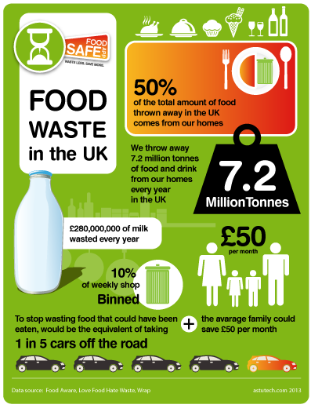
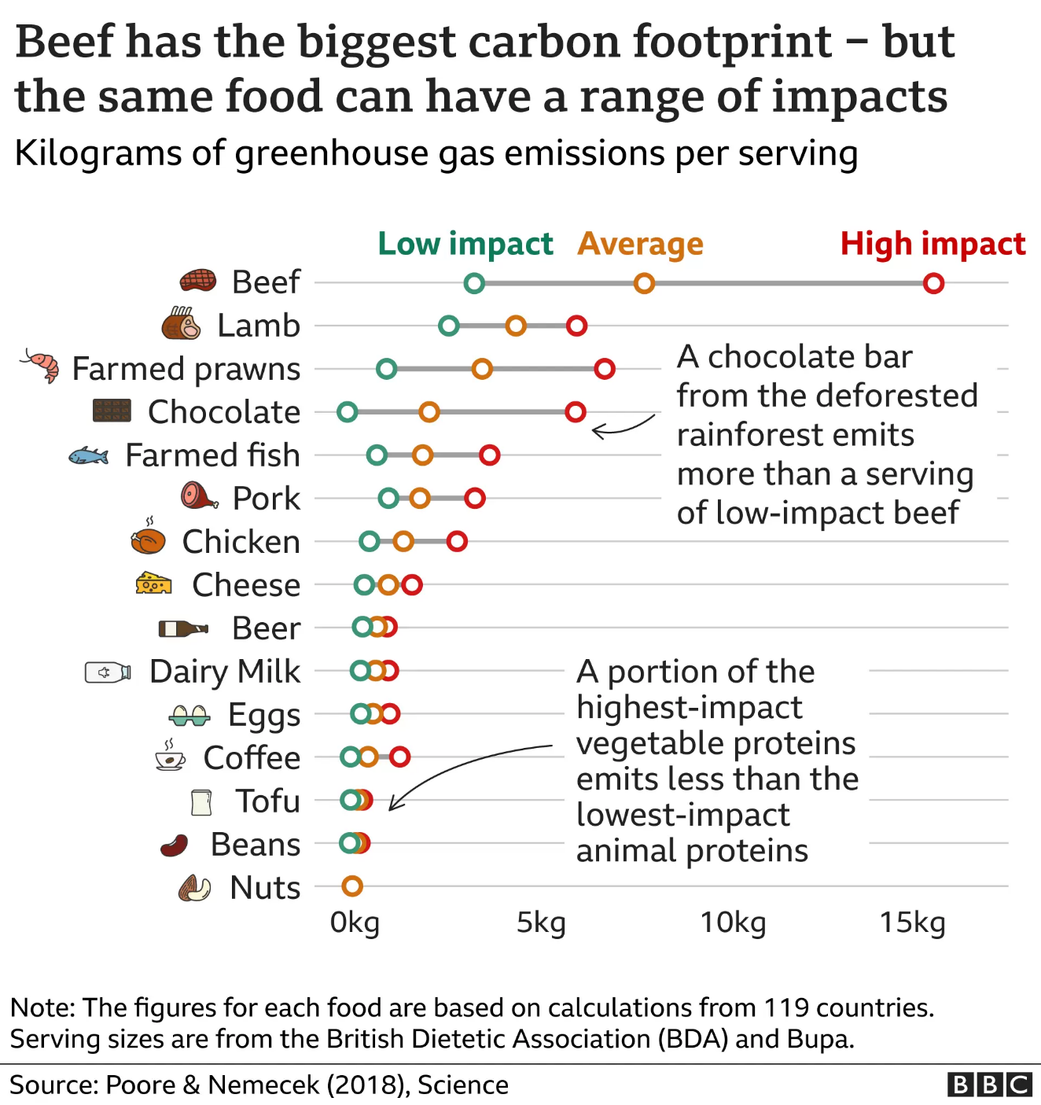
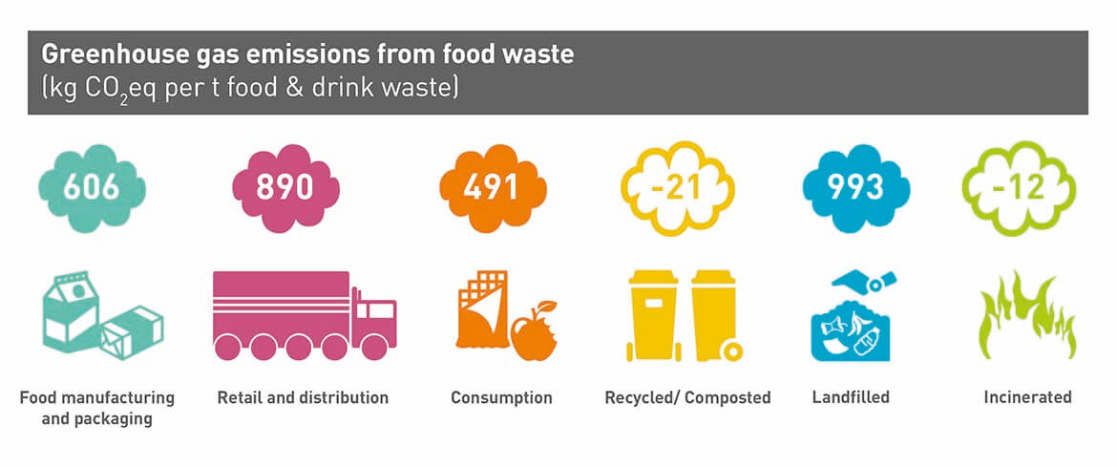
CAN WE EAT OUR WAY TO A HEALTHIER PLANET?
Project concept – define your problem
Step 1: Decide on the problem you will solve.
How does food link to a sustainable and healthy planet?
What problems can you see here? Do any of these link to how you get food, eat it and throw it away?
Which problem will you tackle?
Notes:
Here the problem can be quite broad, as the next slide focuses this further. Remind students of the overarching focus, which is not just about eating and food, but how this is a way to create a healthier planet.
Notes on the images –
- Greenhouse Gas Emissions from Food Waste (Zero Waste Scotland). https://www.zerowastescotland.org.uk/resources/food-waste-environmental-impact This breaks down the direct link between food waste and the health of the planet via greenhouse gas emissions. This is a good to help students to understand key problems to solve if they want to focus on food waste – whether that is through manufacturing, retail, or sending waste to landfill.
- Beef has the biggest carbon footprint – but the same food can have a range of impacts (BBC and Scientific Study). https://www.bbc.co.uk/news/science-environment-46459714 This focuses on the carbon footprint of different ingredients and you can use it to spark discussions around why – such as cattle farming needing a lot of land and cows and sheep emitting methane. There is also nitrous oxide generated through the application of fertilisers for animal feed production and animal farming creates air and water pollution. Land is then also used to create animal feed, such as soya, which requires a lot of water to grow. What is also interesting is that it challenges students to also think of mass production, and mass transportation as a key element to harming the health of the planet and this can be expanded to the production of palm oil and avocados. As an extension to this you can ask students to consider the economic situation of countries involved in this.
- Food Waste Poster (from Food Aware). This is from 2013 and shows problems that still exist and have increased. Currently the UK throws away around 9.5 million tonnes of food waste every year. It shows the main problem is households throwing out food. You can ask students why people do this – such as throwing out food at their best before date, when they may still be okay to eat, or, not using all the food you use in time before it goes bad. Then lead this into discussions on sustainability, with us wasting produce that has needed water to grow, or is meat that adds negatively to our global emissions. All food has been transported by lorries, often diesel powered.
Extensions:
Met Office. This website has a good diagram showing impacts and overall issues for UK agriculture. It is more in-depth if you would like to use this with your students instead. https://blog.metoffice.gov.uk/2022/09/30/food-and-farming-delivering-science-to-our-stakeholders/
2. Climate Change Food Calculator (BBC). This is the website that the middle image comes from. At the top of the website it can calculate the carbon footprint of each ingredient. It creates a result and comparison against similar food groups. This focuses on the message of scientific studies that avoiding meat and dairy in your diet is one of the biggest ways to improve your environmental impact.
3. What does ‘healthier’ mean? As an extension for some students they can focus particularly on what aspect of ‘healthy’ planet they would like to focus on. As currently it could be quite broad.
4. Legal Systems. For students looking to think more outside of the box you could also consider bringing in legal systems and how legislation and regulation may be a potential solution for change. Particularly at a country or corporation level.

Slide 15
CAN WE EAT OUR WAY TO A HEALTHIER PLANET?
Project concept – define your problem
Step 2: Focus your Problem
Why is this important? What is the core problem at the heart of the issue?
What are the particular issues? Where does it happen? Who does it impact?

Slide 16
CAN WE EAT OUR WAY TO A HEALTHIER PLANET?
Project concept – define your problem
Step 3: Create your Problem Statement, which describes the problem you will solve.
Use the following three W’s to create it:
WHO or WHAT is facing your problem?
WHAT is the problem they are facing?
WHY should this problem be solved / WHAT will your solution do and help?
The planet has too much greenhouse gases in the atmosphere. My solution will look at greener ways for farms to transport food across the world, to stop greenhouse gases increasing in the atmosphere and help cool the earth.
Notes:
For Step 3 they can write down their problem statement – or use post it notes for each of the three W’s. Or, they could record it on a video or by speech. The idea is that they have something to keep checking back on when thinking about solutions.
Extension: Their problem statements should consider both parts of the ‘why’ – so should have what the solution will do and how this will help an outcome (as shown in the example). A simplified version would just have ‘What the solution will do’.

Slide 17
CAN WE EAT OUR WAY TO A HEALTHIER PLANET?
Project process – ideas, prototype, test
The next step is to think of ideas for your potential solutions, decide on your favourite, prototype this idea, and then think of ways to test it against your problem statement.
The outcome is to create a solution to your problem and think of ways to test it.
Through doing this you will develop the following skills:
  Research and communication skills
  Creative and logical thinking
  Decision Making
Notes:
Suggested Timings: For the whole of the Project process Stage we would recommend spending 1-2 hours. The following slides break this down into ideas, Prototyping’ and ‘Testing’.
Differentiation / Extension:
You can add detail to the skills, or ask students to think more about what these are / how they are evidenced:
Research and communication skills: Locate specific information, Use language to find relevant information, select relevant and well-regarded sources.
Creative and logical thinking: Organising into next steps, thinking outside of the box, being inspired by a different idea.
Decision Making: Analysing information, assessing against an aim, evaluating outcomes.

Slide 18
CAN WE EAT OUR WAY TO A HEALTHIER PLANET?
Project process – ideas. Think of an interesting, and creative solution to your problem.
Step 1: Research what is out there already. This will also give you inspiration for your solution.
Step 2: Think of at least five new ideas for your solution.
Top tips for developing ideas to your solution:
  It’s not about perfection – don’t be judgemental.
  Warm up your brain before – then give yourself a time limit.
  Write each new idea on a separate post-it to see them all.
  Your idea doesn’t have to be 100% original, many ideas adapt, add to an existing idea, or merge two current ideas to create something new.
Step 3: Select your top idea , to take forward to the next stage. Use your problem statement to help.
Notes:
Suggested timings: This could take approximately 30 – 60 minutes - 15 – 30 minutes for research. 10 – 25 minutes for creating ideas. 5 minutes for choosing your preferred solution.
Research: This develops the skills of focused research and where their problem statement will be very helpful. You can encourage them to research current solutions and do an analysis of what is good about them, but what is also bad about them.
Existing ideas and links are suggested below:
Farming Sustainably. This case study focuses on how an apprentice named Charlotte Bugden is using technology and chemicals for fuel to make farming more sustainable. https://neonfutures.org.uk/case-study/agricultural-engineer-charlotte-budgen/
Using less water in producing food. This case study focuses on how Ben Crowther, a Design Engineer, at LettUs Grow is creating food using less water. https://www.thisisengineering.org.uk/meet-the-engineers/ben/
Using robots in farming. This case study focuses on how Halvard Grimstad has built a robot to support farming in order to make it more effective and sustainable. https://www.thisisengineering.org.uk/meet-the-engineers/halvard/
Urban Farms. These are in urban spaces, to connect people living with cities to nature, animals and growing food. They help with local food supply and some have allotments for people living there. This link highlights 10 across the UK. https://www.farmgarden.org.uk/10-uk-city-farms
Food Packaging. This website breaks down the differences between Eco Packaging (that which considers the environmental impact in its production and can be recycled), Compostable Packaging which can be decomposed by bacteria, and Biodegradable Packaging that breaks down in sun, water or air. https://www.foundation.org.uk/Blog/2023/The-Environmental-Impact-of-Food-Packaging- Foundation for Science and Technology blog on ‘The Environmental Impact of Food Packaging’. https://shorturl.at/ozU05
Food Packaging. Shops like ‘The Source Bulk Foods’ are 100% plastic free to support you in buying and shopping this way from the start. https://thesourcebulkfoods.co.uk/
Alternatives to Meat – Lab Grown Meat. Uncommon are based in Cambridge and create Lab Grown Meat. Lab Grown Meat is predicted to make up 25% of all global meat consumption by 2035. https://uncommonbio.co/our-science/
Alternatives to Meat – Vegan Diets. Campaigns like ‘Veganuary’ encourage people to try a ‘vegan’ diet for a short amount of time. https://veganuary.com/
Robots Supporting Food Sustainability – Robot Chefs. This is an example of where robots precision can support them preparing food and reducing waste. A blog from ‘AI for Good’, entitled ‘Robot Chefs Transforming Cooking and Contributing to Sustainable Development.’ https://shorturl.at/giVY6
Farms taking Sustainable Action. An example here is Dunsters Farm in the North of England who have made sustainable changes across their organization, from lighting, to waste, and list them here https://www.dunstersfarm.com/dunsters-farm-foodservice/sustainability/
Earth Overshoot Day. A page highlights solutions for climate action and has a tab for food which provides many ideas. https://www.overshootday.org/power-of-possibility/
Ideas
Emphasise to students that design thinkingencourages lots of ideas – which is because it wants creative thinking, and people to think outside of the box. So, by forcing yourself to think of at least five (but can be more) ideas you will do this.
Suggest Activities for warming up student brains for creative thinking are in the teacher slides at the start. (Alternative Ideas, Bad Ideas and Using Your Whole Brain).
Selecting their top idea. You can start with them narrowing down their top two, then their chosen one. Encourage students to compare solutions against their problem statement to focus on what would be the best to solve the problem.
Extension: To focus creative thinking students can use the acronym SCAMPER to think about a solution. This is taken from ideas that already exist to create a new idea from them. They can take a few of the ideas they have researched and then apply the acronym to them to think of new ideas. It stands for Substitute, Combine, Adapt, Modify / Magnify, Purpose, Eliminate, Rearrange / Reverse. For instance they can substitute a material, combine two ideas, magnify one part, change the purpose of something that already exists …

Slide 19
CAN WE EAT OUR WAY TO A HEALTHIER PLANET?
Project process – prototype
Prototype Your Chosen Idea. A prototype is a first drawing or model of an idea.
Either draw (2D) or model (3D) your idea.
Add labels, or communicate what each part will do, and consider materials, construction, size etc.
Notes:
Suggested timings: This could take between 20 – 45 minutes, or longer, depending on how detailed they would like to make their models.
Extension:
Students can start with a 2D design and then move into a 3D Design – as this replicates the process that people working in STEM do when creating a prototype.
You can use this free website https://www.tinkercad.com/ for 3D Design. It also allows students to add coding to their design to show movement.

Slide 20
CAN WE EAT OUR WAY TO A HEALTHIER PLANET?
Project process – test
How would you test your solution? An important STEM skill is learning from failure.
Why is testing important? What can it teach us?
Consider how you would test your idea and record this. Would it be tested over time, in different locations, against a control? Would you need to collect data or feedback?
Notes:
Suggested timings: This could take between 10 – 15 minutes.
Testing: Emphasise that the main importance of testing is to help refine your original idea. So, in their considerations of how to test it, it is to see if it does solve the problem and what tweaks should be made next time. Testing isn’t to learn if it works perfectly, but to see what changes need to be made. The ‘Design Thinking’ process is an iterative process, with this built in. You can also emphasise that our brains learn more from failure than success, and approaching failure as a learning tool is essential in STEM jobs, as well as building self-resilience.
Please note that to enter the Big Bang Competition this process represents the stages that students will be judged on, and they do not have to complete testing if it is difficult to do so.
Extension:
Ask students to consider the ethics in testing and if using people, animals or land what should they consider in this? Whose rights should they consider, and what permission will they have to seek?

Slide 21
CAN WE EAT OUR WAY TO A HEALTHIER PLANET?
Project Outcome – reflection
Well Done! You have completed your project and use the ‘Design Thinking’ process. The final stage is to reflect on this, to identify your strengths, what you enjoy and how it can link to a future in STEM.
The outcome is to reflect on the project for yourself, your learning and the next steps to take.
Through doing this you will develop the following skills:
  Goal-Setting
  Resilience
  Self-Awareness
Notes:
Suggested Timings: We would suggest spending up to 30 minutes on this reflection, as a plenary. You can use some of this time to include the slides about roles and next steps as
Differentiation / Extension:
You can add detail to the skills, or ask students to think more about what these are / how they are evidenced:
Goal Setting: Setting targets that are SMART (Specific, Measurable, Achievable, Relevant, Time-Bound), Reflecting, Celebrating Success.
Resilience: Adapting to Change Positively, Being flexible, Viewing set-backs as learning opportunities.
Self-Awareness: Understanding how and why you respond to emotional and learning situations, in order to make the best choices for yourself.

Slide 22
CAN WE EAT OUR WAY TO A HEALTHIER PLANET?
Project Outcome: reflection.
Personal reflection: What were the challenges you faced? How did you overcome difficulty? What parts did you enjoy the most and why?
Project reflection: What worked well on this project? Where would you take it next – a working prototype, doing some testing, presenting it? Would you like to try a different challenge?
Learning reflection: What skills did you develop? What new knowledge did you gain? Have your perceptions about STEM changed, and if so how? What would you do the same and differently in another project?
Notes:
Extension:
- In project reflection you can ask them about future implications of their project and how it might need to be adapted in the future.
- You can get the student / students to present their idea to the class and use the following criteria to structure feedback:
The Problem Statement – specific and clear.
What solution you went with and why you rejected others – logical thinking and reasoning skills.
Talk through the prototype and design – communication, using visuals to support clarification.
Explaining testing options – understanding of the role of testing.
reflection – good self-awareness, evaluation and goal setting.

Slide 23
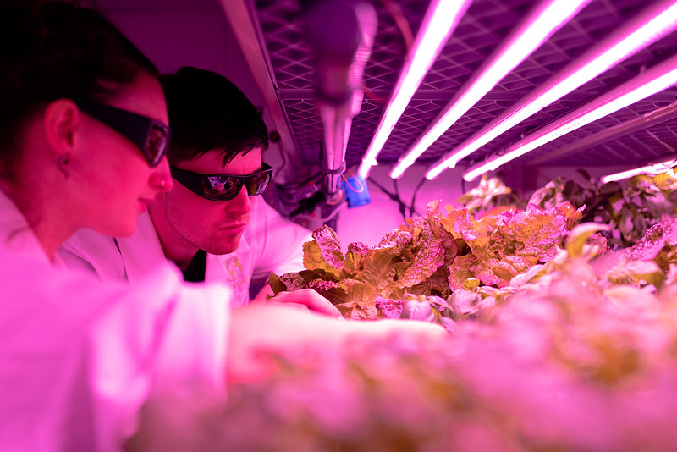
CAN WE EAT OUR WAY TO A HEALTHIER PLANET?
Congratulations on Completing your Project!
Through your Project you used the ‘Design Thinking’ process, which is a highly valued approach in problem solving.
You developed and practiced many skills, including - research, creative thinking, communication, logical thinking, decision making, time management and goal setting.
These are all essential skills in STEM careers, and through doing this project you have shown you would be really successful in a STEM job.
Examples of jobs in this field are:
1. Design Engineer to create new systems for farming.
2. Manufacturing and Mechanical Engineer to create efficient ways to produce chocolate.
If you want to celebrate your project further you can enter it into the Big Bang Project Gallery, or Big Bang Competition.
Notes:
Design Engineer profile: https://www.thisisengineering.org.uk/meet-the-engineers/ben/
2. Manufacturing and Mechanical Engineer profile: https://neonfutures.org.uk/case-study/chocolate-factory-engineer-rob-sharpley/
Next Steps:
You can download the Green Engineering Careers Poster entitled 'Can we eat our way to a healthier planet?'. This explores how engineers have explored this problem and further career information. https://neonfutures.org.uk/resource/green-engineering-careers-posters/
You can provide students with certificates to celebrate their achievement. A certificate template can be downloaded for print from here.
You can enter The Big Bang Project Gallery here.
You can enter The Big Bang Competition here

Slide 24
CHALLENGE 2
TECHNOLOGY MAKING A GREENER WORLD
People in STEM use new and emerging technologies to help solve problems. To succeed on this challenge you are going to have think ahead, predict and be imaginative.

Slide 25
Design thinking
To solve this problem you will use a design thinking process. This is what people working in STEM, and more widely, use to create effective solutions.
It includes the following steps:
Notes:
The design thinking process is used by people working in STEM as a method to solving problems. Major organisations often have a ‘Design Thinking’ Team or ‘Innovation’ Team who work solely in this way, such as Transport for London, Uber Eats, AirBnb, Netflix, or OralB. It is an interative process, that challenges assumptions and develops open minded creativity. In its entirety it has 6 steps, and normally focuses on a user or a particular group. The stages are: empathise, define, Ideate, prototype, test, implement. As students may not choose to focus their problem on a particular person, or group of people we have simplified the process to include 4 steps: define, ideas, prototype, test. The infographic on the slide shows that the testing should help then inform your idea to create a better prototype and test again. This iterative cycle then creates a better design in order to implement.

Slide 26
TECHNOLOGY MAKING A GREENER WORLD
Project concept: define your problem
It is important to be clear on what problem your solution will solve and spend time on this. Why?
The outcome is to create a problem statement.
- You will have three steps to follow to create this.
- Through creating this you will develop the following skills that STEM jobs value :
  Investigative thinking skills
  Critical analysis skills
  Communication of ideas
Notes:
Suggested timings: For this stage we would recommend 30 minutes on the ‘Project concept’ and Defining Your Problem (which is on the next two slides), but it could be shorter if your students already know a lot on the theme.
Emphasise to students that key to problem solving is spending time to focus on the problem. It helps to focus creative thinking, research and make sure that you can test your solution against something at the end.
Differentiation / Extension:
You can add detail to the skills, or ask students to think more about what these are / how they are evidenced:
Investigative Thinking skills: Curiosity, Making connections, Reaching conclusions.
Critical Thinking skills: Asking Questions, Making Judgements, Interpreting.
Communication of Ideas: Clear in descriptions, Framing your language, Sharing information.
You can use the following quote from Einstein to explore more about why spending time focusing on the problem is important: Einstein said ‘’If I had an hour to solve a problem, I’d spend 55 minutes thinking about the problem and 5 minutes thinking about solutions.’’ Preparation is essential to problem solving, and understanding your problem focuses your creativity.

Slide 27
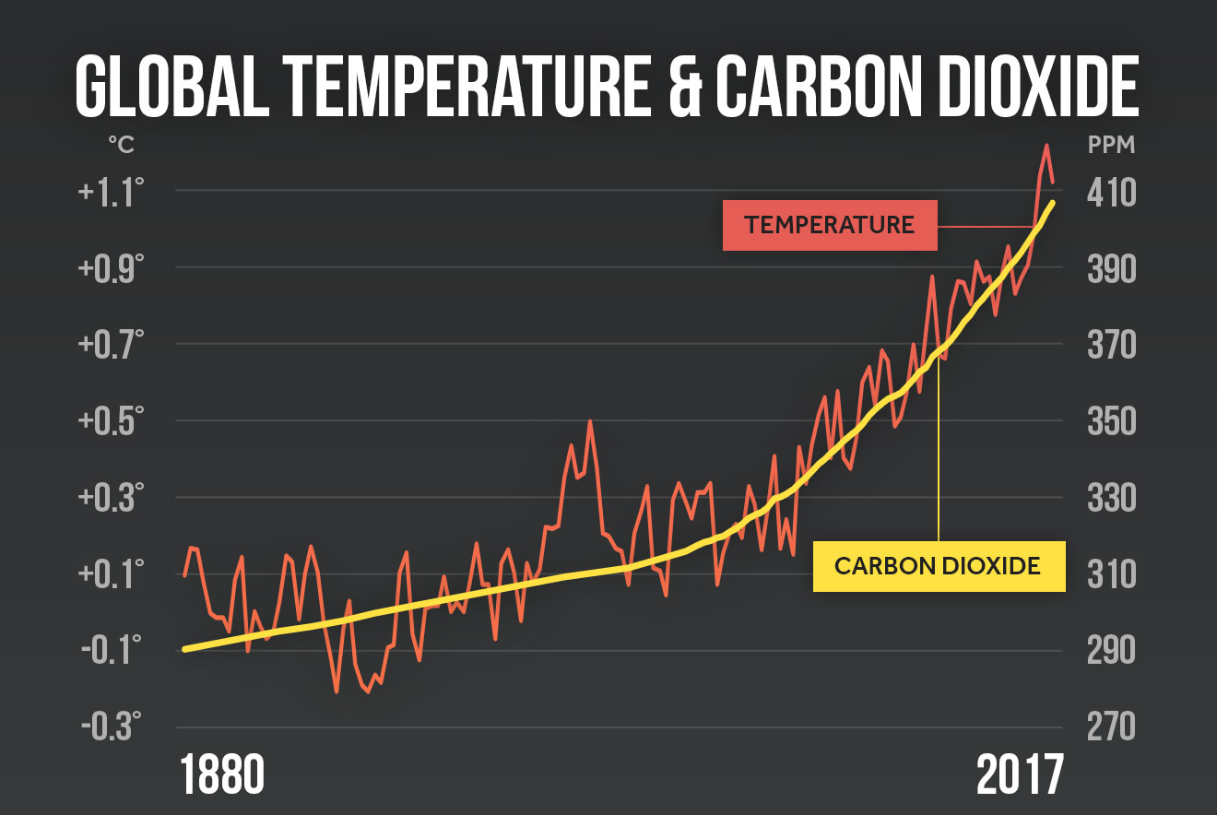
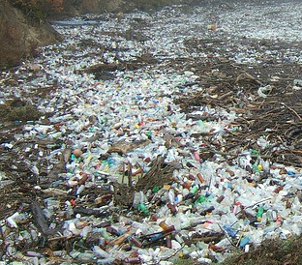

TECHNOLOGY MAKING A GREENER WORLD
Project concept – define your problem
Step 1: Decide on the problem you will solve.
What are they key problems in making a
sustainable and greener world that you know?
What problems can you see here?
Which problem will you tackle?
Notes:
Here the problem can be quite broad, as the next slide focuses this further. Remind students of the overarching focus, which is not about technology (which is the solution), but about making a greener world.
You may want to discuss what 'greener world' means with them first. For this context it would be to design a solution that tackles something that is environmentally bad for the world. Examples of this could be:
- Tackling global warming and reducing the CO2 in our atmosphere.
Alternative ways to generate energy that don't require fossil fuel extraction and burning.
Stopping deforestation.
Getting rid of waste without polluting the planet.
They can also think about sustainability, and creating solutions that make sure our earth is a healthy place for life to exist in the future. This can look at preventing future problems relating to the climate emergency such as:
- Flooding.
Making sure environments remain habitable.
They could also think about the impact of human beings on the planet and solutions to us.
Notes on the images –
Deforestation and Palm Oil. Whilst this image looks completely green, the top part is a rainforest and the bottom is a section that has been deforested to grow palm oil. Palm oil is found in many products, from toothpaste to chocolate and fuel and is cheaper to make than other oils, can grow all year round, produces high quantity in a small area, is low on bad fats, and has virtually no odour or colour.
Over 73 million tonnes were made in 2021 / 2022. 85% of it is made in Indonesia and Malaysia. The main environmental issue with palm oil is that it has led to the deforestation of rainforests and destruction of human habitats to create space to grow it. Now, action is being done to prevent this, but not to reforest.
This can lead to many different discussions, around the problems of deforestation such as
losing diversity (15% of all plants and animals live in forests),
putting carbon into the atmosphere from clearing and burning trees (annually contributes 20% of global greenhouse emissions which is more than the world's transportation sector)
losing the opportunity to capture carbon from the atmosphere. The following video looks at a solution of making sure these habitats return.
Just Imagine: Trees Returning – David Attenborough: A Life on Our Planet. https://www.youtube.com/watch?v=N1XvG440xjM A 1 minute video to show the impact of deforestation and solutions to this – such as growing palm oil and soya on already deforested land, planting more trees. Attenborough also talks about the impact of growing more trees on reducing the carbon in our atmosphere and helping to cool our global temperature.
2. Harmful Waste Removal. This should prompt discussions about how we deal with waste and how that impacts the environment. It can lead to discussions of landfill and where waste goes. The world counts has statistics on this https://www.theworldcounts.com/challenges/planet-earth/state-of-the-planet/world-waste-facts. The more relevant ones state that 99% of what people buy is thrown out within 6 months and each year 2.12 billion tonnes of waste ends up in landfill decomposing.
Plastic: This particular image is taken from a University of Birmingham article called 'Getting a Grip on the UKs Plastic Recycling Crisis' https://www.birmingham.ac.uk/news/2021/getting-a-grip-on-the-uks-plastic-recycling-crisis-alternatives-to-shipping-the-problem-overseas as plastic takes the longest to decompose, and can take up to 500 years. The article looks at three key issues with plastic use:
The production which is from oil, and changing that material to something that decomposes more quickly
Use of it, and using it for what it is good for, which is long-term rather than single-use and
End of life and recycling. Looking at ways to make sure that plastic can be reused and recycled.
The article also looks at how the UK Government of 2021 was exporting plastic to other countries. Those countries often didn't have the technology to dispose of plastic safely, and would burn it.
3. Global Temperature and Carbon Dioxide (Climate Central) Previewing the National Climate Assessment | Climate Central
This graph shows the direct correlation between the amount of carbon dioxide in the atmosphere and rising global temperatures. This can then spark many discussions.
Firstly, about rising temperatures and why they provide issues regarding a green and sustainable world, such as extreme weather, extinction of animals and habitats, struggling to farm.
You can also discuss about why carbon dioxide leads to a warming planet, with it being a greenhouse gas and absorbing the sun's heat and radiating it back to the planet.
It can also lead to what creates carbon dioxide and in particular why has the temperature dramatically increased in the later part of the graph (post 1950). This can then lead to conclusions that not only carbon dioxide is a factor of a warming planet, but also human activity and the industrial revolution.
If you would like to use alternative graphs you can and two are suggested below:
Evolution of Average Global Temperatures (Iberdrola) https://www.iberdrola.com/sustainability/increase-average-temperature-on-earth This graph shows how since 1980 the global average temperature has increased by 0.75 degrees celcius. It shows it to be consistent and plots out where this may lead to in the future years. What can also be pointed out to students is that the rate of warming has doubled since just after 1980 (between 1906 and 2005 it rose by half). The graph also points to two causes, humans and the industrial revolution in the nineteenth century.
2. Another graph to show this can be found here. -Climate Change: Global Warming (Climate.Gov). https://www.climate.gov/news-features/understanding-climate/climate-change-global-temperature This graph shows the global average temperature from 1880 – 2023. how the average global temperature since 1880 has consistently risen, despite there being some dips in individual years.
Extensions:
Just Imagine: Trees Returning – David Attenborough: A Life on Our Planet. https://www.youtube.com/watch?v=N1XvG440xjM A 1 minute video to show the impact of deforestation and solutions to this – such as growing palm oil and soya on already deforested land, planting more trees. Attenborough also talks about the impact of growing more trees on reducing the carbon in our atmosphere and helping to cool our global temperature.
GreenPeace's 'Wasteminster' Film from 2021 shows this process and environmental impact of the UK sending plastic abroad. https://www.greenpeace.org.uk/news/wasteminster-downing-street-disaster/
Cities and Sea Level Rise (The Future We Don't Want). https://www.c40.org/what-we-do/scaling-up-climate-action/adaptation-water/the-future-we-dont-want/sea-level-rise/ This website looks at cities and sea level rises and the impact of them by 2050. It does look at problems this will cause and suggests some solutions in a poster as well. This focuses on problems that will happen in the future which can be dealt with now in order to make sure our world is more 'sustainable'.
Climate Justice. As an extension you can discuss with students about the economic link to sustainability. Can capitalism and a green and sustainable world co-exist? What about green solutions that cost a lot of money, are you punishing countries and individuals who cannot afford green solutions by introducing them at an unaffordable cost?

Slide 28
TECHNOLOGY MAKING A GREENER WORLD
Project concept – define your problem
Step 2: Focus your Problem
Why is this important? What is the core problem at the heart of the issue?
What are the particular issues? Where does it happen? Who does it impact?

Slide 29
TECHNOLOGY MAKING A GREENER WORLD
Project concept – define your problem
Step 3: Create your Problem Statement, which describes the problem you will solve.
Use the following three W’s to create it:
WHO or WHAT is facing your problem?
WHAT is the problem they are facing?
WHY should this problem be solved / WHAT will your solution do and help?
The ocean has too much plastic in it. My solution will use technology to create a way to remove current plastic and stop anymore from entering the ocean, to help the ocean be cleaner.
Notes:
For Step 3 they can write down their problem statement – or use post it notes for each of the three W’s. Or, they could record it on a video or by speech. The idea is that they have something to keep checking back on when thinking about solutions.
Extension: Their problem statements should consider both parts of the ‘why’ – so should have what the solution will do and how this will help an outcome (as shown in the example). A simplified version would just have ‘What the solution will do’.

Slide 30
TECHNOLOGY MAKING A GREENER WORLD
Project process – ideas, prototype, test
The next step is to think of ideas for your potential solutions, decide on your favourite, prototype this idea, and then think of ways to test it against your problem statement.
The outcome is to create a solution to your problem and think of ways to test it.
Through doing this you will develop the following skills:
  Research and communication skills
  Creative and logical thinking
  Decision Making
Notes:
Suggested Timings: For the whole of the Project process Stage we would recommend spending 1-2 hours. The following slides break this down into ideas, Prototyping’ and ‘Testing’.
Differentiation / Extension:
You can add detail to the skills, or ask students to think more about what these are / how they are evidenced:
Research and communication skills: Locate specific information, Use language to find relevant information, select relevant and well-regarded sources.
Creative and logical thinking: Organising into next steps, thinking outside of the box, being inspired by a different idea.
Decision Making: Analysing information, assessing against an aim, evaluating outcomes.

Slide 31
TECHNOLOGY MAKING A GREENER WORLD
Project process – ideas. Think of an interesting, and creative solution to your problem.
Step 1: Research what is out there already. This will also give you inspiration for your solution.
Step 2: Think of at least five new ideas for your solution.
Top tips for developing ideas to your solution:
  It’s not about perfection – don’t be judgemental.
  Warm up your brain before – then give yourself a time limit.
  Write each new idea on a separate post-it to see them all.
  Your idea doesn’t have to be 100% original, many ideas adapt, add to an existing idea, or merge two current ideas to create something new.
Step 3: Select your top idea , to take forward to the next stage. Use your problem statement to help.
Notes:
Suggested timings: This could take approximately 30 – 60 minutes - 15 – 30 minutes for research. 10 – 25 minutes for creating ideas. 5 minutes for choosing your preferred solution.
Research: This develops the skills of focused research and where their problem statement will be very helpful. You can encourage them to research current solutions and do an analysis of what is good about them, but what is also bad about them.
Existing ideas and links are suggested below:
Greener Energy in Africa. This case study focuses on how Drew Corbyn has used technology to create hydro-electric power plants in Malawi. https://neonfutures.org.uk/case-study/energy-engineer-drew-corbyn/
Using robots in farming. This case study focuses on how Halvard Grimstad has built a robot to support farming in order to make it more effective and sustainable. https://www.thisisengineering.org.uk/meet-the-engineers/halvard/
Farming Sustainably. This case study focuses on how an apprentice named Charlotte Bugden is using technology and chemicals for fuel to make farming more sustainable. https://neonfutures.org.uk/case-study/agricultural-engineer-charlotte-budgen/
Waste Hierarchy. This helps to show the preferred ways to deal with waste, from the most sustainable at the top to the least at the bottom. These are solutions on a big theme, rather than specific examples, but can spark ideas. https://ismwaste.co.uk/help/what-is-the-waste-hierarchy
2BO Robot that helps with recycling. This YouTube video shows how the robot uses technology, like AI, to help tackle waste issues and change behaviour in individuals towards recyclable goods. https://www.youtube.com/watch?v=ZcW7UEymBtQ
Emerging technologies for all areas of Climate Action. This website provides a good list of many ways technology is supporting many issues now and for the future. The ones that are particularly relevant are:
-Climate Trace (pinpointing global emissions),
-Recognising energy links (AI using a lot of energy),
-Solar-collecting fabric (a polymer on clothes)
-Elevator Generators (regenerative breaking systems).
https://www.sap.com/insights/viewpoints/by-land-sea-and-air-emerging-technologies-to-tackle-climate-change.html
Sustainable Development. Students can use the following three recommended points to guide what is 'sustainable development'. These are: Environment (is it good for the planet), Social (will people think it's fair), and Economy (can we afford it)? The Sustainable Development Model (aeon.info)
Ground Source Heat Pumps. This technology is an alternative way to heat homes than electricity and gas. More information can be found here, including impact and logistics such as cost. https://energysavingtrust.org.uk/advice/ground-source-heat-pumps/
Ideas
Emphasise to students that design thinkingencourages lots of ideas – which is because it wants creative thinking, and people to think outside of the box. So, by forcing yourself to think of at least five (but can be more) ideas you will do this.
Suggest Activities for warming up student brains for creative thinking are in the teacher slides at the start. (Alternative Ideas, Bad Ideas and Using Your Whole Brain).
Selecting their top idea. You can start with them narrowing down their top two, then their chosen one. Encourage students to compare solutions against their problem statement to focus on what would be the best to solve the problem.
Extension: To focus creative thinking students can use the acronym SCAMPER to think about a solution. This is taken from ideas that already exist to create a new idea from them. They can take a few of the ideas they have researched and then apply the acronym to them to think of new ideas. It stands for Substitute, Combine, Adapt, Modify / Magnify, Purpose, Eliminate, Rearrange / Reverse. For instance they can substitute a material, combine two ideas, magnify one part, change the purpose of something that already exists …

Slide 32
TECHNOLOGY MAKING A GREENER WORLD
Project process – prototype
Prototype Your Chosen Idea. A prototype is a first drawing or model of an idea.
Either draw (2D) or model (3D) your idea.
Add labels, or communicate what each part will do, and consider materials, construction, size etc.
Notes:
Suggested timings: This could take between 20 – 45 minutes, or longer, depending on how detailed they would like to make their models.
Extension:
Students can start with a 2D design and then move into a 3D Design – as this replicates the process that people working in STEM do when creating a prototype.
You can use this free website https://www.tinkercad.com/ for 3D Design. It also allows students to add coding to their design to show movement.

Slide 33
TECHNOLOGY MAKING A GREENER WORLD
Project process – test
How would you test your solution? An important STEM skill is learning from failure.
Why is testing important? What can it teach us?
Consider how you would test your idea and record this. Would it be tested over time, in different locations, against a control? Would you need to collect data or feedback?
Notes:
Suggested timings: This could take between 10 – 15 minutes.
Testing: Emphasise that the main importance of testing is to help refine your original idea. So, in their considerations of how to test it, it is to see if it does solve the problem and what tweaks should be made next time. Testing isn’t to learn if it works perfectly, but to see what changes need to be made. The ‘Design Thinking’ process is an iterative process, with this built in. You can also emphasise that our brains learn more from failure than success, and approaching failure as a learning tool is essential in STEM jobs, as well as building self-resilience.
Please note that to enter the Big Bang Competition this process represents the stages that students will be judged on, and they do not have to complete testing if it is difficult to do so.
Extension:
Ask students to consider the ethics in testing and if using people, animals or land what should they consider in this? Whose rights should they consider, and what permission will they have to seek?

Slide 34
TECHNOLOGY MAKING A GREENER WORLD
Project Outcome – reflection
Well Done! You have completed your project and use the ‘Design Thinking’ process. The final stage is to reflect on this, to identify your strengths, what you enjoy and how it can link to a future in STEM.
The outcome is to reflect on the project for yourself, your learning and the next steps to take.
Through doing this you will develop the following skills:
  Goal-Setting
  Resilience
  Self-Awareness
Notes:
Suggested Timings: We would suggest spending up to 30 minutes on this reflection, as a plenary. You can use some of this time to include the slides about roles and next steps as
Differentiation / Extension:
You can add detail to the skills, or ask students to think more about what these are / how they are evidenced:
Goal Setting: Setting targets that are SMART (Specific, Measurable, Achievable, Relevant, Time-Bound), Reflecting, Celebrating Success.
Resilience: Adapting to Change Positively, Being flexible, Viewing set-backs as learning opportunities.
Self-Awareness: Understanding how and why you respond to emotional and learning situations, in order to make the best choices for yourself.

Slide 35
TECHNOLOGY MAKING A GREENER WORLD
Project Outcome: reflection.
Personal reflection: What were the challenges you faced? How did you overcome difficulty? What parts did you enjoy the most and why?
Project reflection: What worked well on this project? Where would you take it next – a working prototype, doing some testing, presenting it? Would you like to try a different challenge?
Learning reflection: What skills did you develop? What new knowledge did you gain? Have your perceptions about STEM changed, and if so how? What would you do the same and differently in another project?
Notes:
Extension:
- In project reflection you can ask them about future implications of their project and how it might need to be adapted in the future.
- You can get the student / students to present their idea to the class and use the following criteria to structure feedback:
The Problem Statement – specific and clear.
What solution you went with and why you rejected others – logical thinking and reasoning skills.
Talk through the prototype and design – communication, using visuals to support clarification.
Explaining testing options – understanding of the role of testing.
reflection – good self-awareness, evaluation and goal setting.

Slide 36
TECHNOLOGY MAKING A GREENER WORLD
Congratulations on Completing your Project!
Through your Project you used the ‘Design Thinking’ process, which is a highly valued approach in problem solving.
You developed and practiced many skills, including - research, creative thinking, communication, logical thinking, decision making, time management and goal setting.
These are all essential skills in STEM careers, and through doing this project you have shown you would be really successful in a STEM job.
Examples of jobs in this field are:
1. Energy Consultant to create renewable energy systems around the world.
2. Apprentice Engineer to use technology to farm more sustainably.
If you want to celebrate your project further you can enter it into the Big Bang Project Gallery, or Big Bang Competition.
Notes:
1. Energy Consultant profile: https://neonfutures.org.uk/case-study/energy-engineer-drew-corbyn/
2. Apprentice Engineer profile: https://neonfutures.org.uk/case-study/agricultural-engineer-charlotte-budgen/
Next Steps:
You can provide students with certificates to celebrate their achievement. A certificate template can be downloaded for print from here.
You can enter The Big Bang Project Gallery here.
You can enter The Big Bang Competition here

Slide 37
CHALLENGE 3
GAME, SET, MATCH:
TRANSFORMING SPORT WITH STEM
People in STEM work in many different roles, many that we don’t expect. To succeed on this challenge, you will have to see STEM in new places and think outside of the box.

Slide 38
Design thinking
To solve this problem you will use a design thinking process. This is what people working in STEM, and more widely, use to create effective solutions.
It includes the following steps:
Notes:
The design thinking process is used by people working in STEM as a method to solving problems. Major organisations often have a ‘Design Thinking’ Team or ‘Innovation’ Team who work solely in this way, such as Transport for London, Uber Eats, AirBnb, Netflix, or OralB. It is an interative process, that challenges assumptions and develops open minded creativity. In its entirety it has 6 steps, and normally focuses on a user or a particular group. The stages are: empathise, define, Ideate, prototype, test, implement. As students may not choose to focus their problem on a particular person, or group of people we have simplified the process to include 4 steps: define, ideas, prototype, test. The infographic on the slide shows that the testing should help then inform your idea to create a better prototype and test again. This iterative cycle then creates a better design in order to implement.

Slide 39
GAME, SET, MATCH: TRANSFORMING SPORT WITH STEM
Project concept: define your problem
It is important to be clear on what problem your solution will solve and spend time on this. Why?
The outcome is to create a problem statement.
- You will have three steps to follow to create this.
- Through creating this you will develop the following skills that STEM jobs value :
  Investigative thinking skills
  Critical analysis skills
  Communication of ideas
Notes:
Suggested timings: For this stage we would recommend 30 minutes on the ‘Project concept’ and Defining Your Problem (which is on the next two slides), but it could be shorter if your students already know a lot on the theme.
Emphasise to students that key to problem solving is spending time to focus on the problem. It helps to focus creative thinking, research and make sure that you can test your solution against something at the end.
Differentiation / Extension:
You can add detail to the skills, or ask students to think more about what these are / how they are evidenced:
Investigative Thinking skills: Curiosity, Making connections, Reaching conclusions.
Critical Thinking skills: Asking Questions, Making Judgements, Interpreting.
Communication of Ideas: Clear in descriptions, Framing your language, Sharing information.
You can use the following quote from Einstein to explore more about why spending time focusing on the problem is important: Einstein said ‘’If I had an hour to solve a problem, I’d spend 55 minutes thinking about the problem and 5 minutes thinking about solutions.’’ Preparation is essential to problem solving, and understanding your problem focuses your creativity.

Slide 40
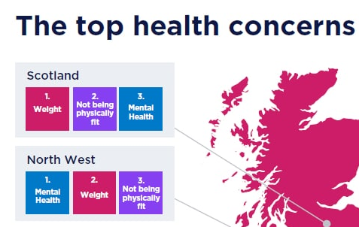
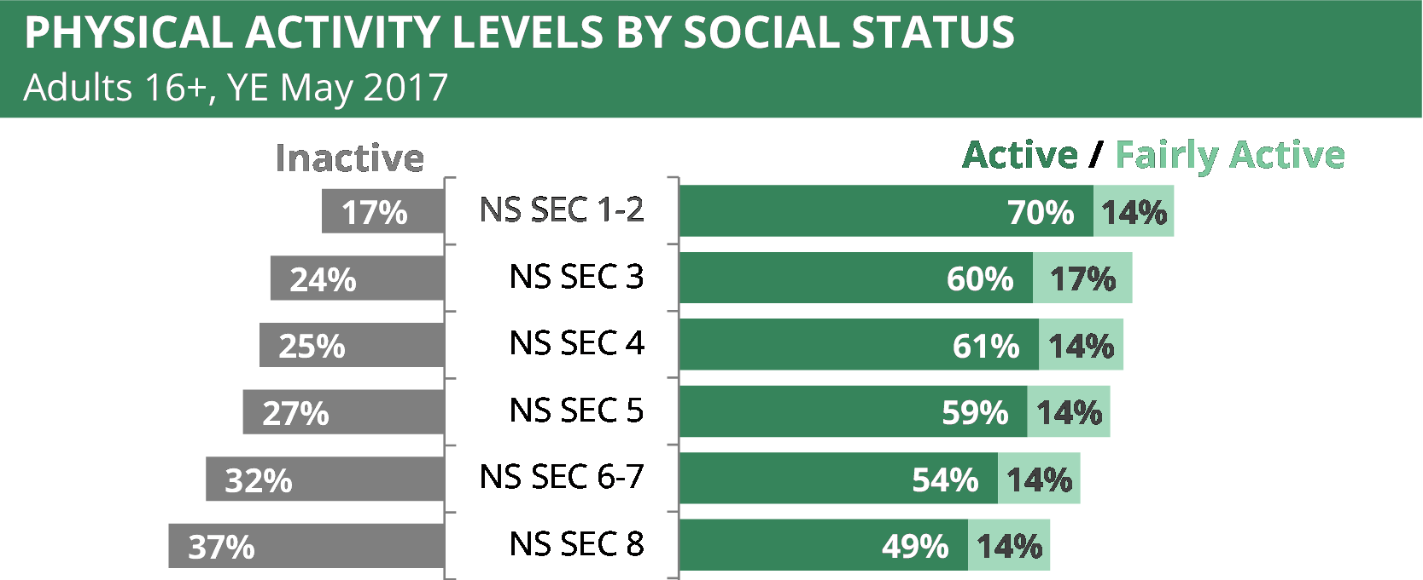
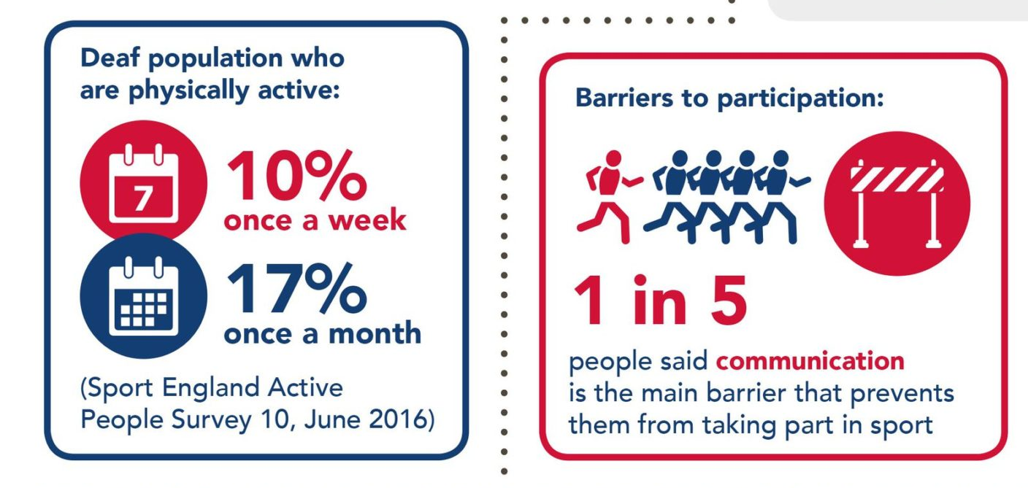
GAME, SET, MATCH: TRANSFORMING SPORT WITH STEM
Project concept – define your problem
Step 1: Decide on the problem you will solve.
What are key problems in sport that you know?
What problems can you see here?
Which problem will you tackle?
Notes:
Here the problem can be quite broad, as the next slide focuses this further. Remind students of the overarching focus, which is to solve problems in sport.
Notes on the images –
- Deaf People's Participation in Sport (UK Deaf Sport) https://ukdeafsport.org.uk/infographic-about-deaf-peoples-participation-in-sport/ This is a cropped image from a larger one found on the link above. It represents the wider point that sport isn't fully accessible to everyone. It states that 11 million people are deaf in the UK, and highlights the main barrier as communication. This is important for students to understand, that when looking to solve problems that link to people, to hear from them what the barriers are, rather than make assumptions, to make sure your solution does improve their lives.
- Physical Activity Levels by Social Class (House of Commons – Sport Participation in England). https://commonslibrary.parliament.uk/research-briefings/cbp-8181/ https://commonslibrary.parliament.uk/research-briefings/cbp-8181/ This graph shows what percentage of each social class is active (150 minutes a week), fairly active (30 –149 minutes a week) and inactive (below 30 minutes a week) in terms of exercise. The data is taken from 2017, but Sport England reports that these statistics are still seen today https://www.sportengland.org/research-and-data/research/lower-socio-economic-groups#:~:text=Our%20Active%20Lives%20Adult%20Survey,to%20be%20active%20(54%25). You can ask students to think about what the numbers stand for, and which of the numbers represent those who have access to more money and those that do not. The categories are:
NS SEC 1 - Higher managerial and professional occupations
NS SEC 2 - Lower managerial and professional occupations
NS SEC 3 - Intermediate occupations (clerical, sales, service)
NS SEC 4 - Small employers and own account workers
NS SEC 5 - Lower supervisory and technical occupations
NS SEC 6 - Semi-routine occupations
NS SEC 7 - Routine occupations
NS SEC 8 - Never worked or long-term unemployed
It shows a 21% difference between those in the top and bottom category and you can discuss reasons behind this, such as cost and access, which can be the problem they will solve.
The website also provides statistics on who takes part in sport based on gender, disability and the types of sport they participate in.
- The Top Health Concerns (Sustain Health). https://sustainhealth.fit/lifestyle/top-10-uk-health-issues-to-watch-in-2023/ This is a cropped picture from the whole of the UK showing what people's top health concerns are in 2023. The research was conducted by Bupa. Ask students what trends they already see just by showing two geographical locations. Weight is then the top concern they can see here, and this is replicated across the whole of the UK. By looking on the website you can see the whole country and the top three health concerns are; weight; mental health and not enough exercise. What is good about looking at this picture last, is that you can ask students to make linked up conclusions. Firstly between the three top health concerns, in that doing exercise is both good for mental health and managing weight, and secondly between this and the two other images that look at barriers to people getting enough exercise through sports. So, if a student wants to improve mental health through sports, they can think of a solution that tackles accessibility.
Extensions:
Activity Alliance. This is a national charity for disabled people in sports and activities. On its facts and statistics page it has links to information broken down by gender, age and region. https://www.activityalliance.org.uk/how-we-help/fact-and-statistics
Sport England. This organisation has conducted research into why particular groups may not get involved with sport. This linked page has a focus on specific demographics at the bottom of it. On each of these you can click the 'Research' tab to highlight particular barriers. https://www.sportengland.org/research-and-data/research#horizonscanning-16633
Survey each other as to barriers they face to doing more sport. Students can interview and ask each other as to what barriers they find to doing sport or activities, or what they find as issues in it if they do a lot of it. One of the key barriers that comes across is time and having the time to do sports (including a warm up and cool down), so they could look at solutions to this.

Slide 41
GAME, SET, MATCH: TRANSFORMING SPORT WITH STEM
Project concept – define your problem
Step 2: Focus your Problem
Why is this important? What is the core problem at the heart of the issue?
What are the particular issues? Where does it happen? Who does it impact?

Slide 42
GAME, SET, MATCH: TRANSFORMING SPORT WITH STEM
Project concept – define your problem
Step 3: Create your Problem Statement, which describes the problem you will solve.
Use the following three W’s to create it:
WHO or WHAT is facing your problem?
WHAT is the problem they are facing?
WHY should this problem be solved / WHAT will your solution do and help?
Blind people cannot access sport easily. My solution will create better facilities for blind people to take part in group sports, to improve their physical and mental health.
Notes:
For Step 3 they can write down their problem statement – or use post it notes for each of the three W’s. Or, they could record it on a video or by speech. The idea is that they have something to keep checking back on when thinking about solutions.
Extension: Their problem statements should consider both parts of the ‘why’ – so should have what the solution will do and how this will help an outcome (as shown in the example). A simplified version would just have ‘What the solution will do’.

Slide 43
GAME, SET, MATCH: TRANSFORMING SPORT WITH STEM
Project process – ideas, prototype, test
The next step is to think of ideas for your potential solutions, decide on your favourite, prototype this idea, and then think of ways to test it against your problem statement.
The outcome is to create a solution to your problem and think of ways to test it.
Through doing this you will develop the following skills:
  Research and communication skills
  Creative and logical thinking
  Decision Making
Notes:
Suggested Timings: For the whole of the Project process Stage we would recommend spending 1-2 hours. The following slides break this down into ideas, Prototyping’ and ‘Testing’.
Differentiation / Extension:
You can add detail to the skills, or ask students to think more about what these are / how they are evidenced:
Research and communication skills: Locate specific information, Use language to find relevant information, select relevant and well-regarded sources.
Creative and logical thinking: Organising into next steps, thinking outside of the box, being inspired by a different idea.
Decision Making: Analysing information, assessing against an aim, evaluating outcomes.

Slide 44
GAME, SET, MATCH: TRANSFORMING SPORT WITH STEM
Project process – ideas. Think of an interesting, and creative solution to your problem.
Step 1: Research what is out there already. This will also give you inspiration for your solution.
Step 2: Think of at least five new ideas for your solution.
Top tips for developing ideas to your solution:
  It’s not about perfection – don’t be judgemental.
  Warm up your brain before – then give yourself a time limit.
  Write each new idea on a separate post-it to see them all.
  Your idea doesn’t have to be 100% original, many ideas adapt, add to an existing idea, or merge two current ideas to create something new.
Step 3: Select your top idea , to take forward to the next stage. Use your problem statement to help.
Notes:
Suggested timings: This could take approximately 30 – 60 minutes - 15 – 30 minutes for research. 10 – 25 minutes for creating ideas. 5 minutes for choosing your preferred solution.
Research: This develops the skills of focused research and where their problem statement will be very helpful. You can encourage them to research current solutions and do an analysis of what is good about them, but what is also bad about them.
Existing ideas and links are suggested below:
Bionic Limbs. This webpage and video looks at how a combination of technology and engineering are used to create prosthetics specifically for active lives. It includes a video as well. https://www.stem.org.uk/resources/elibrary/resource/33321/bionic-limbs
Virtual Sports. This case study focuses on how Patty Srinath has developed new gadgets to track and measure our fitness. https://neonfutures.org.uk/case-study/sports-engineer-patty-srinath/
Making a Pitch. This case study focuses on how Sean McDermott created hi-tech artificial football pitches that can be used all year round to increase accessibility. https://neonfutures.org.uk/case-study/sports-engineer-sean-mcdermott/
Technology to improve performance. This case study focuses on how Charles Burr has created a boxing app to help athletes improve their game, and has also created a wearable technology, called Corner, to provide performance feedback to those wearing it. https://www.thisisengineering.org.uk/meet-the-engineers/charles/ Information about Corner can be found here https://uk.trainwithcorner.com/
Accessible Swimming. This case study focuses on how Ellen Harper has created a lift for wheelchair users to access swimming pools independently. https://neonfutures.org.uk/case-study/product-design-engineer-ellen-harper/
An introduction to Sports Engineering. This YouTube video of 6.45 minutes is more suitable for KS4 and above as it talks about studying Sports Engineering. But, it provides good examples of how STEM is used in both golf and tennis to improve the game. https://www.youtube.com/watch?v=2xJ3q3q1i4c
Designs and Materials for Best Performance. This case study focuses on how Chris Holmes develops sports balls and kit to create the best performance. The website includes a video of 1.25 minutes. https://www.stem.org.uk/resources/elibrary/resource/26080/sports-technologist
Ideas
Emphasise to students that design thinkingencourages lots of ideas – which is because it wants creative thinking, and people to think outside of the box. So, by forcing yourself to think of at least five (but can be more) ideas you will do this.
Suggest Activities for warming up student brains for creative thinking are in the teacher slides at the start. (Alternative Ideas, Bad Ideas and Using Your Whole Brain).
Selecting their top idea. You can start with them narrowing down their top two, then their chosen one. Encourage students to compare solutions against their problem statement to focus on what would be the best to solve the problem.
Extension: To focus creative thinking students can use the acronym SCAMPER to think about a solution. This is taken from ideas that already exist to create a new idea from them. They can take a few of the ideas they have researched and then apply the acronym to them to think of new ideas. It stands for Substitute, Combine, Adapt, Modify / Magnify, Purpose, Eliminate, Rearrange / Reverse. For instance they can substitute a material, combine two ideas, magnify one part, change the purpose of something that already exists …

Slide 45
GAME, SET, MATCH: TRANSFORMING SPORT WITH STEM
Project process – prototype
Prototype Your Chosen Idea. A prototype is a first drawing or model of an idea.
Either draw (2D) or model (3D) your idea.
Add labels, or communicate what each part will do, and consider materials, construction, size etc.
Notes:
Suggested timings: This could take between 20 – 45 minutes, or longer, depending on how detailed they would like to make their models.
Extension:
Students can start with a 2D design and then move into a 3D Design – as this replicates the process that people working in STEM do when creating a prototype.
You can use this free website https://www.tinkercad.com/ for 3D Design. It also allows students to add coding to their design to show movement.

Slide 46
GAME, SET, MATCH: TRANSFORMING SPORT WITH STEM
Project process – test
How would you test your solution? An important STEM skill is learning from failure.
Why is testing important? What can it teach us?
Consider how you would test your idea and record this. Would it be tested over time, in different locations, against a control? Would you need to collect data or feedback?
Notes:
Suggested timings: This could take between 10 – 15 minutes.
Testing: Emphasise that the main importance of testing is to help refine your original idea. So, in their considerations of how to test it, it is to see if it does solve the problem and what tweaks should be made next time. Testing isn’t to learn if it works perfectly, but to see what changes need to be made. The ‘Design Thinking’ process is an iterative process, with this built in. You can also emphasise that our brains learn more from failure than success, and approaching failure as a learning tool is essential in STEM jobs, as well as building self-resilience.
Please note that to enter the Big Bang Competition this process represents the stages that students will be judged on, and they do not have to complete testing if it is difficult to do so.
Extension:
Ask students to consider the ethics in testing and if using people what should they consider in this? Whose rights should they consider, and what permission will they have to seek?

Slide 47
GAME, SET, MATCH: TRANSFORMING SPORT WITH STEM
Project Outcome – reflection
Well Done! You have completed your project and use the ‘Design Thinking’ process. The final stage is to reflect on this, to identify your strengths, what you enjoy and how it can link to a future in STEM.
The outcome is to reflect on the project for yourself, your learning and the next steps to take.
Through doing this you will develop the following skills:
  Goal-Setting
  Resilience
  Self-Awareness
Notes:
Suggested Timings: We would suggest spending up to 30 minutes on this reflection, as a plenary. You can use some of this time to include the slides about roles and next steps as
Differentiation / Extension:
You can add detail to the skills, or ask students to think more about what these are / how they are evidenced:
Goal Setting: Setting targets that are SMART (Specific, Measurable, Achievable, Relevant, Time-Bound), Reflecting, Celebrating Success.
Resilience: Adapting to Change Positively, Being flexible, Viewing set-backs as learning opportunities.
Self-Awareness: Understanding how and why you respond to emotional and learning situations, in order to make the best choices for yourself.

Slide 48
GAME, SET, MATCH: TRANSFORMING SPORT WITH STEM
Project Outcome: reflection.
Personal reflection: What were the challenges you faced? How did you overcome difficulty? What parts did you enjoy the most and why?
Project reflection: What worked well on this project? Where would you take it next – a working prototype, doing some testing, presenting it? Would you like to try a different challenge?
Learning reflection: What skills did you develop? What new knowledge did you gain? Have your perceptions about STEM changed, and if so how? What would you do the same and differently in another project?
Notes:
Extension:
- In project reflection you can ask them about future implications of their project and how it might need to be adapted in the future.
- You can get the student / students to present their idea to the class and use the following criteria to structure feedback:
The Problem Statement – specific and clear.
What solution you went with and why you rejected others – logical thinking and reasoning skills.
Talk through the prototype and design – communication, using visuals to support clarification.
Explaining testing options – understanding of the role of testing.
reflection – good self-awareness, evaluation and goal setting.

Slide 49
GAME, SET, MATCH: TRANSFORMING SPORT WITH STEM
Congratulations on Completing your Project!
Through your Project you used the ‘Design Thinking’ process, which is a highly valued approach in problem solving.
You developed and practiced many skills, including - research, creative thinking, communication, logical thinking, decision making, time management and goal setting.
These are all essential skills in STEM careers, and through doing this project you have shown you would be really successful in a STEM job.
Examples of jobs in this field are:
1. Test and Validation Engineer at Nike to develop technology to measure your fitness.
2. Sports Technologist to create the best materials to enhance athletes' performance.
If you want to celebrate your project further you can enter it into the Big Bang Project Gallery, or Big Bang Competition.
Notes:
1. Test and Validation Engineer https://neonfutures.org.uk/case-study/sports-engineer-patty-srinath/
2. Sports Technologist: https://www.stem.org.uk/resources/elibrary/resource/26080/sports-technologist
Next Steps:
You can provide students with certificates to celebrate their achievement. A certificate template can be downloaded for print from here.
You can enter The Big Bang Project Gallery here.
You can enter The Big Bang Competition here

Slide 50
CHALLENGE 4
HOW CAN ROBOTS AND ARTIFICIAL INTELLIGENCE (AI) HELP HUMANKIND?
People in STEM often work with new and emerging technologies, which aren’t yet fully understood. To succeed on this challenge you will have to think creatively, use your imagination and consider the ethics and implications of your solution.
Notes:
As a starter you can discuss the difference between robots and AI. We define them as the following:
Robots: Programmed to complete an action and function. Their actions will be the same, specific and precise. Examples of robotic technology can be found in dishwashers, factory machines, checkouts.
AI: Programmed to mimic human intelligence to complete an action or function. It processes a lot of information to make decisions, which can be different each time depending on what it learns or new evidence. Examples of AI technology can be found in social media feeds, voice assistants like Alexa, Google searches.
Activities to support this are:
Coding: videos and guidance with microbit. https://microbit.org/
Computational Thinking: Getting students to understand that programming robots and AI involves computational thinking, which is breaking a big problem down step by step. Then, you would programme each step for the robot or AI system. You can demonstrate this in an analogue way be getting students to 'programme' each other with a set of instructions to achieve a task.

Slide 51
Design thinking
To solve this problem you will use a design thinking process. This is what people working in STEM, and more widely, use to create effective solutions.
It includes the following steps:
Notes:
The design thinking process is used by people working in STEM as a method to solving problems. Major organisations often have a ‘Design Thinking’ Team or ‘Innovation’ Team who work solely in this way, such as Transport for London, Uber Eats, AirBnb, Netflix, or OralB. It is an interative process, that challenges assumptions and develops open minded creativity. In its entirety it has 6 steps, and normally focuses on a user or a particular group. The stages are: empathise, define, Ideate, prototype, test, implement. As students may not choose to focus their problem on a particular person, or group of people we have simplified the process to include 4 steps: define, ideas, prototype, test. The infographic on the slide shows that the testing should help then inform your idea to create a better prototype and test again. This iterative cycle then creates a better design in order to implement.

Slide 52
HOW CAN ROBOTS AND AI HELP HUMANKIND?
Project concept: define your problem
It is important to be clear on what problem your solution will solve and spend time on this. Why?
The outcome is to create a problem statement.
- You will have three steps to follow to create this.
- Through creating this you will develop the following skills that STEM jobs value :
  Investigative thinking skills
  Critical analysis skills
  Communication of ideas
Notes:
Suggested timings: For this stage we would recommend 30 minutes on the ‘Project concept’ and Defining Your Problem (which is on the next two slides), but it could be shorter if your students already know a lot on the theme.
Emphasise to students that key to problem solving is spending time to focus on the problem. It helps to focus creative thinking, research and make sure that you can test your solution against something at the end.
Differentiation / Extension:
You can add detail to the skills, or ask students to think more about what these are / how they are evidenced:
Investigative Thinking skills: Curiosity, Making connections, Reaching conclusions.
Critical Thinking skills: Asking Questions, Making Judgements, Interpreting.
Communication of Ideas: Clear in descriptions, Framing your language, Sharing information.
You can use the following quote from Einstein to explore more about why spending time focusing on the problem is important: Einstein said ‘’If I had an hour to solve a problem, I’d spend 55 minutes thinking about the problem and 5 minutes thinking about solutions.’’ Preparation is essential to problem solving, and understanding your problem focuses your creativity.

Slide 53
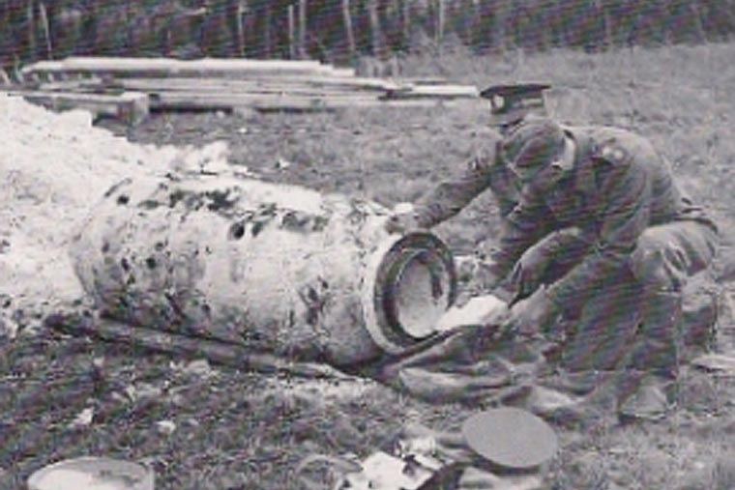
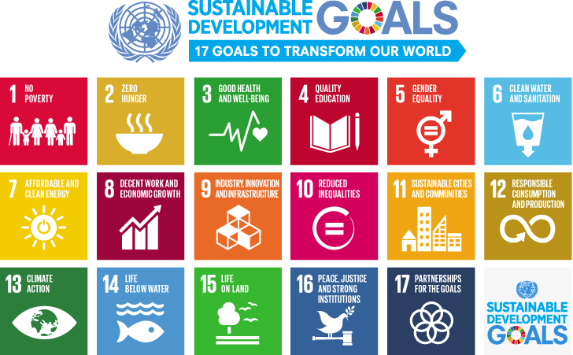
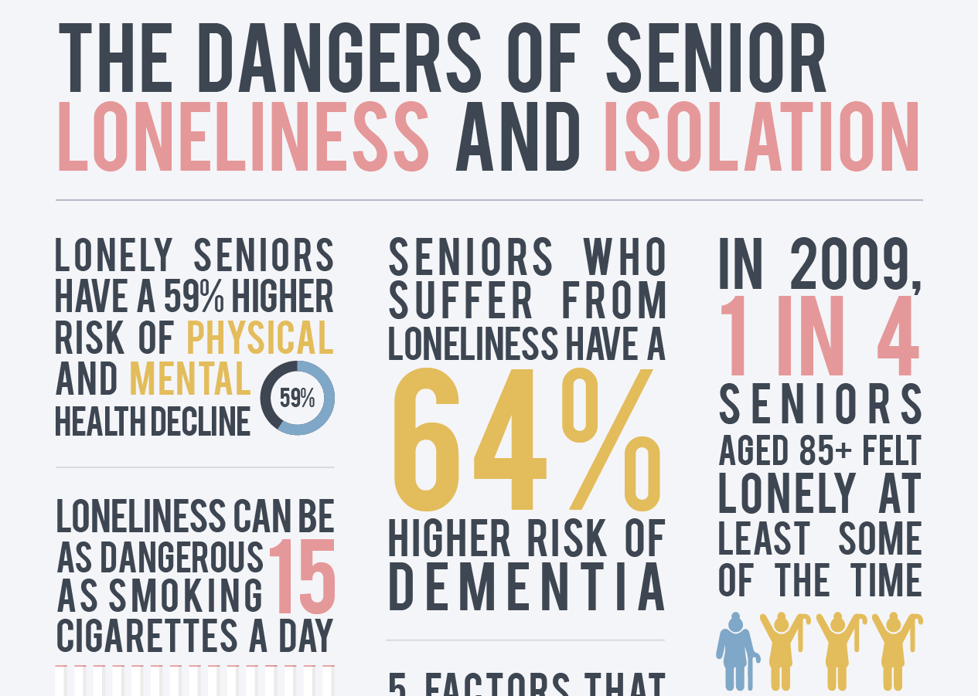
HOW CAN ROBOTS AND AI HELP HUMANKIND?
Project concept – define your problem
Step 1: Decide on the problem you will solve.
What problems do humans face that could be helped by robots and AI?
What problems can you see here?
Which problem will you tackle?
Notes:
Here the problem can be quite broad, as the next slide focuses this further. We have used the term 'humankind' to focus on people and their problems, but you can take it broader than that. Students should also be thinking about what robots and AI can help with.
Notes on the images –
Loneliness. https://www.welbi.co/blog/the-dangers-of-senior-loneliness-and-isolation This highlights not only how many people are lonely, but a good thing for students to bring out are the wider problems of this, such as increasing risk of dementia and physical and mental health decline. This a cropped image and the wider one can be found in the link. This is from an organisation based in America, but similar statistics are also found for the UK.
Sustainable Development Goals (UN). https://www.un.org/sustainabledevelopment/sustainable-development-goals/ These 17 goals were set by the UN to build a sustainable and better future for everyone on the planet by 2030. They are interconnected and more information can be found about each goal on their website. What is interesting for students to think about is what would be a particular problem that could be helped by robots and AI?
Bomb Disposal (Royal Engineers). https://www.royalengineersbombdisposal-eod.org.uk/our-history/ This picture is from when the Royal Engineer Bomb Disposal Unit was formed in the Second World War. The specific link looks at other conflicts that the Royal Engineers have disposed bombs at, and the amount. The image can also represent dangerous, high pressure, specific jobs. You can discuss the issue with humans doing this job, in that pressure can lead to human error, and that robots and AI can quickly analyse data to make informed decisions that limit the loss of human life.
Extensions / Differentiation:
Dangerous Jobs (Go Compare) https://www.gocompare.com/life-insurance/uk-riskiest-jobs-report/ This page includes details of dangerous jobs in the UK, analysed in 2022. It breaks it down across, role, the country as well as by gender.
Discuss the ethics of AI. As AI becomes more commonly used and developed, an interesting discussion is how best to use AI to solve problems. It comes with its own environmental impact, as it requires a lot of energy, but also how to consider the best use for humankind. Unesco outlines ten principles to this, which can be found here, mid-way down the page under 'A human rights approach to AI' https://www.unesco.org/en/artificial-intelligence/recommendation-ethics

Slide 54
HOW CAN ROBOTS AND AI HELP HUMANKIND?
Project concept – define your problem
Step 2: Focus your Problem
Why is this important? What is the core problem at the heart of the issue?
What are the particular issues? Where does it happen? Who does it impact?

Slide 55
HOW CAN ROBOTS AND AI HELP HUMANKIND?
Project concept – define your problem
Step 3: Create your Problem Statement, which describes the problem you will solve.
Use the following three W’s to create it:
WHO or WHAT is facing your problem?
WHAT is the problem they are facing?
WHY should this problem be solved / WHAT will your solution do and help?
Some people in the world do not have access to clean water. My solution will use robots and AI to make all water safe to drink, which will decrease illnesses and improve sanitation.
Notes:
For Step 3 they can write down their problem statement – or use post it notes for each of the three W’s. Or, they could record it on a video or by speech. The idea is that they have something to keep checking back on when thinking about solutions.
Extension: Their problem statements should consider both parts of the ‘why’ – so should have what the solution will do and how this will help an outcome (as shown in the example). A simplified version would just have ‘What the solution will do’.

Slide 56
HOW CAN ROBOTS AND AI HELP HUMANKIND?
Project process – ideas, prototype, test
The next step is to think of ideas for your potential solutions, decide on your favourite, prototype this idea, and then think of ways to test it against your problem statement.
The outcome is to create a solution to your problem and think of ways to test it.
Through doing this you will develop the following skills:
  Research and communication skills
  Creative and logical thinking
  Decision making
Notes:
Suggested Timings: For the whole of the Project process Stage we would recommend spending 1-2 hours. The following slides break this down into ideas, Prototyping’ and ‘Testing’.
Differentiation / Extension:
You can add detail to the skills, or ask students to think more about what these are / how they are evidenced:
Research and communication skills: Locate specific information, Use language to find relevant information, select relevant and well-regarded sources.
Creative and logical thinking: Organising into next steps, thinking outside of the box, being inspired by a different idea.
Decision making: Analysing information, assessing against an aim, evaluating outcomes.

Slide 57
HOW CAN ROBOTS AND AI HELP HUMANKIND?
Project process – ideas. Think of an interesting, and creative solution to your problem.
Step 1: Research what is out there already. This will also give you inspiration for your solution.
Step 2: Think of at least five new ideas for your solution.
Top tips for developing ideas to your solution:
  It’s not about perfection – don’t be judgemental.
  Warm up your brain before – then give yourself a time limit.
  Write each new idea on a separate post-it to see them all.
  Your idea doesn’t have to be 100% original, many ideas adapt, add to an existing idea, or merge two current ideas to create something new.
Step 3: Select your top idea , to take forward to the next stage. Use your problem statement to help.
Notes:
Suggested timings: This could take approximately 30 – 60 minutes - 15 – 30 minutes for research. 10 – 25 minutes for creating ideas. 5 minutes for choosing your preferred solution.
Research: This develops the skills of focused research and where their problem statement will be very helpful. You can encourage them to research current solutions and do an analysis of what is good about them, but what is also bad about them.
Existing ideas and links are suggested below:
Using robots in farming. This case study focuses on how Halvard Grimstad has built a robot to support farming in order to make it more effective and sustainable. https://www.thisisengineering.org.uk/meet-the-engineers/halvard/
2BO Robot that helps with recycling. This YouTube video shows how the robot uses technology, like AI, to help tackle waste issues and change behaviour in individuals towards recyclable goods. https://www.youtube.com/watch?v=ZcW7UEymBtQ
Robots Supporting Food Sustainability – Robot Chefs. This is an example of where robots precision can support them preparing food and reducing waste. A blog from ‘AI for Good’, entitled ‘Robot Chefs Transforming Cooking and Contributing to Sustainable Development.’ https://shorturl.at/giVY6
Harris T7 Robot for Bomb Disposal. In the UK army these robots are used to diffuse and dispose of bombs. 'Robots' have been used since 1972 to dispose of bombs, but in the past were more like drones. The newest forms of robots are still controlled by humans, but have more dexterity. https://www.gov.uk/government/news/defence-secretary-announces-55m-contract-for-uk-bomb-disposal-robots-at-dsei
Robots and AI helping around the home. This article lists many different ways that robots and AI are doing tasks to help people around the world. It is a positive article about the rise of robots, which you can draw out further with your students regarding the ethics around some of these potential uses – such as childcare, learning and providing company. https://www.schlage.com/blog/categories/2023/01/robots-for-home.html
'jibo'the first social robot. This video has Jibo introducing themselves. They were developed in 2016 as the first social robot, that did similar commands to an 'Alexa' but also performed a social function and recognised people in the home it was in. However, it required a huge amount of energy to run from servers and has now been taken over by another company who would like to use it's function for healthcare and learning, which the video shows. https://www.youtube.com/watch?v=e_6g6NMCALw There is a BBC article that speaks about this when it was first released in 2016 and reactions to it. https://www.bbc.co.uk/news/av/technology-35353546
Ideas
Emphasise to students that design thinkingencourages lots of ideas – which is because it wants creative thinking, and people to think outside of the box. So, by forcing yourself to think of at least five (but can be more) ideas you will do this.
Suggest Activities for warming up student brains for creative thinking are in the teacher slides at the start. (Alternative Ideas, Bad Ideas and Using Your Whole Brain).
Selecting their top idea. You can start with them narrowing down their top two, then their chosen one. Encourage students to compare solutions against their problem statement to focus on what would be the best to solve the problem.
Extension: To focus the creative thinking students can use the acronym SCAMPER to think about a solution. This is taken from ideas that already exist to then create a new idea from them. They can take a few of the ideas they have researched and then apply the acronym to them to think of new ideas. It stands for Substitute, Combine, Adapt, Modify / Magnify, Purpose, Eliminate, Rearrange / Reverse. For instance they can substitute a material, combine two ideas, magnify one part, change the purpose of something that already exists …

Slide 58
HOW CAN ROBOTS AND AI HELP HUMANKIND?
Project process – prototype
Prototype Your Chosen Idea. A prototype is a first drawing or model of an idea.
Either draw (2D) or model (3D) your idea.
Add labels, or communicate what each part will do, and consider materials, construction, size etc.
Notes:
Suggested timings: This could take between 20 – 45 minutes, or longer, depending on how detailed they would like to make their models.
Extension:
Students can start with a 2D design and then move into a 3D Design – as this replicates the process that people working in STEM do when creating a prototype.
You can use this free website https://www.tinkercad.com/ for 3D Design. It also allows students to add coding to their design to show movement.

Slide 59
HOW CAN ROBOTS AND AI HELP HUMANKIND?
Project process – test
How would you test your solution? An important STEM skill is learning from failure.
Why is testing important? What can it teach us?
Consider how you would test your idea and record this. Would it be tested over time, in different locations, against a control? Would you need to collect data or feedback?
Notes:
Suggested timings: This could take between 10 – 15 minutes.
Testing: Emphasise that the main importance of testing is to help refine your original idea. So, in their considerations of how to test it, it is to see if it does solve the problem and what tweaks should be made next time. Testing isn’t to learn if it works perfectly, but to see what changes need to be made. The ‘Design Thinking’ process is an iterative process, with this built in. You can also emphasise that our brains learn more from failure than success, and approaching failure as a learning tool is essential in STEM jobs, as well as building self-resilience.
Please note that to enter the Big Bang Competition this process represents the stages that students will be judged on, and they do not have to complete testing if it is difficult to do so.
Extension:
Ask students to consider the ethics in testing and if using people what should they consider in this? Whose rights should they consider, and what permission will they have to seek?

Slide 60
HOW CAN ROBOTS AND AI HELP HUMANKIND?
Project Outcome – reflection
Well Done! You have completed your project and use the ‘Design Thinking’ process. The final stage is to reflect on this, to identify your strengths, what you enjoy and how it can link to a future in STEM.
The outcome is to reflect on the project for yourself, your learning and the next steps to take.
Through doing this you will develop the following skills:
  Goal-Setting
  Resilience
  Self-Awareness
Notes:
Suggested Timings: We would suggest spending up to 30 minutes on this reflection, as a plenary. You can use some of this time to include the slides about roles and next steps as
Differentiation / Extension:
You can add detail to the skills, or ask students to think more about what these are / how they are evidenced:
Goal Setting: Setting targets that are SMART (Specific, Measurable, Achievable, Relevant, Time-Bound), Reflecting, Celebrating Success.
Resilience: Adapting to Change Positively, Being flexible, Viewing set-backs as learning opportunities.
Self-Awareness: Understanding how and why you respond to emotional and learning situations, in order to make the best choices for yourself.

Slide 61
HOW CAN ROBOTS AND AI HELP HUMANKIND?
Project Outcome: reflection.
Personal reflection: What were the challenges you faced? How did you overcome difficulty? What parts did you enjoy the most and why?
Project reflection: What worked well on this project? Where would you take it next – a working prototype, doing some testing, presenting it? Would you like to try a different challenge?
Learning reflection: What skills did you develop? What new knowledge did you gain? Have your perceptions about STEM changed, and if so how? What would you do the same and differently in another project?
Notes:
Extension:
- In project reflection you can ask them about future implications of their project and how it might need to be adapted in the future.
- You can get the student / students to present their idea to the class and use the following criteria to structure feedback:
The Problem Statement – specific and clear.
What solution you went with and why you rejected others – logical thinking and reasoning skills.
Talk through the prototype and design – communication, using visuals to support clarification.
Explaining testing options – understanding of the role of testing.
reflection – good self-awareness, evaluation and goal setting.

Slide 62
HOW CAN ROBOTS AND AI HELP HUMANKIND?
Congratulations on Completing your Project!
Through your Project you used the ‘Design Thinking’ process, which is a highly valued approach in problem solving.
You developed and practiced many skills, including - research, creative thinking, communication, logical thinking, decision making, time management and goal setting.
These are all essential skills in STEM careers, and through doing this project you have shown you would be really successful in a STEM job.
Examples of jobs in this field are:
1. Mechanical Engineer to develop robots to feed the planet more sustainably.
2. Research and Development Engineer to make new ideas come to life in technology and software.
If you want to celebrate your project further you can enter it into the Big Bang Project Gallery, or Big Bang Competition.
Notes:
1. Mechanical Engineer https://www.thisisengineering.org.uk/meet-the-engineers/halvard/
2. Research and Development Engineer: https://neonfutures.org.uk/case-study/robotics-engineer-dilani-selvanathan/
Next Steps
You can provide students with certificates to celebrate their achievement. A certificate template can be downloaded for print from here.
You can enter The Big Bang Project Gallery here.
You can enter The Big Bang Competition here

Slide 63
CHALLENGE 5
ENGINEERING FOR THE EXTREME
People working in STEM don’t just work on present problems, they also have to predict future problems and create solutions for them. To succeed on this challenge you will have to think ahead, be proactive and innovative.
Notes:
We have focused on extreme weather, including natural disasters, as the 'extreme' for this challenge, and just those that are consequences of the rising temperature of our planet. These include:
Hotter temperatures: Droughts, Heatwaves and Wildfires.
Increased precipitation: Heavy rainfall, storms and rising sea levels.

Slide 64
Design thinking
To solve this problem you will use a design thinking process. This is what people working in STEM, and more widely, use to create effective solutions.
It includes the following steps:
Notes:
The design thinking process is used by people working in STEM as a method to solving problems. Major organisations often have a ‘Design Thinking’ Team or ‘Innovation’ Team who work solely in this way, such as Transport for London, Uber Eats, AirBnb, Netflix, or OralB. It is an interative process, that challenges assumptions and develops open minded creativity. In its entirety it has 6 steps, and normally focuses on a user or a particular group. The stages are: empathise, define, Ideate, prototype, test, implement. As students may not choose to focus their problem on a particular person, or group of people we have simplified the process to include 4 steps: define, ideas, prototype, test. The infographic on the slide shows that the testing should help then inform your idea to create a better prototype and test again. This iterative cycle then creates a better design in order to implement.

Slide 65
ENGINEERING FOR THE EXTREME
Project concept: define your problem
It is important to be clear on what problem your solution will solve and spend time on this. Why?
The outcome is to create a problem statement.
- You will have three steps to follow to create this.
- Through creating this you will develop the following skills that STEM jobs value :
  Investigative thinking skills
  Critical analysis skills
  Communication of ideas
Notes:
Suggested timings: For this stage we would recommend 30 minutes on the ‘Project concept’ and Defining Your Problem (which is on the next two slides), but it could be shorter if your students already know a lot on the theme.
Emphasise to students that key to problem solving is spending time to focus on the problem. It helps to focus creative thinking, research and make sure that you can test your solution against something at the end.
Differentiation / Extension:
You can add detail to the skills, or ask students to think more about what these are / how they are evidenced:
Investigative Thinking skills: Curiosity, making connections, Reaching conclusions.
Critical Thinking skills: Asking Questions, making Judgements, Interpreting.
Communication of Ideas: Clear in descriptions, Framing your language, Sharing information.
You can use the following quote from Einstein to explore more about why spending time focusing on the problem is important: Einstein said ‘’If I had an hour to solve a problem, I’d spend 55 minutes thinking about the problem and 5 minutes thinking about solutions.’’ Preparation is essential to problem solving, and understanding your problem focuses your creativity.

Slide 66
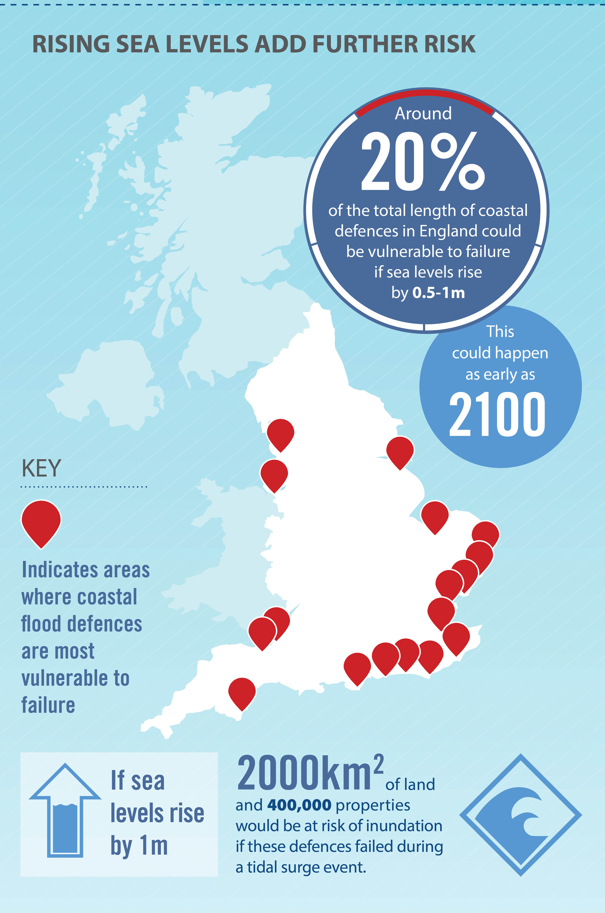
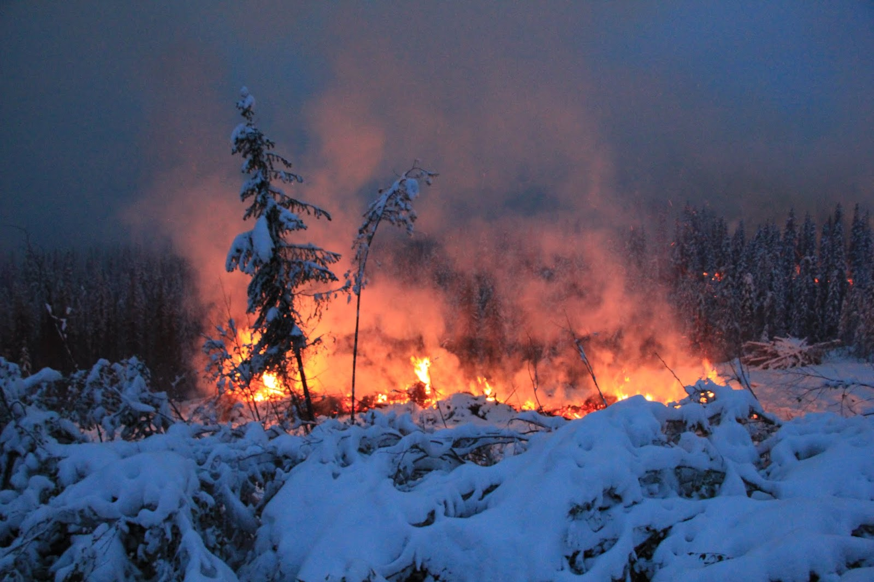
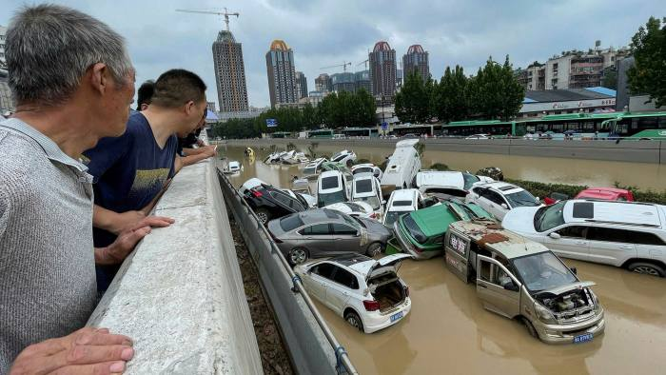
ENGINEERING FOR THE EXTREME
Project concept – define your problem
Step 1: Decide on the problem you will solve.
What problems do extreme weather and climate cause
What extreme weather have you witnessed or seen?
What problems can you see here?
Which problem will you tackle?
Notes:
Here the problem can be quite broad, as the next slide focuses this further.
Notes on the images –
Flash Flood in Zhengzhou in July 2021. https://www.bbc.co.uk/news/world-asia-china-57861067 This image is not only a flood, but a flash flood, where 8 months of rainfall fell in a 24 hour period, and a year's rainfall fell in a 3 day period. You can ask students about how they would know it happened quickly – as many cars were still on the road. 12 people died due to floods. The article looks at many reasons why this happened, which you can ask students to also consider such as:
Global: Rising temperatures, building cities on river banks, hard to predict amount of rainfall in advance.
Local: Cities flood defences not prepared for this amount of water, building too many dams on rivers and disrupting the access to flood plains from the river, having non-absorbant materials for buildings and surfaces.
Zombie Wildfire in the Arctic. https://www.bbc.co.uk/newsround/57173570 This image shows a wildfire in the arctic, which have been happening more and more recently over the last 5 years. You can ask the students to pick out what is different about this image, as that it is a fire in a place with snow, and ask them why this might happen?
It has occurred due to the melting of snow and ice in the arctic, which has exposed dry areas of straw and peat which ignite easily and then burn for a long time if the snow reforms. They are called 'Zombie' wildfires due to them coming back to life next summer, after burning more deeply over winter. Some wildfires happen due to humans, but these are due to environmental warming and are then hard to reach as they are often in remote areas. You can also ask students what the impact of wildfires are on the warming planet, with further releasing of carbon from the trees.
Rising Sea Level add Further Risk. https://www.theccc.org.uk/2016/01/15/infographic-future-flood-risk-in-the-uk/ This is a cropped image from the Climate Change Committee looking at flood risk across the UK and how rising sea levels will exacerbate this. This is the only image that is predicting something, as it highlights how many places in England could be at risk by 2100. A good point to bring out with students is how this is an important part to helping to solve problems as engineers, in that they have to predict what might happen and create solutions for something that hasn't yet happened.
Extensions / Differentiation:
Ask students what are the themes of 'extreme' weather that can be seen here and how do they link together? These would be hotter temperatures, and increase precipitation. You can ask students why an increase in global temperatures would also lead to an increase in precipitation – with references to the fact that warmer air can hold more water. There is more detail on this webpage, under 'Changes to UK Climate and Weather Events'. https://www.metoffice.gov.uk/weather/climate-change/effects-of-climate-change .
2. Impact of Unexpected Heatwaves. If students would like to focus on individual impact and create a solution to help improve people's lives impacted by these weather systems then this website and insights could be helpful. https://www.weforum.org/agenda/2022/10/heatwaves-unexpected-impact-diverse-communities/

Slide 67
ENGINEERING FOR THE EXTREME
Project concept – define your problem
Step 2: Focus your Problem
Why is this important? What is the core problem at the heart of the issue?
What are the particular issues? Where does it happen? Who does it impact?

Slide 68
ENGINEERING FOR THE EXTREME
Project concept – define your problem
Step 3: Create your Problem Statement, which describes the problem you will solve.
Use the following three W’s to create it:
WHO or WHAT is facing your problem?
WHAT is the problem they are facing?
WHY should this problem be solved / WHAT will your solution do and help?
Farms are struggling to grow crops because of droughts and flooding. My solution will help soil keep water for longer, to make sure people have enough food and to prevent flooding when it rains.
Notes:
For Step 3 they can write down their problem statement – or use post it notes for each of the three W’s. Or, they could record it on a video or by speech. The idea is that they have something to keep checking back on when thinking about solutions.
Extension: Their problem statements should consider both parts of the ‘why’ – so should have what the solution will do and how this will help an outcome (as shown in the example). A simplified version would just have ‘What the solution will do’.

Slide 69
ENGINEERING FOR THE EXTREME
Project process – ideas, prototype, test
The next step is to think of ideas for your potential solutions, decide on your favourite, prototype this idea, and then think of ways to test it against your problem statement.
The outcome is to create a solution to your problem and think of ways to test it.
Through doing this you will develop the following skills:
  Research and communication skills
  Creative and logical thinking
  Decision making
Notes:
Suggested Timings: For the whole of the Project Process Stage we would recommend spending 1-2 hours. The following slides break this down into ideas, Prototyping’ and ‘Testing’.
Differentiation / Extension:
You can add detail to the skills, or ask students to think more about what these are / how they are evidenced:
Research and communication skills: Locate specific information, Use language to find relevant information, select relevant and well-regarded sources.
Creative and logical thinking: Organising into next steps, thinking outside of the box, being inspired by a different idea.
Decision making: Analysing information, assessing against an aim, evaluating outcomes.

Slide 70
ENGINEERING FOR THE EXTREME
Project process – ideas. Think of an interesting, and creative solution to your problem.
Step 1: Research what is out there already. This will also give you inspiration for your solution.
Step 2: Think of at least five new ideas for your solution.
Top tips for developing ideas to your solution:
  It’s not about perfection – don’t be judgemental.
  Warm up your brain before – then give yourself a time limit.
  Write each new idea on a separate post-it to see them all.
  Your idea doesn’t have to be 100% original, many ideas adapt, add to an existing idea, or merge two current ideas to create something new.
Step 3: Select your top idea , to take forward to the next stage. Use your problem statement to help.
Notes:
Suggested timings: This could take approximately 30 – 60 minutes - 15 – 30 minutes for research. 10 – 25 minutes for creating ideas. 5 minutes for choosing your preferred solution.
Research: This develops the skills of focused research and where their problem statement will be very helpful. You can encourage them to research current solutions and do an analysis of what is good about them, but what is also bad about them.
Existing ideas and links are suggested below:
Stemming the Flood. This case study looks at how Hiba Khan uses a geo bag to prevent flooding in Bangladesh. It includes a video showing this which is 1 minute and 40 seconds. https://neonfutures.org.uk/case-study/civil-engineer-hiba-khan/
Structural Assessment. This case study focuses on Joshua Macabuag and how he uses assessments and computers to access collapsed buildings after disasters, in order to safely rescue people. It includes a video of 57 seconds. https://neonfutures.org.uk/case-study/earthquake-research-engineer-joshua-macabuag/
Keeping homes safe from flooding. This case study focuses on how Simon Crowther uses Water Gate barriers to help prevent flooding to UK homes. It includes a video of 1 minute and 55 seconds.
Gowing Underground. In London a disused underground tunnel is being used to grow plants, that are then locally transported to New Covent Garden Market for sale. The site is monitored digitally at the University of Cambridge to assess what is needed to make the plants succeed. https://www.cam.ac.uk/stories/growingunderground
AI Weather Forecasting. This article is advanced in content, and looks at how AI is getting better at predicting extreme weather. Previously it just used past weather to predict future events, and now takes into account physics and mathematical equations for that location as well. But, it raises the point that if temperatures keep rising, then basing judgements on the past will limit AI's potential and it should complement, rather than replace, existing methods. https://www.sciencemuseumgroup.org.uk/blog/ai-weather-forecasting-shows-promise/
Floating Homes. This article looks at how the Netherlands have used technology to build homes that float and move on the water, so if it rises the home rises with the water rather than be flooded by it. https://www.bbc.com/future/article/20220202-floating-homes-the-benefits-of-living-on-water
Floating Farm. In Rotterdam there is a floating dairy farm. It is on the water and moves with it, so cannot be flooded. It also generates its own electricity with solar panels and uses robots to milk each cow, provide them with food and clean the farm. https://www.dezeen.com/2019/05/24/floating-farm-rotterdam-climate-change-cows-dairy/
Ideas
Emphasise to students that design thinkingencourages lots of ideas – which is because it wants creative thinking, and people to think outside of the box. So, by forcing yourself to think of at least five (but can be more) ideas you will do this.
Suggest Activities for warming up student brains for creative thinking are in the teacher slides at the start. (Alternative Ideas, Bad Ideas and Using Your Whole Brain).
Selecting their top idea. You can start with them narrowing down their top two, then their chosen one. Encourage students to compare solutions against their problem statement to focus on what would be the best to solve the problem.
Extension: To focus creative thinking students can use the acronym SCAMPER to think about a solution. This is taken from ideas that already exist to then create a new idea from them. They can take a few of the ideas they have researched and then apply the acronym to them to think of new ideas. It stands for Substitute, Combine, Adapt, Modify / Magnify, Purpose, Eliminate, Rearrange / Reverse. For instance they can substitute a material, combine two ideas, magnify one part, change the purpose of something that already exists …

Slide 71
ENGINEERING FOR THE EXTREME
Project process – prototype
Prototype Your Chosen Idea. A prototype is a first drawing or model of an idea.
Either draw (2D) or model (3D) your idea.
Add labels, or communicate what each part will do, and consider materials, construction, size etc.
Notes:
Suggested timings: This could take between 20 – 45 minutes, or longer, depending on how detailed they would like to make their models.
Extension:
Students can start with a 2D design and then move into a 3D Design – as this replicates the process that people working in STEM do when creating a prototype.
You can use this free website https://www.tinkercad.com/ for 3D Design. It also allows students to add coding to their design to show movement.

Slide 72
ENGINEERING FOR THE EXTREME
Project process – test
How would you test your solution? An important STEM skill is learning from failure.
Why is testing important? What can it teach us?
Consider how you would test your idea and record this. Would it be tested over time, in different locations, against a control? Would you need to collect data or feedback?
Notes:
Suggested timings: This could take between 10 – 15 minutes.
Testing: Emphasise that the main importance of testing is to help refine your original idea. So, in their considerations of how to test it, it is to see if it does solve the problem and what tweaks should be made next time. Testing isn’t to learn if it works perfectly, but to see what changes need to be made. The ‘Design Thinking’ process is an iterative process, with this built in. You can also emphasise that our brains learn more from failure than success, and approaching failure as a learning tool is essential in STEM jobs, as well as building self-resilience.
Please note that to enter the Big Bang Competition this process represents the stages that students will be judged on, and they do not have to complete testing if it is difficult to do so.
Extension:
Ask students to consider the ethics in testing and if using people what should they consider in this? Whose rights should they consider, and what permission will they have to seek?

Slide 73
ENGINEERING FOR THE EXTREME
Project Outcome – reflection
Well Done! You have completed your project and use the ‘Design Thinking’ process. The final stage is to reflect on this, to identify your strengths, what you enjoy and how it can link to a future in STEM.
The outcome is to reflect on the project for yourself, your learning and the next steps to take.
Through doing this you will develop the following skills:
  Goal-Setting
  Resilience
  Self-Awareness
Notes:
Suggested Timings: We would suggest spending up to 30 minutes on this reflection, as a plenary. You can use some of this time to include the slides about roles and next steps as
Differentiation / Extension:
You can add detail to the skills, or ask students to think more about what these are / how they are evidenced:
Goal Setting: Setting targets that are SMART (Specific, Measurable, Achievable, Relevant, Time-Bound), Reflecting, Celebrating Success.
Resilience: Adapting to Change Positively, Being flexible, Viewing set-backs as learning opportunities.
Self-Awareness: Understanding how and why you respond to emotional and learning situations, in order to make the best choices for yourself.

Slide 74
ENGINEERING FOR THE EXTREME
Project Outcome: reflection.
Personal reflection: What were the challenges you faced? How did you overcome difficulty? What parts did you enjoy the most and why?
Project reflection: What worked well on this project? Where would you take it next – a working prototype, doing some testing, presenting it? Would you like to try a different challenge?
Learning reflection: What skills did you develop? What new knowledge did you gain? Have your perceptions about STEM changed, and if so how? What would you do the same and differently in another project?
Notes:
Extension:
- In project reflection you can ask them about future implications of their project and how it might need to be adapted in the future.
- You can get the student / students to present their idea to the class and use the following criteria to structure feedback:
The Problem Statement – specific and clear.
What solution you went with and why you rejected others – logical thinking and reasoning skills.
Talk through the prototype and design – communication, using visuals to support clarification.
Explaining testing options – understanding of the role of testing.
reflection – good self-awareness, evaluation and goal setting.

Slide 75
ENGINEERING FOR THE EXTREME
Congratulations on Completing your Project!
Through your Project you used the ‘Design Thinking’ process, which is a highly valued approach in problem solving.
You developed and practiced many skills, including - research, creative thinking, communication, logical thinking, decision making, time management and goal setting.
These are all essential skills in STEM careers, and through doing this project you have shown you would be really successful in a STEM job.
Examples of jobs in this field are:
1. Catastrophe Consultant to help rescue people affected by natural disasters.
2. Structural Engineer to help create buildings withstand natural disasters.
If you want to celebrate your project further you can enter it into the Big Bang Project Gallery, or Big Bang Competition.
Notes:
1. Catastrophe Consultant https://www.thisisengineering.org.uk/meet-the-engineers/josh/
2. Structural Engineer: https://neonfutures.org.uk/case-study/structural-engineer-alice-bond/
Next Steps
You can provide students with certificates to celebrate their achievement. A certificate template can be downloaded for print from here.
You can enter The Big Bang Project Gallery here.
You can enter The Big Bang Competition here

Slide 76
CHALLENGE 6
CAN WE MAKE OUR AIR FRESH AGAIN?
People working in STEM have to consider all angles to solve large scale problems. To succeed on this challenge, you will have to prioritise your problem and solution, use effective judgement, and consider the role of influencing behaviour change in people.
Notes:
This Big Bang Challenge explores how to improve the poor air quality.
We focus on the following two main contributors of polluted air:
Particulate Matter (PM or PM2.5): This is everything in the air that isn't gas, such as pollen, sea spray, dust and smoke. These are released from burning wood and coal domestically, transport (such as vehicles braking and tyres on the road releasing rubber) and industrial fires.
Noxious gases: These include sulphur dioxide, ammonia and nitrogen oxide (NOx) which are released from waste, burning fossil fuels, transport, farming practices and energy generation.
https://www.gov.uk/government/publications/air-quality-explaining-air-pollution/air-quality-explaining-air-pollution-at-a-glance

Slide 77
Design thinking
To solve this problem you will use a design thinking process. This is what people working in STEM, and more widely, use to create effective solutions.
It includes the following steps:
Notes:
The design thinking process is used by people working in STEM as a method to solving problems. Major organisations often have a ‘Design Thinking’ Team or ‘Innovation’ Team who work solely in this way, such as Transport for London, Uber Eats, AirBnb, Netflix, or OralB. It is an interative process, that challenges assumptions and develops open minded creativity. In its entirety it has 6 steps, and normally focuses on a user or a particular group. The stages are: empathise, define, Ideate, prototype, test, implement. As students may not choose to focus their problem on a particular person, or group of people we have simplified the process to include 4 steps: define, ideas, prototype, test. The infographic on the slide shows that the testing should help then inform your idea to create a better prototype and test again. This iterative cycle then creates a better design in order to implement.

Slide 78
CAN WE MAKE OUR AIR FRESH AGAIN?
Project concept: define your problem
It is important to be clear on what problem your solution will solve and spend time on this. Why?
The outcome is to create a problem statement.
- You will have three steps to follow to create this.
- Through creating this you will develop the following skills that STEM jobs value :
  Investigative thinking skills
  Critical analysis skills
  Communication of ideas
Notes:
Suggested timings: For this stage we would recommend 30 minutes on the ‘Project concept’ and Defining Your Problem (which is on the next two slides), but it could be shorter if your students already know a lot on the theme.
Emphasise to students that key to problem solving is spending time to focus on the problem. It helps to focus creative thinking, research and make sure that you can test your solution against something at the end.
Differentiation / Extension:
You can add detail to the skills, or ask students to think more about what these are / how they are evidenced:
Investigative Thinking skills: Curiosity, making connections, Reaching conclusions.
Critical Thinking skills: Asking Questions, making Judgements, Interpreting.
Communication of Ideas: Clear in descriptions, Framing your language, Sharing information.
You can use the following quote from Einstein to explore more about why spending time focusing on the problem is important: Einstein said ‘’If I had an hour to solve a problem, I’d spend 55 minutes thinking about the problem and 5 minutes thinking about solutions.’’ Preparation is essential to problem solving, and understanding your problem focuses your creativity.

Slide 79

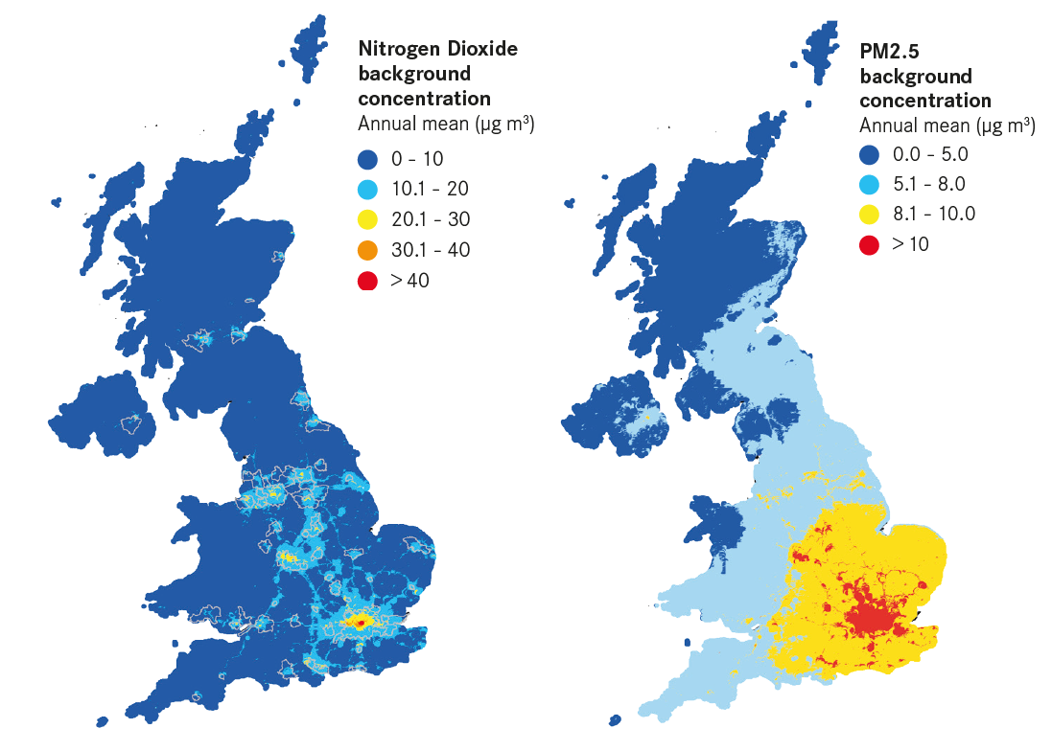
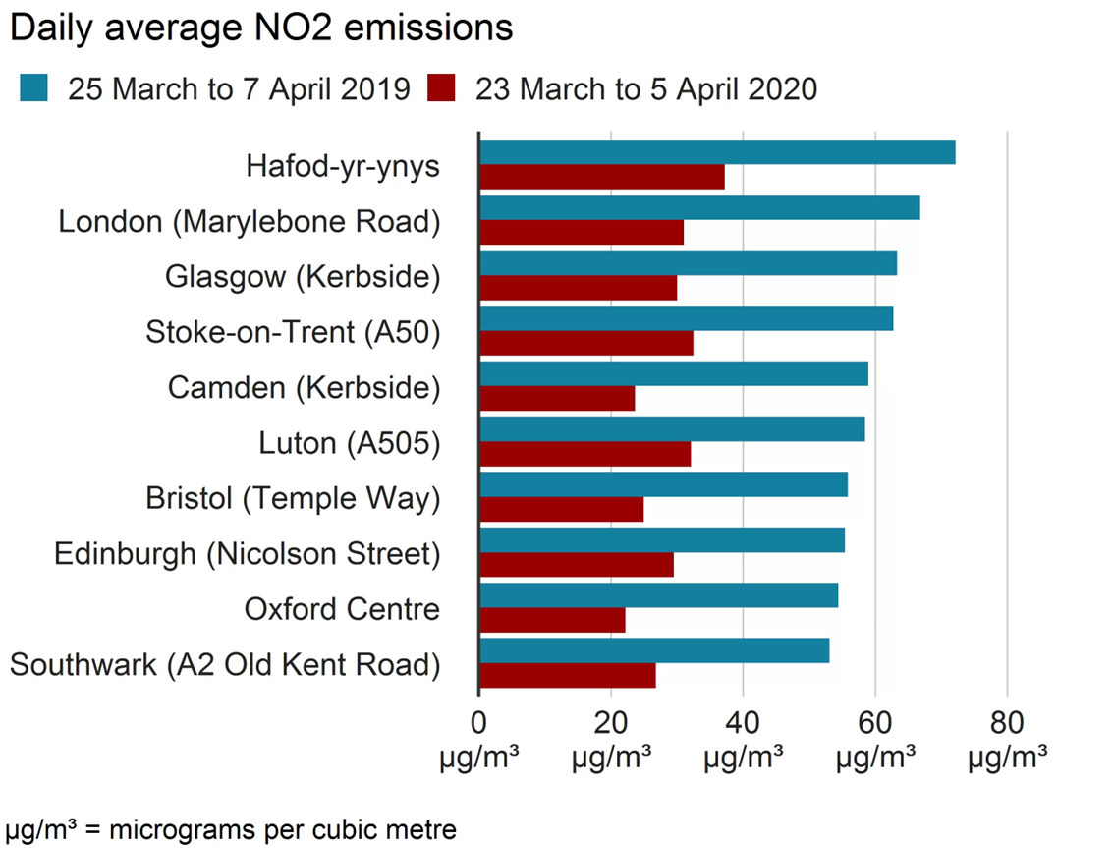
CAN WE MAKE OUR AIR FRESH AGAIN?
Project concept – define your problem
Step 1: Decide on the problem you will solve.
What are the key causes of poor air quality in the UK?
Is the air quality where you live known to be good or bad?
Which problem will you tackle to clean the air?
Notes:
Here the problem can be quite broad, as the next slide focuses this further. These images all focus on problems that contribute to poor air quality, including noxious gases (NO2, sulphur dioxide and ammonia) and particulate matter (PM or PM2.5). A breakdown for each is on the first challenge slide.
You can also start with discussion why this is an important issue and the impact of bad air quality for health. There is a link to a website in the extension / differentiation section below to support that discussion.
Notes on the images –
-Graph showing daily NO2 levels compared from 2019 to 2020. https://www.bbc.co.uk/news/uk-england-52202974 This image shows the level of NO2 (nitrogen dioxide in the air). This contributes to bad air quality and indirectly to global warming. It compares levels in the same period in 2019 and 2020 and students can then be asked about changes that happened to reduce air pollution across the UK. At this time the first lockdown occurred, so the dramatic reduction in car use had the most impact, but also in places like London the reduction of air travel would have also helped. The recommended maximum amount of NO2 in the air is 40 micrograms per cubic metre.
-UK air quality with two mapped images. https://www.centreforcities.org/reader/cities-outlook-2020/air-quality-cities/ This image shows two maps: one is the level of a noxious gas; Nitrogen Oxide across the UK and the other is a map of places with levels of particulate matter. You can ask students to consider what these suggests around what contributes to bad air quality in terms of geography and city versus rural areas. Cities have higher Nitrogen Oxide, but that isn't purely the case with particulate matter, which occurs more in the south of England than the north. So, students can think about how cities create bad air quality, and high density of people, but that also that it drifts from other countries.
-Factories emit smoke and pollutants into the air. This image represents a key cause of air pollution, which is industry. You can ask students to think more deeply about this problem, in that it not only is releasing particulate matter into the air through smoke, but also represents the burning of fossil fuels which also adds noxious gases into the air. The web link this image comes from includes new framework around how to tackle this from the Government in 2022. https://www.gov.uk/government/news/new-framework-announced-to-tackle-industrial-emissions-across-the-uk
Extensions / Differentiation:
1.Ask students to think about how people and behaviour affect poor air quality. From the images above you can ask students to infer what they think is the currently the least regulated area that impacts air quality. Whilst industry has more specifications on it, individual actions with driving and transport does not. Therefore, behaviour change of individuals is a key area they can explore.
2. You can ask students to think about impacts on people of bad air quality. In Europe it has been declared as the largest environmental health risk to people’s lives. This website then has detail about how it can impact individuals, which you can also ask students to think about. https://www.eea.europa.eu/en/topics/in-depth/air-pollution This Guardian article also explores how working days are lost to air quality, due to individuals needing to take time off or to look after children, who are among the worst affected by air pollution. https://www.theguardian.com/environment/2020/sep/09/air-pollution-causes-3m-lost-working-days-per-year-in-uk-says-cbi
3. The breakdown of particulate matter and noxious gases further in the cause of vehicle transport. Transport is a cause that has great impact on poor air quality, due to both contributing to particulate matter through exhaust emissions, braking and tyres on the road, but also noxious gases through emissions and the use of fossil fuels in powering them. So, you can ask students to consider how effective a move to electric vehicles would be in limiting the air quality, if the tyre material and braking systems were the same?

Slide 80
CAN WE MAKE OUR AIR FRESH AGAIN?
Project concept – define your problem
Step 2: Focus your Problem
Why is this important? What is the core problem at the heart of the issue?
What are the particular issues? Where does it happen? Who does it impact?

Slide 81
CAN WE MAKE OUR AIR FRESH AGAIN?
Project concept – define your problem
Step 3: Create your Problem Statement, which describes the problem you will solve.
Use the following three W’s to create it:
WHO or WHAT is facing your problem?
WHAT is the problem they are facing?
WHY should this problem be solved / WHAT will your solution do and help?
Cars contribute to bad air quality. My solution will help to reduce the pollutants that cars produce, to make the air cleaner and people healthier.
Notes:
For Step 3 they can write down their problem statement – or use post it notes for each of the three W’s. Or, they could record it on a video or by speech. The idea is that they have something to keep checking back on when thinking about solutions.
Extension: Their problem statements should consider both parts of the ‘why’ – so should have what the solution will do and how this will help an outcome (as shown in the example). A simplified version would just have ‘What the solution will do’.

Slide 82
CAN WE MAKE OUR AIR FRESH AGAIN?
Project process – ideas, prototype, test
The next step is to think of ideas for your potential solutions, decide on your favourite, prototype this idea, and then think of ways to test it against your problem statement.
The outcome is to create a solution to your problem and think of ways to test it.
Through doing this you will develop the following skills:
  Research and communication skills
  Creative and logical thinking
  Decision making
Notes:
Suggested Timings: For the whole of the Project process Stage we would recommend spending 1-2 hours. The following slides break this down into ideas, Prototyping’ and ‘Testing’.
Differentiation / Extension:
You can add detail to the skills, or ask students to think more about what these are / how they are evidenced:
Research and communication skills: Locate specific information, Use language to find relevant information, select relevant and well-regarded sources.
Creative and logical thinking: Organising into next steps, thinking outside of the box, being inspired by a different idea.
Decision making: Analysing information, assessing against an aim, evaluating outcomes.

Slide 83
CAN WE MAKE OUR AIR FRESH AGAIN?
Project process – ideas. Think of an interesting, and creative solution to your problem.
Step 1: Research what is out there already. This will also give you inspiration for your solution.
Step 2: Think of at least five new ideas for your solution.
Top tips for developing ideas to your solution:
  It’s not about perfection – don’t be judgemental.
  Warm up your brain before – then give yourself a time limit.
  Write each new idea on a separate post-it to see them all.
  Your idea doesn’t have to be 100% original, many ideas adapt, add to an existing idea, or merge two current ideas to create something new.
Step 3: Select your top idea , to take forward to the next stage. Use your problem statement to help.
Notes:
Suggested timings: This could take approximately 30 – 60 minutes - 15 – 30 minutes for research. 10 – 25 minutes for creating ideas. 5 minutes for choosing your preferred solution.
Research: This develops the skills of focused research and where their problem statement will be very helpful. You can encourage them to research current solutions and do an analysis of what is good about them, but what is also bad about them.
Existing ideas and links are suggested below:
Electric Vehicles. This case study focuses on Sujith Kollamthodi and how he works on tackling air quality, including the solution of electric vehicles. https://neonfutures.org.uk/case-study/automotive-engineer-sujith-kollamthodi/
Campaigns to Change Behaviour. The website 'Global Action Plan' includes information on four different campaigns to encourage behaviour change. These are:
Clean Air Day
Freedom to Breath
Build Back Cleaner Air
Cleaner Air for Communities
https://www.actionforcleanair.org.uk/campaigns
ULEZ. The Ultra Low Emission Zone has been introduced in London to create behaviour change in how people access the city. It charges vehicles that are petrol or diesel powered and emit a particular amount of harmful emissions, to enter the zone. It does not charge against particulate matter. More information can be found here https://www.london.gov.uk/programmes-strategies/environment-and-climate-change/pollution-and-air-quality/ultra-low-emission-zone-ulez-london and here https://tfl.gov.uk/modes/driving/ultra-low-emission-zone You may also want to discuss with students that some people have challenged the expansion of this zone in 2023.
Natural Solutions – Green Bangkok Project 2030. In 2020 hundreds of schools in Bangkok had to close due to unsafe levels of PM2.5 in the air. They have created a plan, involving a planned natural solution to improve air quality. This is centered around providing more green space, improving people's access to green space around the city, and increasing the urban tree canopy. https://www.c40.org/case-studies/the-green-bangkok-2030-project/
Global Solutions. This list includes 16 examples of solutions from around the world to help tackle air pollution. They include solutions that gather data, use nature, technology and regulation to create change. https://interestingengineering.com/lists/15-projects-that-could-end-air-pollution-around-the-world
Ideas
Emphasise to students that design thinkingencourages lots of ideas – which is because it wants creative thinking, and people to think outside of the box. So, by forcing yourself to think of at least five (but can be more) ideas you will do this.
Suggest Activities for warming up student brains for creative thinking are in the teacher slides at the start. (Alternative Ideas, Bad Ideas and Using Your Whole Brain).
Selecting their top idea. You can start with them narrowing down their top two, then their chosen one. Encourage students to compare solutions against their problem statement to focus on what would be the best to solve the problem.
Extension: To focus creative thinking students can use the acronym SCAMPER to think about a solution. This is taken from ideas that already exist to then create a new idea from them. They can take a few of the ideas they have researched and then apply the acronym to them to think of new ideas. It stands for Substitute, Combine, Adapt, Modify / Magnify, Purpose, Eliminate, Rearrange / Reverse. For instance they can substitute a material, combine two ideas, magnify one part, change the purpose of something that already exists …

Slide 84
CAN WE MAKE OUR AIR FRESH AGAIN?
Project process – prototype
Prototype Your Chosen Idea. A prototype is a first drawing or model of an idea.
Either draw (2D) or model (3D) your idea.
Add labels, or communicate what each part will do, and consider materials, construction, size etc.
Notes:
Suggested timings: This could take between 20 – 45 minutes, or longer, depending on how detailed they would like to make their models.
Extension:
Students can start with a 2D design and then move into a 3D Design – as this replicates the process that people working in STEM do when creating a prototype.
You can use this free website https://www.tinkercad.com/ for 3D Design. It also allows students to add coding to their design to show movement.

Slide 85
CAN WE MAKE OUR AIR FRESH AGAIN?
Project process – test
How would you test your solution? An important STEM skill is learning from failure.
Why is testing important? What can it teach us?
Consider how you would test your idea and record this. Would it be tested over time, in different locations, against a control? Would you need to collect data or feedback?
Notes:
Suggested timings: This could take between 10 – 15 minutes.
Testing: Emphasise that the main importance of testing is to help refine your original idea. So, in their considerations of how to test it, it is to see if it does solve the problem and what tweaks should be made next time. Testing isn’t to learn if it works perfectly, but to see what changes need to be made. The ‘Design Thinking’ process is an iterative process, with this built in. You can also emphasise that our brains learn more from failure than success, and approaching failure as a learning tool is essential in STEM jobs, as well as building self-resilience.
Please note that to enter the Big Bang Competition this process represents the stages that students will be judged on, and they do not have to complete testing if it is difficult to do so.
Extension:
Ask students to consider the ethics in testing and if using people what should they consider in this? Whose rights should they consider, and what permission will they have to seek?

Slide 86
CAN WE MAKE OUR AIR FRESH AGAIN?
Project Outcome – reflection
Well Done! You have completed your project and use the ‘Design Thinking’ process. The final stage is to reflect on this, to identify your strengths, what you enjoy and how it can link to a future in STEM.
The outcome is to reflect on the project for yourself, your learning and the next steps to take.
Through doing this you will develop the following skills:
  Goal-Setting
  Resilience
  Self-Awareness
Notes:
Suggested Timings: We would suggest spending up to 30 minutes on this reflection, as a plenary. You can use some of this time to include the slides about roles and next steps as
Differentiation / Extension:
You can add detail to the skills, or ask students to think more about what these are / how they are evidenced:
Goal Setting: Setting targets that are SMART (Specific, Measurable, Achievable, Relevant, Time-Bound), Reflecting, Celebrating Success.
Resilience: Adapting to Change Positively, Being flexible, Viewing set-backs as learning opportunities.
Self-Awareness: Understanding how and why you respond to emotional and learning situations, in order to make the best choices for yourself.

Slide 87
CAN WE MAKE OUR AIR FRESH AGAIN?
Project Outcome: reflection.
Personal reflection: What were the challenges you faced? How did you overcome difficulty? What parts did you enjoy the most and why?
Project reflection: What worked well on this project? Where would you take it next – a working prototype, doing some testing, presenting it? Would you like to try a different challenge?
Learning reflection: What skills did you develop? What new knowledge did you gain? Have your perceptions about STEM changed, and if so how? What would you do the same and differently in another project?
Notes:
Extension:
- In project reflection you can ask them about future implications of their project and how it might need to be adapted in the future.
- You can get the student / students to present their idea to the class and use the following criteria to structure feedback:
The Problem Statement – specific and clear.
What solution you went with and why you rejected others – logical thinking and reasoning skills.
Talk through the prototype and design – communication, using visuals to support clarification.
Explaining testing options – understanding of the role of testing.
reflection – good self-awareness, evaluation and goal setting.

Slide 88
CAN WE MAKE OUR AIR FRESH AGAIN?
Congratulations on Completing your Project!
Through your Project you used the ‘Design Thinking’ process, which is a highly valued approach in problem solving.
You developed and practiced many skills, including - research, creative thinking, communication, logical thinking, decision making, time management and goal setting.
These are all essential skills in STEM careers, and through doing this project you have shown you would be really successful in a STEM job.
Examples of jobs in this field are:
1. Graduate Engineer to design aircraft engines that are more efficient and create less emissions
2. Environmental Consultant to design the next generation of cars.
If you want to celebrate your project further you can enter it into the Big Bang Project Gallery, or Big Bang Competition.
Notes:
1. Graduate Engineer: https://neonfutures.org.uk/case-study/aeronautical-engineer-daniel-newman/
2. Environmental Consultant: https://neonfutures.org.uk/case-study/automotive-engineer-sujith-kollamthodi/
Next Steps:
You can download the Green Engineering Careers Poster entitled 'Can we make our air fresh again?'. This explores how engineers have explored this problem and further career information. https://neonfutures.org.uk/resource/green-engineering-careers-posters/
You can provide students with certificates to celebrate their achievement. A certificate template can be downloaded for print from here.
You can enter The Big Bang Project Gallery here.
You can enter The Big Bang Competition here

Slide 89
CHALLENGE 7
ON TRACK TO NET ZERO?
People working in STEM have to think long-term and create solutions that solve problems in the present as well as in the future. To succeed on this challenge, you will have to think about the consequences of your solutions, make effective judgements and be innovative.
Notes:
This Big Bang Challenge explores how railways are part of the solution to achieving Net Zero.
You can explore a definition of net zero with students as a starter. We have also put a definition of greenhouse gas emissions here as well.
Net Zero: 'Net Zero means cutting greenhouse gas emissions to as close to zero as possible, with any remaining emissions re-absorbed from the atmosphere, by oceans and forests for instance. To keep global warming to no more than 1.5°C – as called for in the Paris Agreement – emissions need to be reduced by 45% by 2030 and reach net zero by 2050.'
The UN also states that we are not on track to reach this, therefore there is a question mark in the title.
https://www.un.org/en/climatechange/net-zero-coalition
BBC Bitesize: There is a video and definition found on here to explain this further. What is net zero? - KS3 - The Regenerators - BBC Bitesize
Greenhouse Gas Emissions: Greenhouse Gases are gases that help to warm the earth. The naturally occurring ones are carbon dioxide (CO2), Methane, Nitrous Oxide and Water Vapour. The human actions that emit more of these into the atmosphere are: burning fossil fuels, deforestation, cattle farming, landfill waste dumps, fertilisers and production of oil and gas. For this problem we are focusing on actions that relate to rail.

Slide 90
Design Thinking
To solve this problem you will use a design thinking process. This is what people working in STEM, and more widely, use to create effective solutions.
It includes the following steps:
Notes:
The design thinking process is used by people working in STEM as a method to solving problems. Major organisations often have a ‘Design Thinking’ Team or ‘Innovation’ Team who work solely in this way, such as Transport for London, Uber Eats, AirBnb, Netflix, or OralB. It is an interative process, that challenges assumptions and develops open minded creativity. In its entirety it has 6 steps, and normally focuses on a user or a particular group. The stages are: empathise, define, Ideate, prototype, test, implement. As students may not choose to focus their problem on a particular person, or group of people we have simplified the process to include 4 steps: define, ideas, prototype, test. The infographic on the slide shows that the testing should help then inform your idea to create a better prototype and test again. This iterative cycle then creates a better design in order to implement.

Slide 91
ON TRACK TO NET ZERO?
Project concept: define your problem
It is important to be clear on what problem your solution will solve and spend time on this. Why?
The outcome is to create a problem statement.
- You will have three steps to follow to create this.
- Through creating this you will develop the following skills that STEM jobs value :
  Investigative thinking skills
  Critical analysis skills
  Communication of ideas
Notes:
Suggested timings: For this stage we would recommend 30 minutes on the ‘Project Concept’ and Defining Your Problem (which is on the next two slides), but it could be shorter if your students already know a lot on the theme.
Emphasise to students that key to problem solving is spending time to focus on the problem. It helps to focus creative thinking, research and make sure that you can test your solution against something at the end.
Differentiation / Extension:
You can add detail to the skills, or ask students to think more about what these are / how they are evidenced:
Investigative Thinking skills: Curiosity, making connections, Reaching conclusions.
Critical Thinking skills: Asking Questions, making Judgements, Interpreting.
Communication of Ideas: Clear in descriptions, Framing your language, Sharing information.
You can use the following quote from Einstein to explore more about why spending time focusing on the problem is important: Einstein said ‘’If I had an hour to solve a problem, I’d spend 55 minutes thinking about the problem and 5 minutes thinking about solutions.’’ Preparation is essential to problem solving, and understanding your problem focuses your creativity.

Slide 92

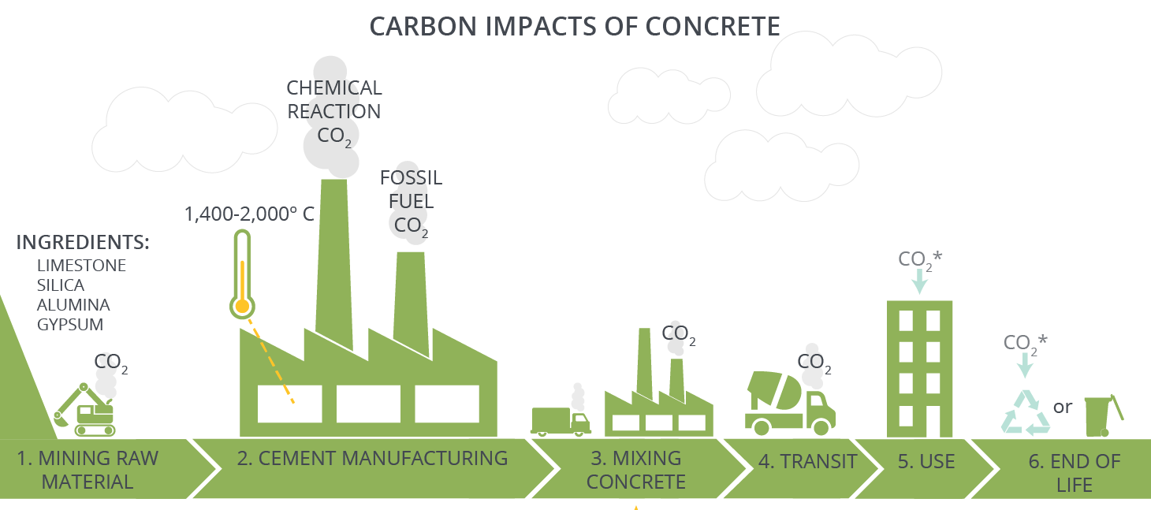
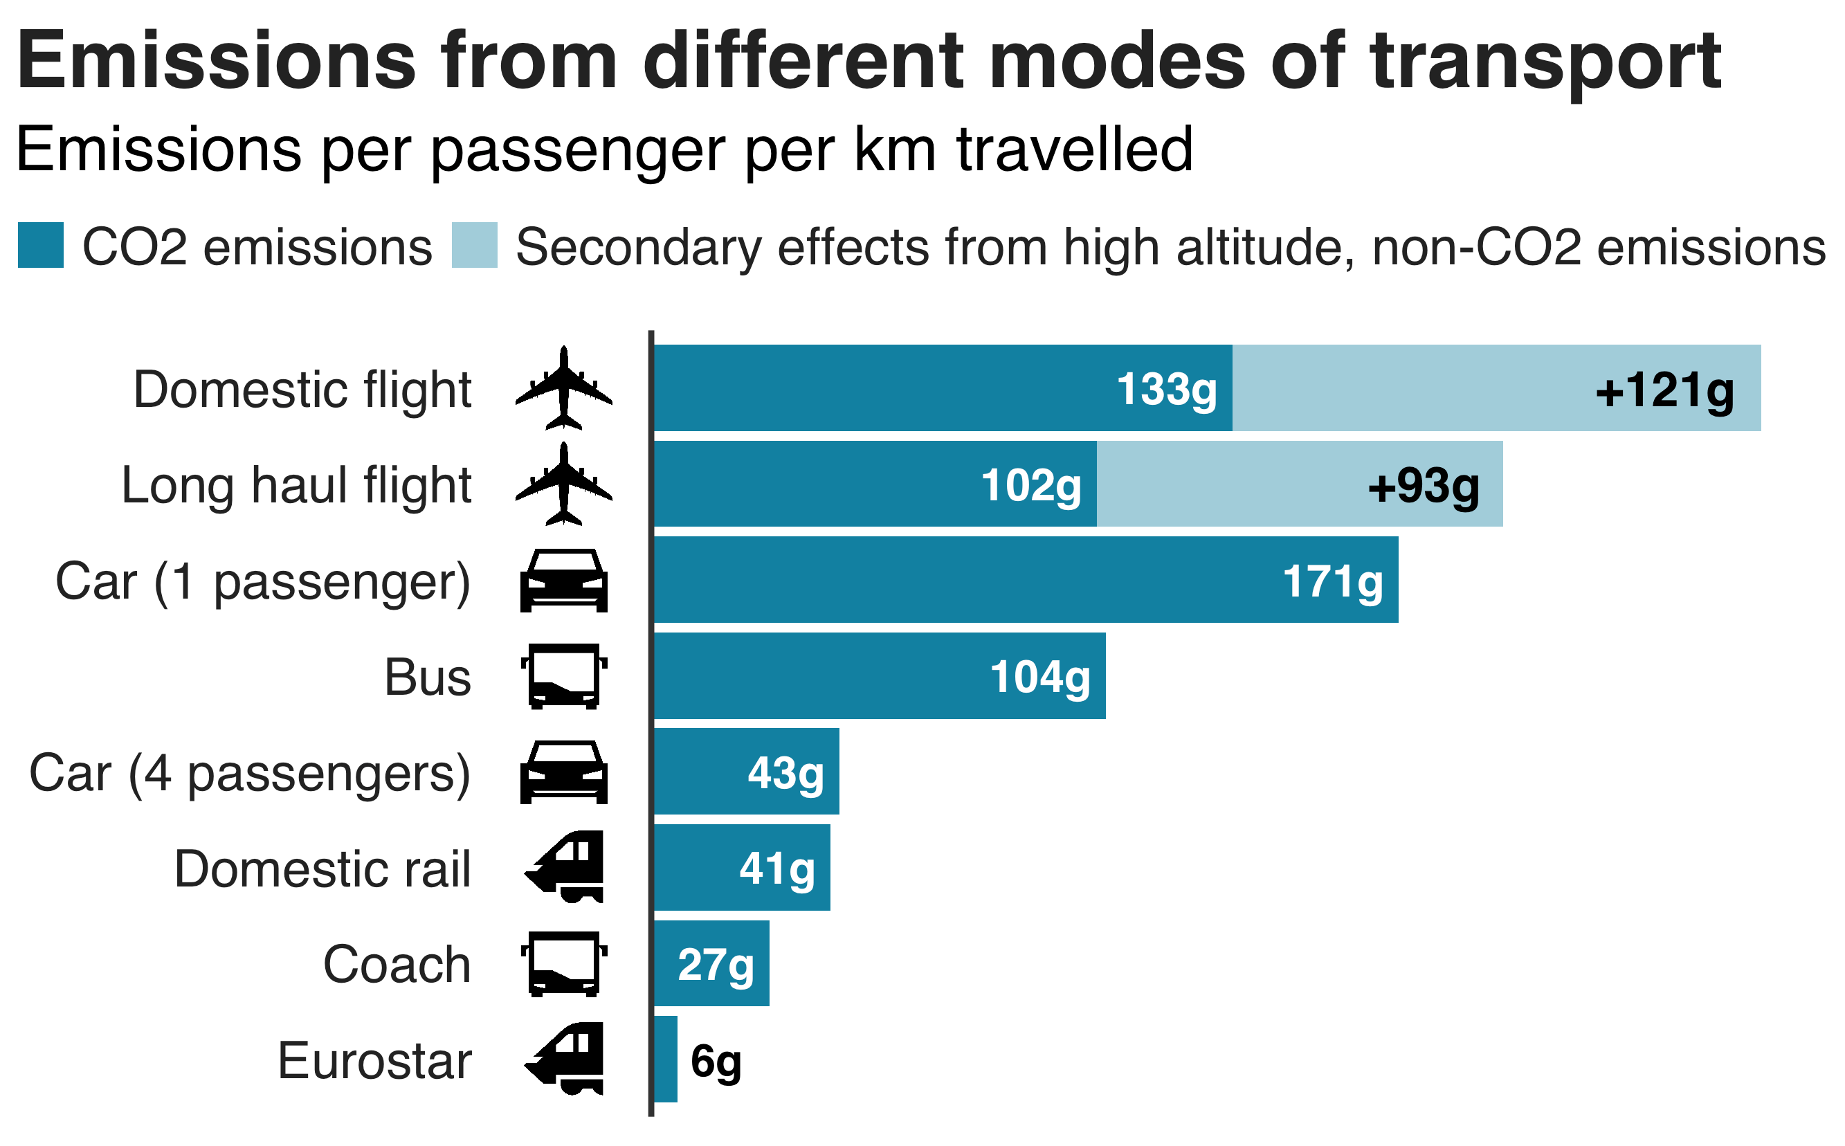
ON TRACK TO NET ZERO?
Project concept – define your problem
Step 1: Decide on the problem you will solve
How does transport create greenhouse gas emissions?
How can railways help the solution?
Which problem will you tackle?
Notes:
Here the problem can be quite broad, as the next slide focuses this further.
Notes on the images -
Emissions from different modes of transport. https://www.bbc.co.uk/news/science-environment-49349566 You can use this graph to think about how railways are part of the solution. It shows that they are one of the lowest contributors to emissions per km travelled, with air travel and private transport the largest contributors. Therefore, this can lead to a discussion about finding ways to encourage people to use railways more is an effective solution in lowering emissions overall. Then, students can consider problems to this and how they can solve this.
Carbon Impacts of Concrete. https://materialspalette.org/concrete/ This is a cropped image to show the CO2 emissions from creating concrete. Concrete is the most widely used building material due to its durability, fire resistance, strength and versatility. You can ask students to identify all of the ways that concrete leads to more greenhouse gas emissions. Some students may notice that whilst concrete leads to a lot of CO2 being emitted during the creation (due to fossil fuels being used to create the temperatures needed to create the cement), but at the end of the image it shows that concrete can absorb CO2 as well. This is due to this sometimes occurring when concrete is exposed to air, and the potential for it to be recycled.
You can then also lead into discussions about how this links to the transport sector, and railways in particular. Concrete is used as a material for stations, platforms, lining tunnels, building bridges, on the tracks and sleepers. It is also often reinforced with steel. Students should then consider how the construction of railways is an important issue in reaching net zero.
Diesel Powered Trains. https://collection.sciencemuseumgroup.org.uk/objects/co205817/british-railways-d200-diesel-locomotive This image can present students with a clear way in that trains contribute greenhouse gas emissions, as it shows a diesel powered train (which is written on the front of the train). You can ask students to think about how these release CO2, which is both in production of diesel as it is made from crude oil as well as the reaction of it with high temperatures in an engine.
The figure for diesel powered trains is currently approximately 29% with plans to completely phase them out.
As a further discussion point this train was in production from 1958 – 1988. Which shows the longevity of trains, and that they are normally in production and use for a long time. You can ask students to then consider what this means for reaching net zero by 2050 and that changes need to happen now to achieve this.
Extensions / Differentiation:
Global Comparisons: This website has global comparisons of electric and diesel passenger and freight trains, which are also linked to CO2 emissions. There are two graphs to show this to students, which you can explore with them if this is an area of interest. https://www.railengineer.co.uk/selling-electrification/
2. Ethics of Behaviour Change. As an extension if students want to focus on the problem of changing people's behaviour to use public over private transport for journeys, then you can further this by discussing the ethics of this and how to create behaviour change that doesn't negatively impact anybody's lives.
3. Transport and Environment Statistics in the UK 2022. https://www.gov.uk/government/statistics/transport-and-environment-statistics-2022/transport-and-environment-statistics-2022 This website provides up-to-date comparisons for emissions in different sectors in the UK, including travelling between different destinations. It can provide more information around this theme if students want to explore this further. It is then interesting to look at how different destinations have different emissions per travel option.

Slide 93
ON TRACK TO NET ZERO?
Project concept – define your problem
Step 2: Focus your Problem
Why is this important? What is the core problem at the heart of the issue?
What are the particular issues? Where does it happen? Who does it impact?

Slide 94
ON TRACK TO NET ZERO?
Project concept – define your problem
Step 3: Create your Problem Statement, which describes the problem you will solve.
Use the following three W’s to create it:
WHO or WHAT is facing your problem?
WHAT is the problem they are facing?
WHY should this problem be solved / WHAT will your solution do and help?
Diesel trains create CO2 emissions. My solution will create a cleaner way to power trains, as well as a system to capture existing CO2, to reach net zero by 2050.
Notes:
For Step 3 they can write down their problem statement – or use post it notes for each of the three W’s. Or, they could record it on a video or by speech. The idea is that they have something to keep checking back on when thinking about solutions.
Extension: Their problem statements should consider both parts of the ‘why’ – so should have what the solution will do and how this will help an outcome (as shown in the example). A simplified version would just have ‘What the solution will do’.

Slide 95
ON TRACK TO NET ZERO?
Project process – ideas, prototype, test
The next step is to think of ideas for your potential solutions, decide on your favourite, prototype this idea, and then think of ways to test it against your problem statement.
The outcome is to create a solution to your problem and think of ways to test it.
Through doing this you will develop the following skills:
  Research and communication skills
  Creative and logical thinking
  Decision making
Notes:
Suggested Timings: For the whole of the Project process Stage we would recommend spending 1-2 hours. The following slides break this down into ideas, Prototyping’ and ‘Testing’.
Differentiation / Extension:
You can add detail to the skills, or ask students to think more about what these are / how they are evidenced:
Research and communication skills: Locate specific information, Use language to find relevant information, select relevant and well-regarded sources.
Creative and logical thinking: Organising into next steps, thinking outside of the box, being inspired by a different idea.
Decision making: Analysing information, assessing against an aim, evaluating outcomes.

Slide 96
ON TRACK TO NET ZERO?
Project process – ideas. Think of an interesting, and creative solution to your problem.
Step 1: Research what is out there already. This will also give you inspiration for your solution.
Step 2: Think of at least five new ideas for your solution.
Top tips for developing ideas to your solution:
  It’s not about perfection – don’t be judgemental.
  Warm up your brain before – then give yourself a time limit.
  Write each new idea on a separate post-it to see them all.
  Your idea doesn’t have to be 100% original, many ideas adapt, add to an existing idea, or merge two current ideas to create something new.
Step 3: Select your top idea , to take forward to the next stage. Use your problem statement to help.
Notes:
Suggested timings: This could take approximately 30 – 60 minutes - 15 – 30 minutes for research. 10 – 25 minutes for creating ideas. 5 minutes for choosing your preferred solution.
Research: This develops the skills of focused research and where their problem statement will be very helpful. You can encourage them to research current solutions and do an analysis of what is good about them, but what is also bad about them.
Existing ideas and links are suggested below:
Hydrogen Trains. This video includes a panel talking about how Network Rail are looking to make their network have net zero emissions. From 35.52 a question comes in regarding net zero emissions trains, and the panel talk about this being used in Europe as well as making sure electric trains are powered by electricity that has been created with net zero emissions. Big Bang Digital - Thursday - Live BSL - RAIL CONSORTIUM - YouTube
More on Hydrogen Trains can be found here. This article also includes, at the end, a discussion about the issues with hydrogen powered trains, such as needing a lot of space to store it, needing natural gas to make it, and then not being able to store enough on trains for longer journeys. Next stop, hydrogen-powered trains - BBC Future
Solar Powered Trains. In 2019 the UK trialed the first solar powered train in the world. It is on the Wessex route, with a solar power farm connecting to the track near Aldershot. Pioneering trial for solar-powered trains - Network Rail
This Guardian article also looks at this, and focuses on solar panels on Indian trains as well at the end of the article. India has some solar panels directly on the trains themselves. Rail line in Hampshire is world's first to be powered by solar farm | Network Rail | The Guardian
Network Rail solutions. Network Rail have a goal to reach net zero in Scotland by 2045 and the rest of Britain by 2050. On this webpage they talk about how they are doing that through a low-emission railway. If you click the drop down menu under 'How are we going to reduce our emissions' and the dates of 2020 – 2029 and 2030 – 2050 it lists actions to take. These include monitoring carbon emissions as well as all diesel trains replaced and making sure train timetables are as efficient as possible. A low-emission railway - Network Rail
Biomethane-fueled Trains. An alternative way to power trains is using human and animal waste. This article lists how this was being developed in 2021. New Sustainable UK Train Runs on Human Waste | IE (interestingengineering.com)
Getting electricity to trains and stations.
This first video link has a relevant section from 20.11 - 22.00 minutes. Network Rail looks at how to get enough electricity to trains, when they need so much to power them, as an alternative to diesel. This video covers how they get electric leads to trains safely, and also how to make sure the electricity is produced in the cleanest way possible. https://www.youtube.com/watch?v=T_t-EcZAl70
This second video link has a relevant section from 20.32 - 23.32. Here, LNER talks about the issues with getting electricity to trains when you have no overhead electrical supply – which is the case after Edingburgh. So, trains currently have to switch to diesel. They also speak about
ULEZ. The Ultra Low Emission Zone has been introduced in London to create behaviour change in how people access the city. It charges vehicles that are petrol or diesel powered and emit a particular amount of harmful emissions, to enter the zone. It is included as a deterrent to using private vehicles and encourage people to either change their vehicles to greener technology (such as electric) or to use public transport. More information can be found here https://www.london.gov.uk/programmes-strategies/environment-and-climate-change/pollution-and-air-quality/ultra-low-emission-zone-ulez-london and here https://tfl.gov.uk/modes/driving/ultra-low-emission-zone You may also want to discuss with students that some people have challenged the expansion of this zone in 2023.
Decarbonisation of Construction. If students are particularly interested in how to reduce carbon through building this image and website should also help and can be shown to them. How to decarbonize the construction industry | World Economic Forum (weforum.org) In particular there is an infographic a third of the way down the page that shows the best way to reduce carbon in buildings, to the least best way. This can help students guide towards solutions and best practice guidance in how to approach this.
Cement-free Concrete. In 2021 the first UK cement free concrete block was produced in Cambridge. By removing cement from concrete it helps to reduce the CO2 emissions by up to 77%. It is called 'Greenbloc'. Ultra-low Carbon Concrete | Greenbloc | Poundfield Precast
Carbon Capture. This technology has been used for a long-time but is now being introduced more and more to capture and store carbon dioxide, to prevent it from remaining in the atmosphere. More information about it can be found here. What is carbon capture and storage? | CCS explained | National Grid Group
Regenerative Breaking. The London Underground has been electric powered from 1890. A modern concern from them is the amount of electricity they use. Each year it uses the same amount of electricity as 360,000 homes. One way to save energy is regenerative breaking, in which the energy after a train breaks is captured to then use at another time. They introduced this in 2015 and this link shows the impact of that system. Recycling energy from Tube trains to power stations - Transport for London (tfl.gov.uk)
Ideas
Emphasise to students that design thinkingencourages lots of ideas – which is because it wants creative thinking, and people to think outside of the box. So, by forcing yourself to think of at least five (but can be more) ideas you will do this.
Suggest Activities for warming up student brains for creative thinking are in the teacher slides at the start. (Alternative Ideas, Bad Ideas and Using Your Whole Brain).
Selecting their top idea. You can start with them narrowing down their top two, then their chosen one. Encourage students to compare solutions against their problem statement to focus on what would be the best to solve the problem.
Extension: To focus creative thinking students can use the acronym SCAMPER to think about a solution. This is taken from ideas that already exist to then create a new idea from them. They can take a few of the ideas they have researched and then apply the acronym to them to think of new ideas. It stands for Substitute, Combine, Adapt, Modify / Magnify, Purpose, Eliminate, Rearrange / Reverse. For instance they can substitute a material, combine two ideas, magnify one part, change the purpose of something that already exists …

Slide 97
ON TRACK TO NET ZERO?
Project process – prototype
Prototype Your Chosen Idea. A prototype is a first drawing or model of an idea.
Either draw (2D) or model (3D) your idea.
Add labels, or communicate what each part will do, and consider materials, construction, size etc.
Notes:
Suggested timings: This could take between 20 – 45 minutes, or longer, depending on how detailed they would like to make their models.
Extension:
Students can start with a 2D design and then move into a 3D Design – as this replicates the process that people working in STEM do when creating a prototype.
You can use this free website https://www.tinkercad.com/ for 3D Design. It also allows students to add coding to their design to show movement.

Slide 98
ON TRACK TO NET ZERO?
Project process – test
How would you test your solution? An important STEM skill is learning from failure.
Why is testing important? What can it teach us?
Consider how you would test your idea and record this. Would it be tested over time, in different locations, against a control? Would you need to collect data or feedback?
Notes:
Suggested timings: This could take between 10 – 15 minutes.
Testing: Emphasise that the main importance of testing is to help refine your original idea. So, in their considerations of how to test it, it is to see if it does solve the problem and what tweaks should be made next time. Testing isn’t to learn if it works perfectly, but to see what changes need to be made. The ‘Design Thinking’ process is an iterative process, with this built in. You can also emphasise that our brains learn more from failure than success, and approaching failure as a learning tool is essential in STEM jobs, as well as building self-resilience.
Please note that to enter the Big Bang Competition this process represents the stages that students will be judged on, and they do not have to complete testing if it is difficult to do so.
Extension:
Ask students to consider the ethics in testing and if using people what should they consider in this? Whose rights should they consider, and what permission will they have to seek?

Slide 99
ON TRACK TO NET ZERO?
Project Outcome – reflection
Well Done! You have completed your project and use the ‘Design Thinking’ process. The final stage is to reflect on this, to identify your strengths, what you enjoy and how it can link to a future in STEM.
The outcome is to reflect on the project for yourself, your learning and the next steps to take.
Through doing this you will develop the following skills:
  Goal-Setting
  Resilience
  Self-Awareness
Notes:
Suggested Timings: We would suggest spending up to 30 minutes on this reflection, as a plenary. You can use some of this time to include the slides about roles and next steps as
Differentiation / Extension:
You can add detail to the skills, or ask students to think more about what these are / how they are evidenced:
Goal Setting: Setting targets that are SMART (Specific, Measurable, Achievable, Relevant, Time-Bound), Reflecting, Celebrating Success.
Resilience: Adapting to Change Positively, Being flexible, Viewing set-backs as learning opportunities.
Self-Awareness: Understanding how and why you respond to emotional and learning situations, in order to make the best choices for yourself.

Slide 100
ON TRACK TO NET ZERO?
Project Outcome: reflection.
Personal reflection: What were the challenges you faced? How did you overcome difficulty? What parts did you enjoy the most and why?
Project reflection: What worked well on this project? Where would you take it next – a working prototype, doing some testing, presenting it? Would you like to try a different challenge?
Learning reflection: What skills did you develop? What new knowledge did you gain? Have your perceptions about STEM changed, and if so how? What would you do the same and differently in another project?
Notes:
Extension:
- In project reflection you can ask them about future implications of their project and how it might need to be adapted in the future.
- You can get the student / students to present their idea to the class and use the following criteria to structure feedback:
The Problem Statement – specific and clear.
What solution you went with and why you rejected others – logical thinking and reasoning skills.
Talk through the prototype and design – communication, using visuals to support clarification.
Explaining testing options – understanding of the role of testing.
reflection – good self-awareness, evaluation and goal setting.

Slide 101
ON TRACK TO NET ZERO?
Congratulations on Completing your Project!
Through your Project you used the ‘Design Thinking’ process, which is a highly valued approach in problem solving.
You developed and practiced many skills, including - research, creative thinking, communication, logical thinking, decision making, time management and goal setting.
These are all essential skills in STEM careers, and through doing this project you have shown you would be really successful in a STEM job.
Examples of jobs in this field are:
1. Asset Engineer to look after the structures on the railway to make sure they last as long as possible.
2. Lead Signalling Power Engineer to use the most energy efficient equipment in designs for rail.
If you want to celebrate your project further you can enter it into the Big Bang Project Gallery, or Big Bang Competition.
Notes:
1. Asset Engineer: My three most answered questions about engineering... | Case Study | Neon - Brilliant inspiration (neonfutures.org.uk)
2. Lead Signalling Power Engineer: Leading the signals | Case Study | Neon - Brilliant inspiration (neonfutures.org.uk)
Next Steps:
You can provide students with certificates to celebrate their achievement. A certificate template can be downloaded for print from here.
You can enter The Big Bang Project Gallery here.
You can enter The Big Bang Competition here

