Slide 1
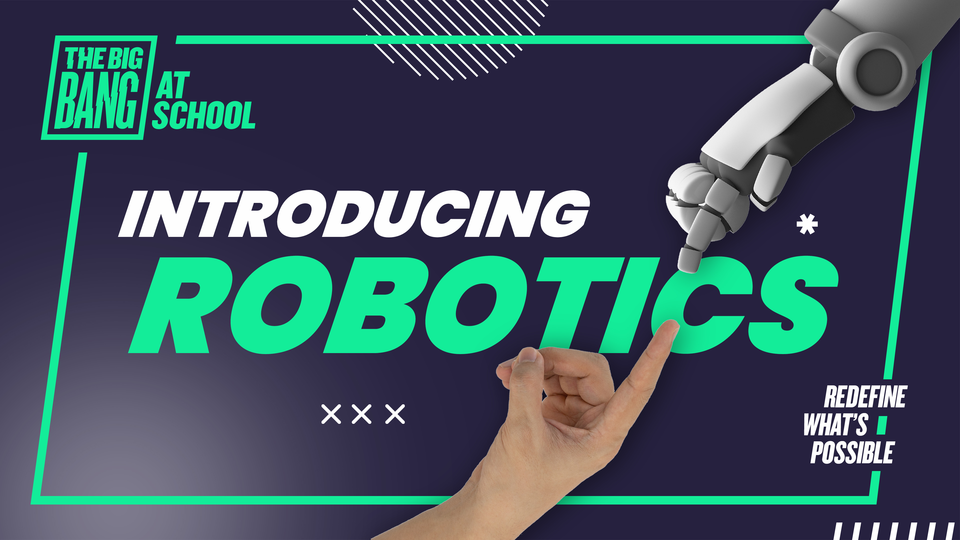

Slide 2
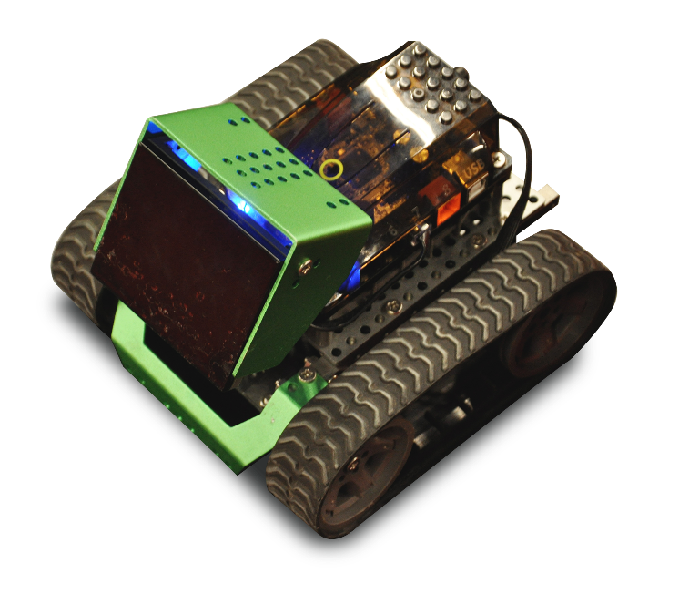

Introducing robotics
Discover how robotics
is changing our world,
and what it could mean
for the future; then apply computational thinking
to solve a simple
robotics challenge.
SUBJECTS
Computing / Computation / Technologies /
ICT; PSHE / Health and Wellbeing / Learning for life
and work
PERSONAL DEVELOPMENT
Teamwork, communication and problem solving
AGES
11 to 14
TIME
Assembly option – 15 to 20 minutes
Classroom option – 60 minutes (with optional extension)

Slide 3
About this lesson
This stand-alone session introduces all students to robotics and raises their awareness of careers in robotics and engineering.
Focusing on young people underrepresented in STEM
Through this session, we aim to encourage more girls, students from UK minority ethnic backgrounds, students who receive FSM, and students with lower ability and/or SEND students to take STEM subjects.
Developed with teachers
This programme has been developed in partnership
with EVERFI and a panel of subject matter experts and practising teachers.
Using this presentation
This presentation includes all the subject knowledge
you’ll need to teach this topic with confidence.
Slides 2 to 8: Overview for teachers.
Hidden slides will not display in presentation mode.
Slides 9 to 42: Slides to adapt and use with students.
  Some slides have animation - view in presentation mode.
  Slide notes contain further teacher guidance.
Teachers’ notes

Slide 4

Session options
Activity | Minutes | Slides | Preparation and resources | Assembly 15-20 mins | Lesson 60 mins
Learning outcomes and objectives | 5 | 9 to 10
Starter: What is a robot? | 5 to 10 | 11 to 15
Case studies: Real-life robots | 5 | 16 to 20
Main activity: Program your classmate! Write a simple algorithm for a simulated ‘robot’ | 25 | 21 to 27 | Print slide x (1 per group) or writing paper
Plenary: Robotics and you (careers) | 5 to 10 | 28 to 33
Extensions / Homework: Programe a delivery robot (a more in-depth look at computational thinking) and Robotics for good (how robotics can improve lives) | 20 to 30 | 34 to 42

Slide 5





Curriculum links – Computing
ENGLAND
WALES
Computing KS3
Computation progression step 4
Design, use and evaluate computational abstractions
that model the state and behaviour of real-world problems
and physical systems
Understand several key algorithms that reflect computational thinking, such as ones for sorting and searching; use logical reasoning to compare the utility of alternative algorithms
for the same problem
Use two or more programming languages, at least one of which is textual, to solve a variety of computational problems
I can decompose given problems and select appropriate constructs to express solutions in a variety of environments
I can select and use data structures that efficiently
manage data in algorithms
I can plan and implement test strategies to identify
errors in programs
I can select and use multiple sensors and actuators that allow computer systems to interact with the world around them
Teachers’ notes

Slide 6

Curriculum links – Computing
SCOTLAND
NORTHERN IRELAND
Technologies
Thinking skills and personal capabilities
Using ICT
I understand language constructs for representing structured information TCH 3-14a. I can select appropriate development tools to design, build, evaluate and refine computing solutions based
on requirements. TCH 3-15a.
Investigate and solve problems in a range of digital environments
Use appropriate ICT tools and features to carry out ongoing improvements and evaluate process and outcomes
Teachers’ notes

Slide 7
Curriculum links – careers & personal development
ENGLAND
PSHE Association Programme of Study KS3
L3. to set realistic yet ambitious targets and goals
L4. the skills and attributes that employers value
L7. about the options available to them at the end
of key stage 3, sources of information, advice and support,
and the skills to manage this decision–making process
L8. about routes into work, training and other vocational
and academic opportunities, and progression routes
L9. the benefits of setting ambitious goals and being
open to opportunities in all aspects of life
L12. about different work roles and career pathways,
including clarifying their own early aspirations
Gatsby Career Benchmarks 3, 4, 5
WALES
Health and wellbeing progression step 4
I can set appropriate goals, plan a course of action
and overcome challenges to achieve them
I can critically evaluate factors and implications, including risks, when making decisions individually and collectively
Careers and work-related experiences
Become increasingly aware of the range of opportunities available to them, broadening their horizons
Develop the attitudes and behaviours required to
overcome barriers to employability, career management and lifelong learning
Explore opportunities through a variety of meaningful experiences in learning, work and entrepreneurship
Develop resilience and the ability to be adaptable in response to the challenges, choices and responsibilities
of work and life
Teachers’ notes

Slide 8
Curriculum links – Careers & personal development
SCOTLAND
Health and Wellbeing
I am developing the skills and attributes which I will need
for learning, life and work. I am gaining understanding of
the relevance of my current learning to future opportunities.
This is helping me to make informed choices about
my life and learning.
Careers Education Standard Entitlements
Develop skills for learning, life and work as an integral part of their education and be clear about how all their achievements relate to these;
NORTHERN ILELAND
Thinking skills and personal capabilities
Employability/Learning for Life and Work
The skills and qualities required for a successful career.
The importance of lifelong learning in achieving your personal and professional potential.
Career planning as a lifelong learning process involving:
Reviewing and evaluating learning,
progress and achievements
Goal setting
SMART target setting
Taking action
Teachers’ notes

Slide 9

Learning objectives and outcomes 5 minutes
What are we learning?

Slide 10
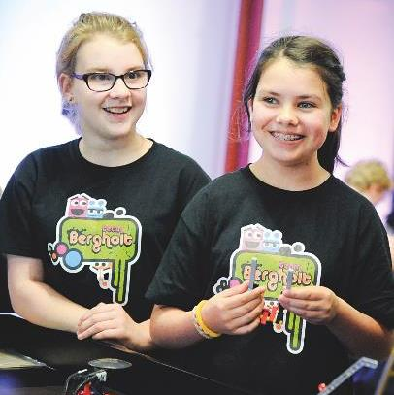

What are we learning?
Learning objectives
To understand what a robot is, how robotics help us,
and what it means for future.
Learning outcomes
You will be able to:
Describe what a robot is, learn about real life examples of them and list some ways robots are helpful
Use computational thinking and employability skills
to develop a set of instructions for a simple robot
Understand that engineers build and program robots and that there are many jobs in robotics engineering
Introducing Robotics – Learning objectives and outcomes

Slide 11
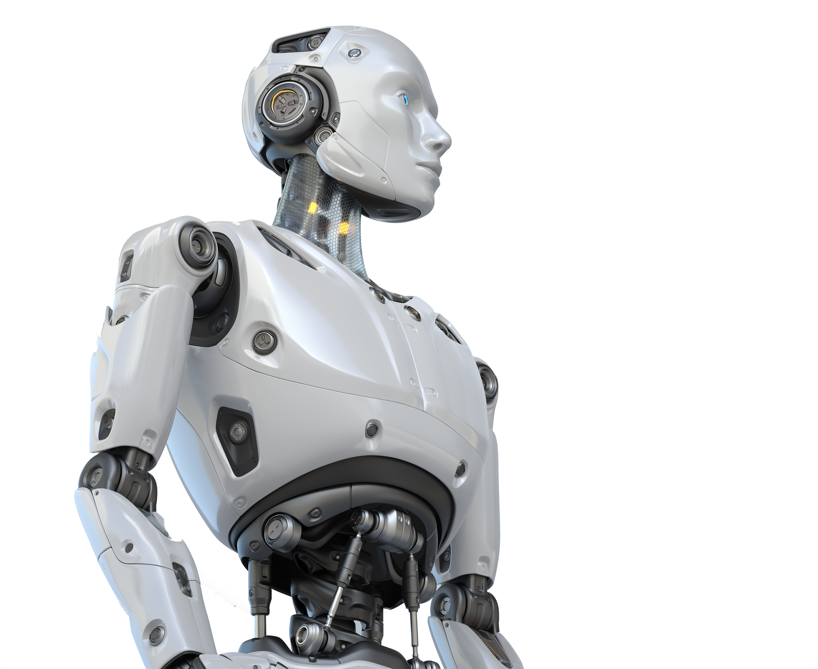
Starter 5-10 minutes
What is
a robot?

Slide 12

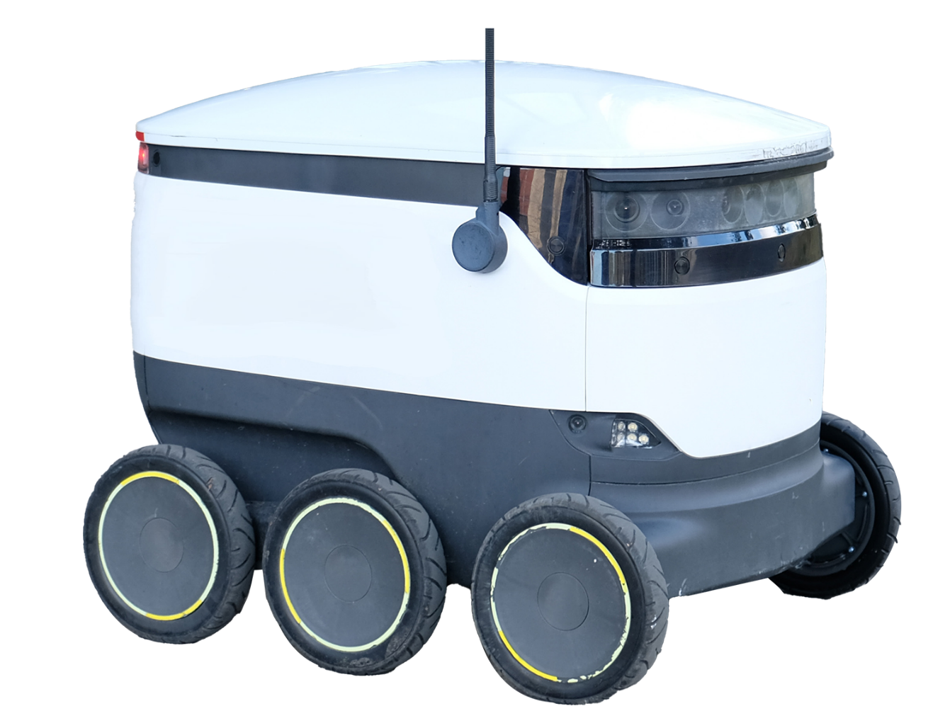
How confident are you in…
Explaining what a robot is?
Describing how robots can help people
Listing some careers that are available in robotics engineering?
Not confident
Extremely confident
1
2
3
4
5
6
7
8
9
10
Starter

Slide 13
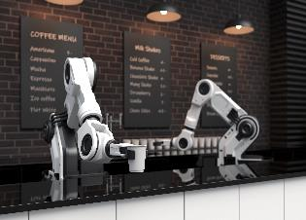
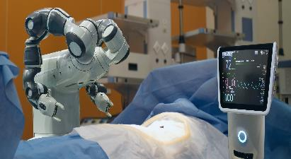
What is a robot?
A robot is a programmable machine that can carry out complex tasks without the need for human help.
Robots are built and programmed by engineers.
The device controlling the robot might be separate or in the robot itself.
A robot might look
like a human, but they
usually don’t.
Starter

Slide 14
What do robots help us to do?
Pros
Cons
Don’t get bored of repetitive tasks
More consistent and accurate than humans
Can do tasks that are unsafe or unpleasant for humans
Can do tasks remotely, e.g. guided by an expert who is far away
Can learn from mistakes and adapt through machine learning
Perform tasks needing precision beyond human capability
Feared to take jobs from humans
In unexpected situations can’t use intuition or instinct,
or improvise as well as humans can
Expensive to build, programme and maintain
‘Uncanny valley’ effect - humans can feel uncomfortable with humanoid robots that appear ‘nearly’ human
Starter
Notes:
Robots are helpful because there are many things they can do better than a human, where it is difficult or dangerous for a person to work, or it’s something that a person can’t do.
The term ‘uncanny valley’ was coined in 1970 by Masahiro Mori, a robotics expert. It describes the uncomfortable feeling that we can get from things that look ‘nearly’ human, e.g. dolls, puppets, shop mannequins or ventriloquist dummies, as well as humanoid robots.

Slide 15
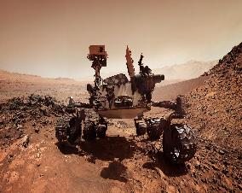
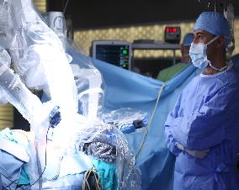
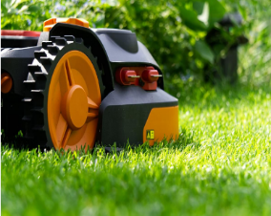
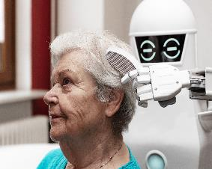
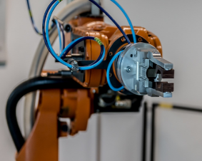
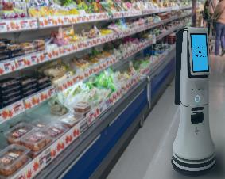
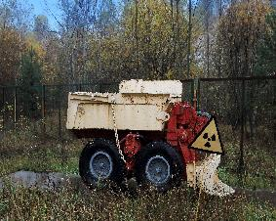

What do robots help us to do?
Explore space
Perform delicate surgery
Keep our homes
and gardens clean
and tidy
Help people who
need additional care
Make complex
products quickly
and without mistakes
Pack our groceries
at super speed
Work in places it’s not safe for people to go
Perform unsafe
stunts in films
Starter
Notes:
Encourage students to develop a wide list of examples of what robots do for us, from manufacturing to exploring or even helping to care for us.
More information about each example:
Space probes and satellites are forms of robot, designed to operate independently even far out in space. The Voyager 1 space probe is now 14.5 billion miles from Earth and still functioning and able to send back data!
Surgical robots like DaVinci turn a surgeon’s hand movements into incredibly precise and delicate movements - even if the surgeon is controlling the robot from another country.
Robot vacuums and lawnmowers are a great help for some homeowners. Many more advanced home appliances like washing machines can also be classified as robots!
Robots can provide practical help and perhaps even companionship for vulnerable people.
Most robots are used in manufacturing where they are great at performing the same task over and over again - something humans are not that good at doing. They can also make items that are too complex, large or small for a person to make.
Online delivery is powered by ‘hives’ of thousands of robots that move around one another on a huge grid of storage bins. They can find and pack groceries much faster than a person.
Importantly, robots can go places where people can’t, like underwater or in hazardous environments like the radioactive areas in nuclear power stations.
Robots are being used to perform stunts in movies that would be dangerous for people.

Slide 16
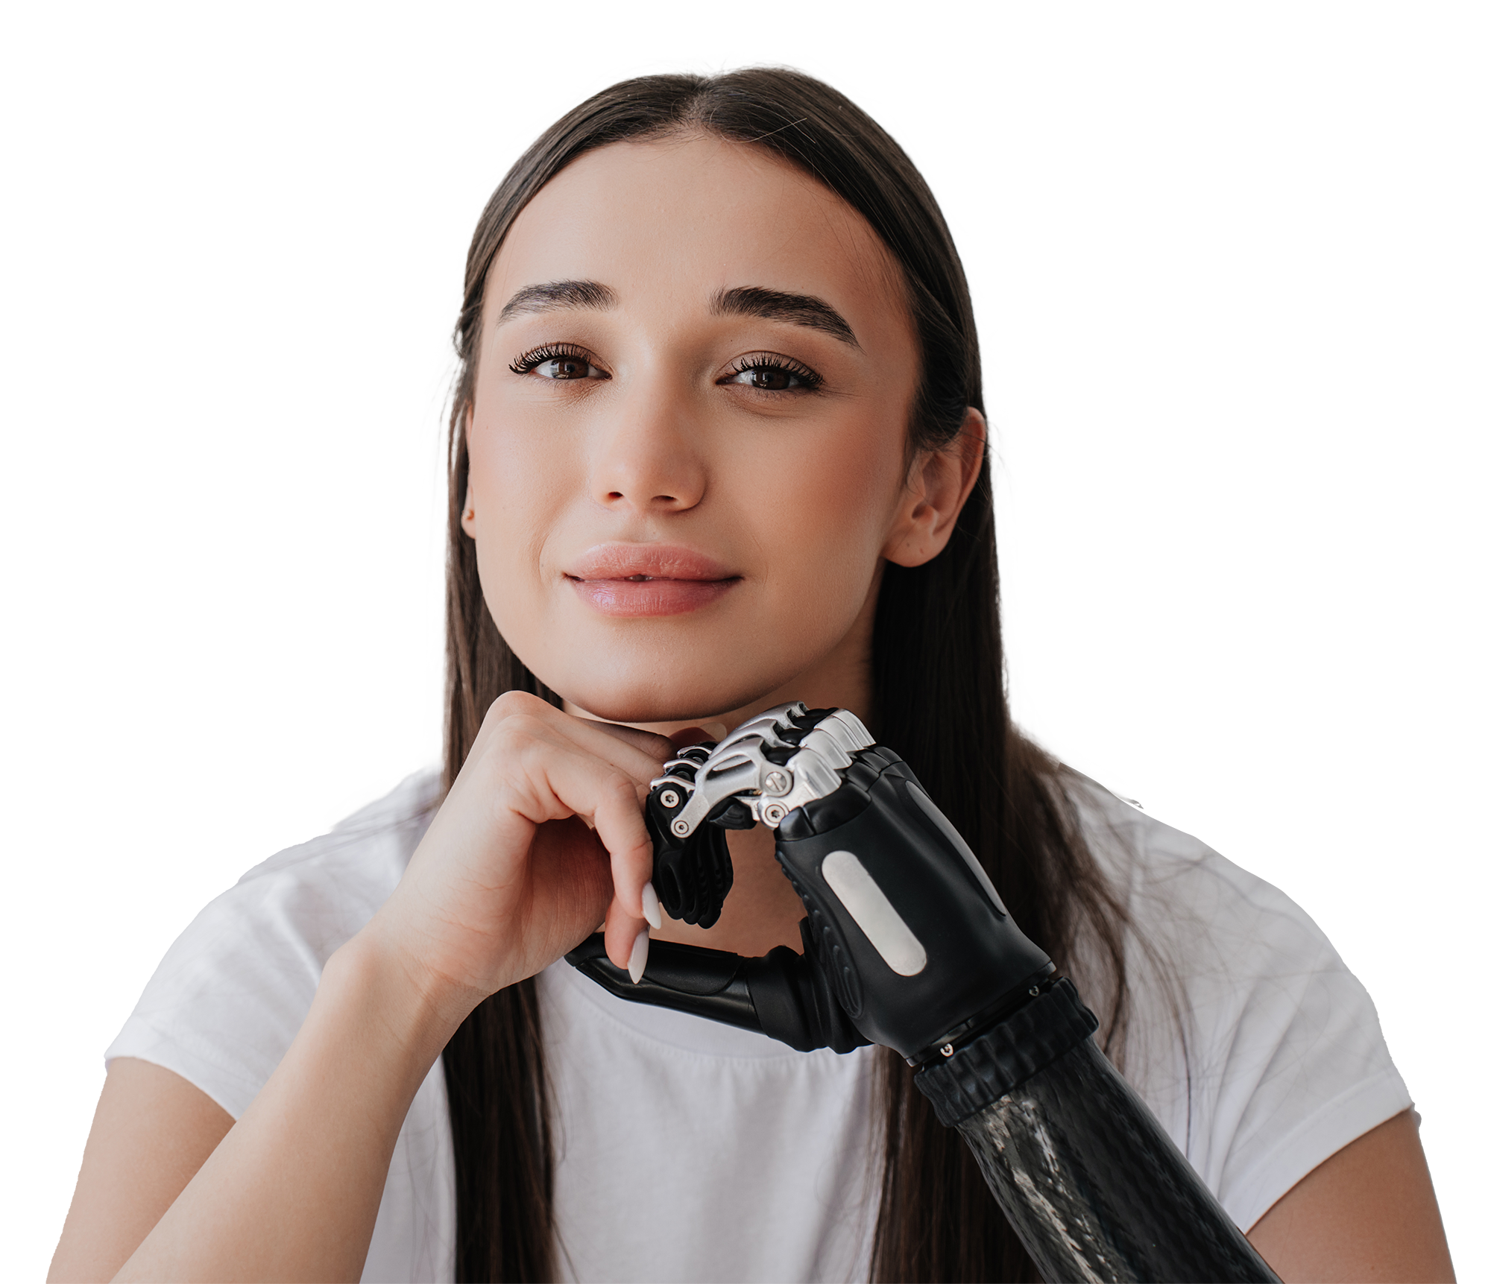


Case studies 5 minutes
Real life
robots

Slide 17
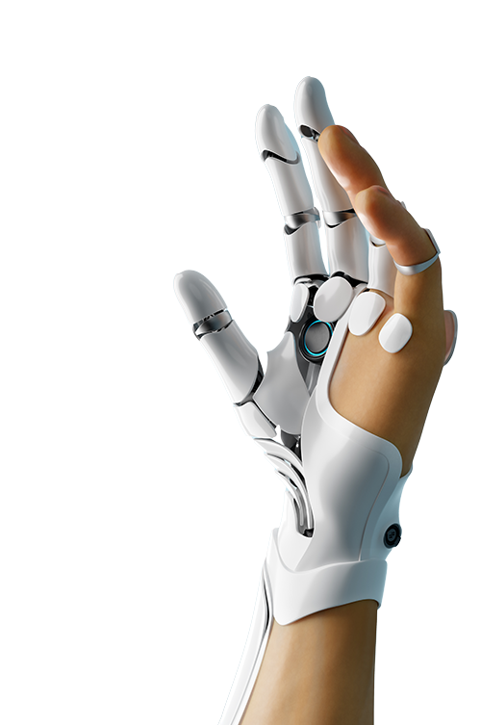

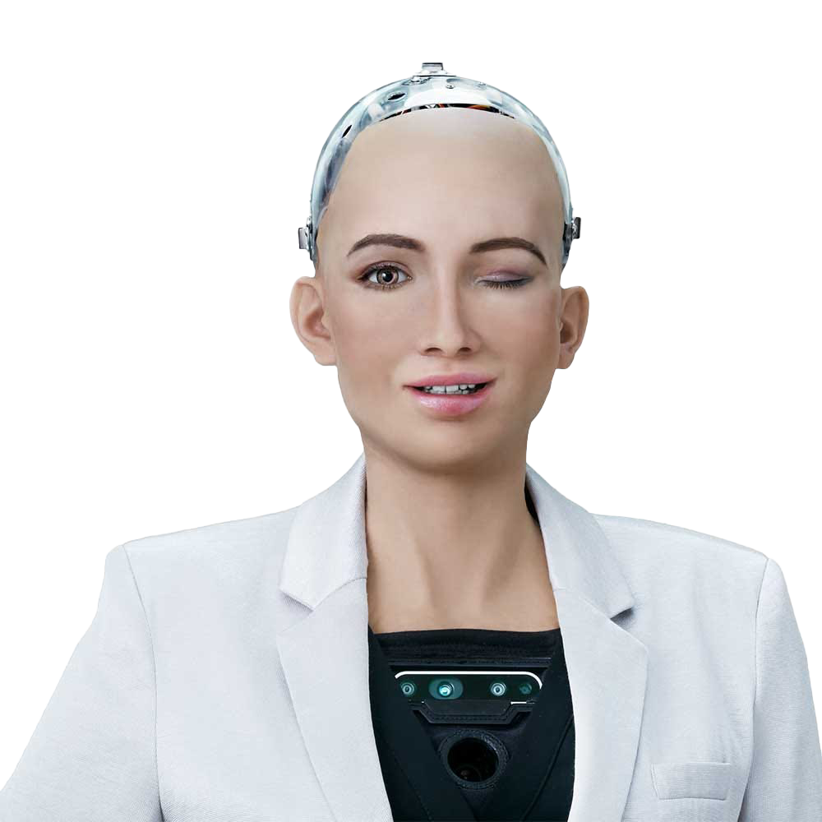
‘Social’ robots to care for people?
Sophia is a humanoid robot from Hong Kong.
She has a Twitter account, and a Saudi Arabian passport!
She can imitate human gestures and have simple conversations.
‘Social’ robots could provide care and compassion
in places like nursing homes.
Robotics in Literature
Klara and the Sun by Kazuo Ishiguro is a dystopian science fiction story.
Klara is a solar-powered Artificial Friend,
chosen by Josie, a sickly child, to be her companion. The novel raises ethical questions around how humans and robots coexist.
How would you feel about being friends with a robot?
Case studies
Notes:
Click through these case studies quickly to show students a few ideas of how robots are being used.
https://en.wikipedia.org/wiki/Sophia_(robot)

Slide 18
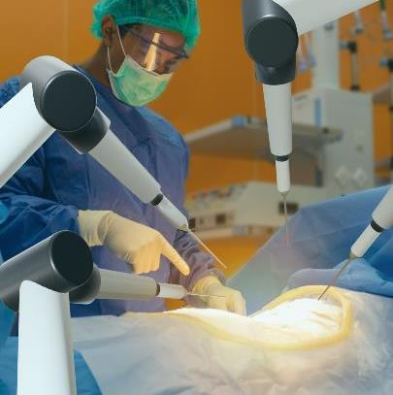


Robotic surgery
Surgeons take control of multiple robotic arms through
a hand-operated console. Sometimes they don’t even have to be in the same room, hospital or even country as the patient.
Robots can perform some procedures better than humans
- there is no chance they will slip.
In 2022, a robot performed delicate surgery on pig tissue without the guiding hand of a human. Could fully automated surgery cut waiting lists and bring down costs?
Would you prefer to be operated on by a human surgeon, or a robotic one?
Case studies
Notes:
Click through these case studies quickly to show students a few ideas of how robots are being used.
https://www.sciencedaily.com/releases/2022/01/220126143954.htm

Slide 19
Robotics and the environment
Engineers are creating robots to help researchers understand the impact of climate change on the Arctic,
where freezing temperatures make work dangerous and difficult for humans.
Some researchers are drilling holes down to the base of glaciers and lowering a robot that can send back images and data about how the glacier base is changing.
Saildrone floating robots are gathering information about sea temperatures, salinity and currents.
Aerial robots gather detailed images and data about how glacier surfaces are changing.
Remote underwater vehicles are gathering important data about the underneath of floating glacier edges.
Case studies
Notes:
Click through these case studies quickly to show students a few ideas of how robots are being used.
https://www.sciencedaily.com/releases/2022/01/220126143954.htm

Slide 20

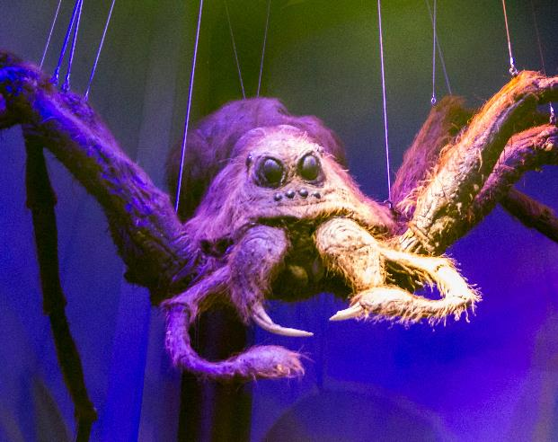
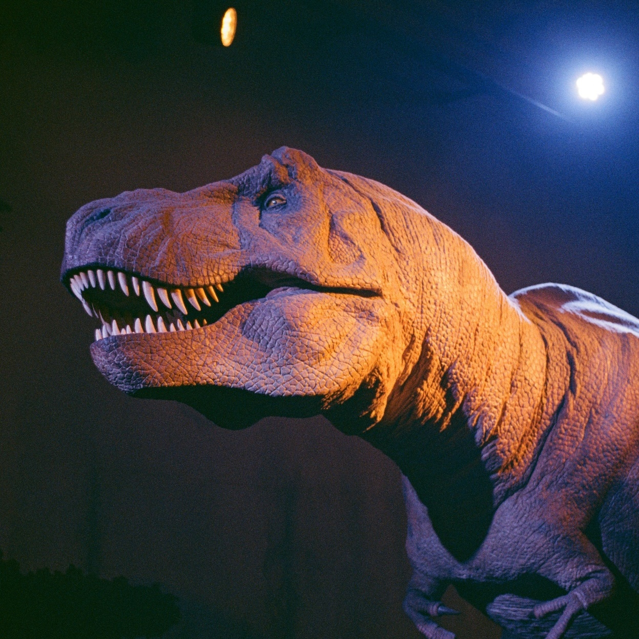

Robotics and the movies
Animatronics is about creating lifelike robots for use in film
or other entertainment.
Animatronics were used in the Harry Potter films to create characters like Aragog, Buckbeak and the dinosaurs in
Jurassic Park.
Robotics are also used by Disney to create autonomous,
self-correcting aerial performers able to perform stunts perfectly, with no risk of anyone getting hurt.
Can you think of any other films that use animatronics?
Case studies
Notes:
Click through these case studies quickly to show students a few ideas of how robots are being used.
www.wbstudiotour.co.uk/explore-the-tour/creature-effects/
https://techcrunch.com/2018/06/28/disney-imagineering-has-created-autonomous-robot-stunt-doubles/
Other famous films using anamatronics include Jurassic Park, Mary Poppins (the bird that Mary sings to) and ET.

Slide 21



Main activity 25-30 minutes
Program your classmate!

Slide 22
What can you program a robot to do?
Choose one of the levels below, and write a program for a robot:
Level 1
Move forwards, spin round twice, and come back
Level 2
Move in a diamond shape then twirl at the centre
Level 3
Make up your own routine!
Example instructions for your program
Start or stop following instructions
Move forward or backward for
a number of seconds or revolutions
Move at 0 - 100% speed
Move at a left or right angle from 0 - 180°
Wait for a number of seconds
Repeat an instruction
Swap programs with another team. One of them will
‘be the robot’ and follow your instructions.
Does your program work the way you wanted it to?
Main activity
Notes:
Students will work in their teams to control how a robot moves. This gives students some initial insights into the basics of how they might attempt the first recycling mat task in the Robotics Challenge, which is to program their robot to do a dance while sharing an important environmental message.
Ask teams to consider what shape or journey they might like to program a robot to take (you might want to constrain this to fit within a certain working space, such as a table top or floor area).
What specific movements would the robot need to make in order to trace out a shape? Ask teams to make a list of the things they might need to program their robot to do. Share ideas, which you can compare with the instruction list on the next slide.
Explain that teams will give their instructions to another team, who will follow them to trace out the movements and shape to see how well the algorithm works.
Add support: Suggest some shapes the robot could make using straight lines, changes of direction and rotations on the spot.
Add challenge: some students could consider how their robot could use sensors to avoid falling off the edge of the fable. What information would they need to collect and what algorithm would help the robot to make a decision and avoid falling?
More detail:
Forward and backward: The robot will have two motors, one for each of two wheels, which can go forward or reverse. In any instruction teams can choose whether this will be for a number of rotations of the axle or for a number of seconds.
Move at an angle: this instructs the robot to turn on the spot until it faces the chosen angle. 90 degrees is a right-angled turn while 180 degrees is a half turn to face the other way.

Slide 23


Engineering skills
Listen
Everyone deserves to
be heard and might have something helpful to say.
Communicate
Be clear when you speak
or write. Ask questions to be sure you understand.
These skills are vital for engineers,
including robotics engineers.
You’ll need them in this task.
Remember your growth mindset:
you can improve at almost anything,
as long as you keep trying and don’t give up!
Support your friends
Help each other - don’t criticise or put each other down. Everyone has something
they can contribute.
Be creative
Think of lots of great ideas
to make your robot move!
Solve problems
Use your new CT skills to break each problem down.
Have fun!
Set a realistic goal.
In this activity, it’s what
you learn and discover
that matters most.
Main activity
Notes:
Use this slide to help students work well in their teams. You might like to link the skills and qualities on the slide, and the important concept of a growth mindset, to your school’s own values and ethos.
Review each helpful skill and quality. If you have time, ask students to suggest how each one will help them to work well together and get their robot making some great moves!
Emphasise the importance of a growth mindset. One important aspect of this is that we can only ever do our best. So some teams might get their robot to do some simple moves. If they did their best and learned some new stuff - that’s great! Other teams might set more ambitious challenges for themselves - and that’s great, too.

Slide 24
Break down the problem
We want our robot to…
We can break this down into these small, simple actions or decisions:
Main activity

Slide 25
Focus on the important bits
These parts matter:
These parts don’t matter:
Main activity

Slide 26
Write clear rules and instructions
Write your robot instructions:
Remember: You can only use
these instructions:
Start or stop following instructions
Move forward or backward for
a number of seconds or revolutions
Move at 0 - 100% speed
Move at a left or right angle from 0 - 180°
Wait for a number of seconds
Repeat an instruction
Main activity

Slide 27
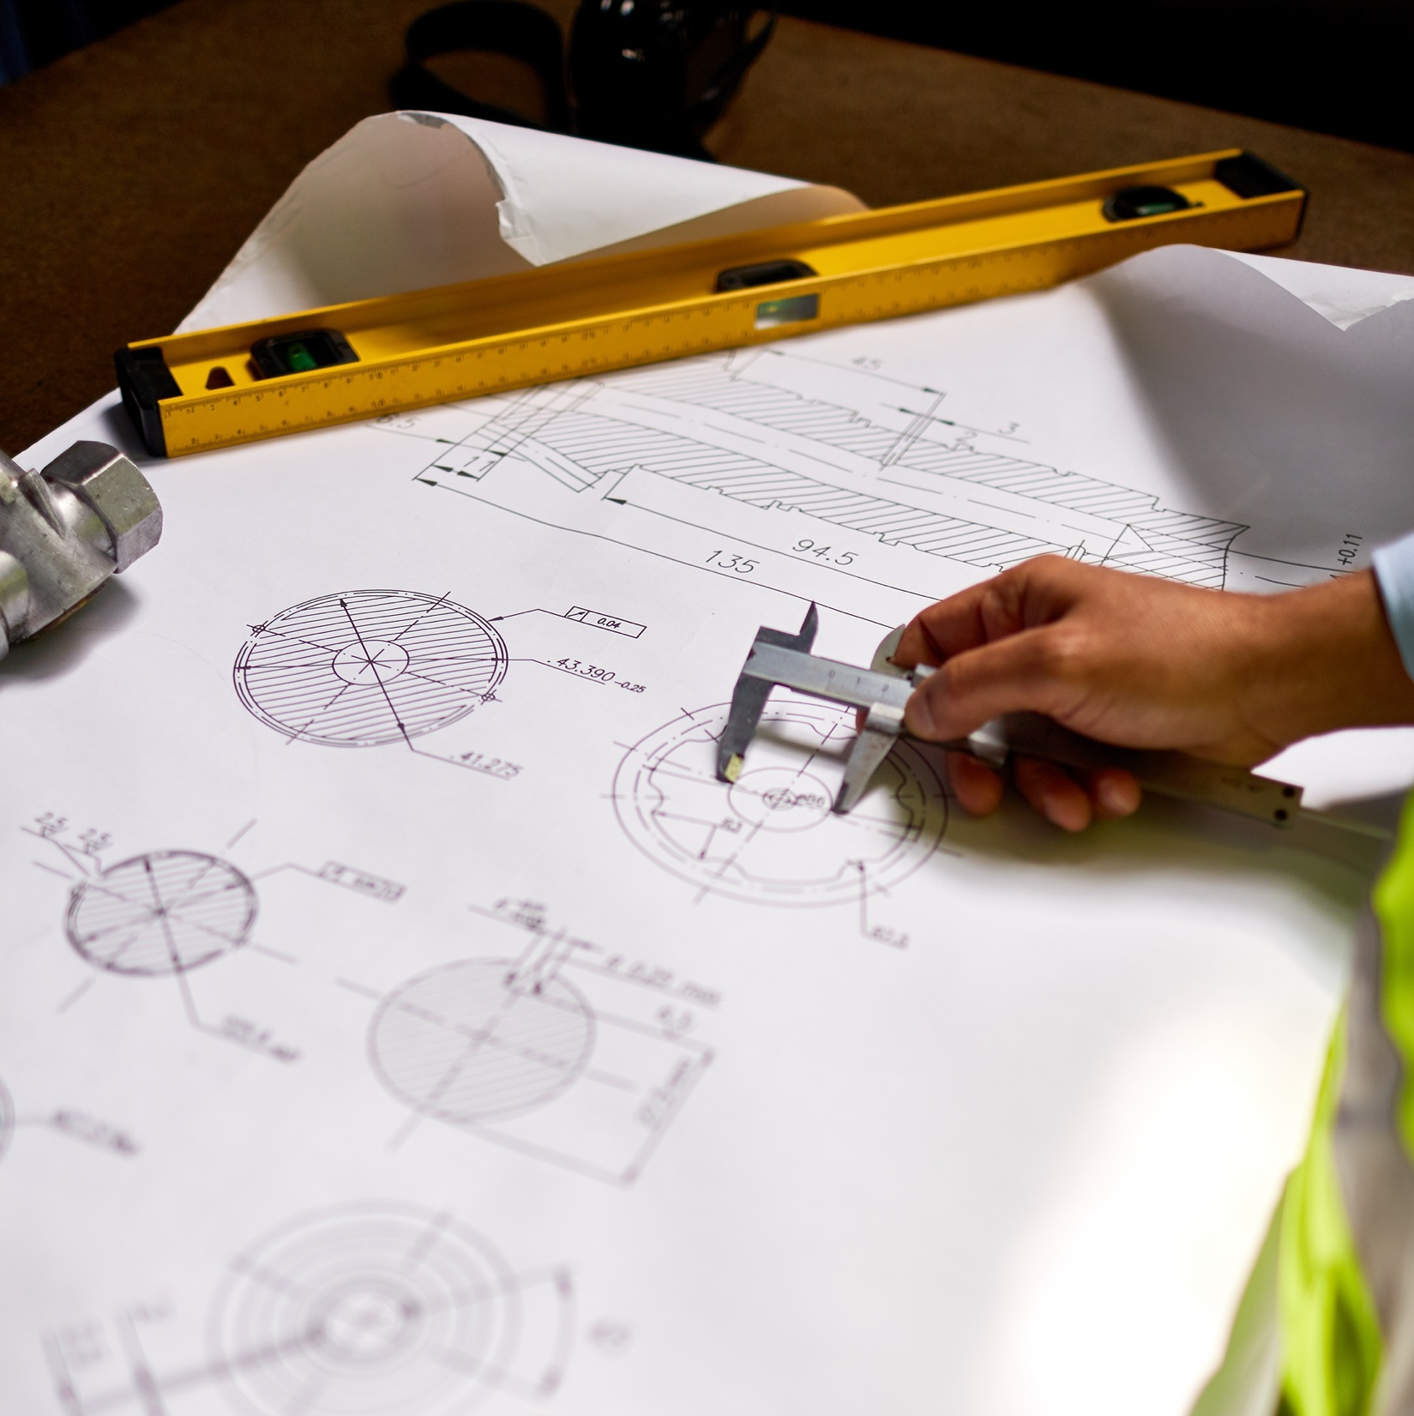
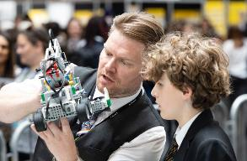


You have been using computational thinking!
Did your robot follow your instructions?
Did it move like you wanted it to?
What went really well?
What would you like to do better?
What helpful things might your robot be able
to do with these moves? What impact could
that have on people’s lives?
How did you use your engineering skills?
What did you learn?
Did you have fun?
Main activity

Slide 28

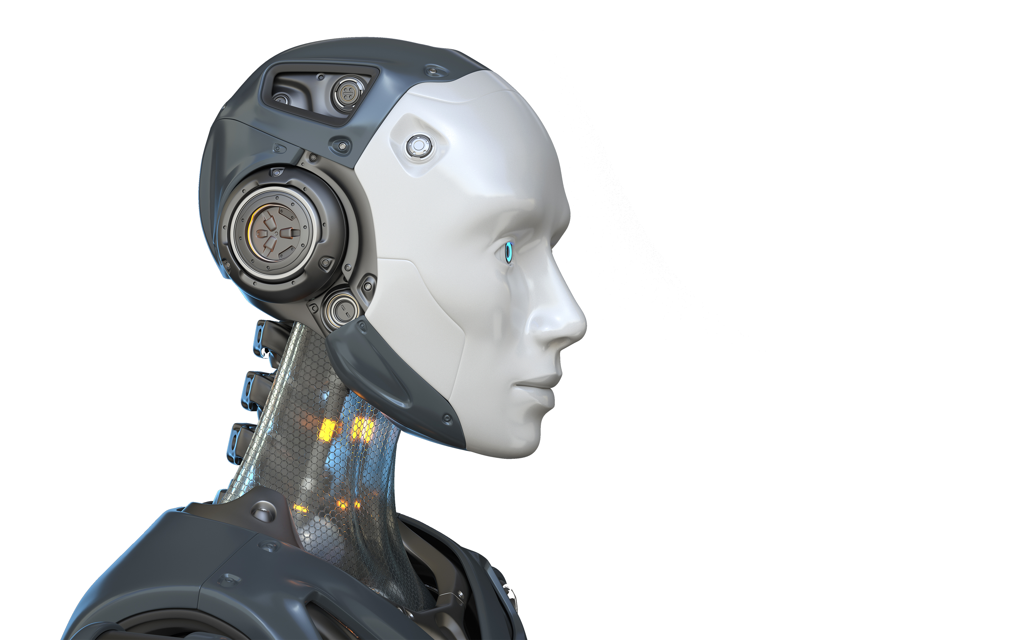
Plenary 5-10 minutes
Robotics
and you

Slide 29
Robots matter
Help the environment
SlothBot is a robotic sloth that monitors endangered species.
Save lives
EMILY rescues people
at sea without risking
human coastguards.
Robots are part of our present and an even bigger part of our future.
Some experts predict that robots could take over 20 million jobs worldwide by 2030.
However robotics will create many interesting new jobs too. Working in robotics, you could…
Improve health
Robot-assisted bladder cancer surgery is safer with improved recovery time.
Make us safer
Railway robots can run
on rail and fly to check
for safety issues.
Make people’s lives easier
iPal is a babysitter robot
who can teach and play with children while their parents are busy working.
Entertain people
Robots are entertaining people at theme parks while they wait for rides and being used in immersive live events.
Engineers are responsible for creating all these robots!
Plenary
Notes:
https://www.cnbc.com/2019/06/26/robots-could-take-over-20-million-jobs-by-2030-study-claims.html
SlothBot: https://earthsky.org/earth/sloth-robot-video/
Save lives: https://emerj.com/ai-sector-overviews/search-and-rescue-robots-current-applications/
Make us safer: https://www.railwayrobotics.com/
Make people’s lives easier:https://www.ipalrobot.com/
Entertain people: https://www.allerin.com/blog/robotics-is-taking-over-the-entertainment-industry
Improve health: https://www.ucl.ac.uk/news/2022/may/robotic-surgery-safer-and-improves-patient-recovery-time
Other example: New legs for a snake! https://www.youtube.com/watch?v=1SgGfMlbCoM

Slide 30
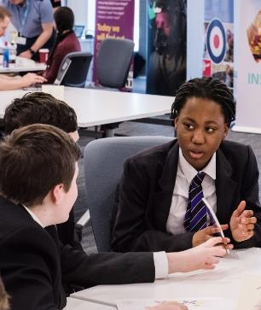
Could you work in robotics?
You can work in many different roles related to robotics, which are often well-paid.
For a lot of these roles, creative thinking, and the skills you have used today will be helpful: communication, teamwork and problem solving.
Research
Hardware and mechanics
Operations
Design
Software and AI
Technician
As well as skills,
you’ll also need knowledge.
Studying Computing,
Maths and Design and Technology and Physics now
will help keep your options
open for a career in
robotics engineering.
Engineer top tip:
There are many
routes into engineering
- T Levels, A Levels, Apprenticeships
- you don’t always
need a degree.
Plenary
Notes:
Remind students that at the start of the lesson they thought about some of the ways robots already help us and that these robots do a great job at things people don’t always do so well, like tasks that need to be repeated exactly the same way, or which need lots of speed and precision.
However, the example of the delivery robot showed that there are some things that robots find it really hard to do, but we find really easy! Like walking from one place to another without colliding with people, buildings and other objects, or understanding what’s going on around us and making quick decisions based on what we sense.
This means that there’s lots we still need to learn and lots of problems still to solve in robotics - and students have been using one of the most important skills needed for this: computational thinking!
Explain that these are just some example career areas that are possible in robotics, from researching new types of robot to making sure that factory robots are in tip top condition.
Ask students to suggest which are they think might be most interesting or might suit them best. Students can use the internet to find out more about each career, or your preferred carters service provider’s resources.

Slide 31


Women in Robotics and Engineering
Margaret Hamilton
is a computer scientist, coder and co-creator of the term 'software engineering'. She wrote code for NASA's Apollo 11 mission in 1969, which put the first humans on the moon!
Ayve Couloute is a teenage
girl from London, who founded 'Girls into Coding' with her mum after becoming interested in coding and robotics aged 7.
She runs regular coding and robotics workshops at schools and universities, and wants to get more girls involved in STEM!
Plenary
Notes:
Discuss the two stories of women in robotics and engineering.
More information on Ayve Couloute and her initiative ‘Girls into Coding’ can be found here: https://www.girlsintocoding.com/
More information on Margaret Hamilton can be found here: https://solarsystem.nasa.gov/people/320/margaret-hamilton/

Slide 32
How confident are you in…
Explaining what a robot is?
Describing how robots can help people
Listing some careers that are available in robotics engineering?
Not confident
Extremely confident
1
2
3
4
5
6
7
8
9
10
Plenary

Slide 33

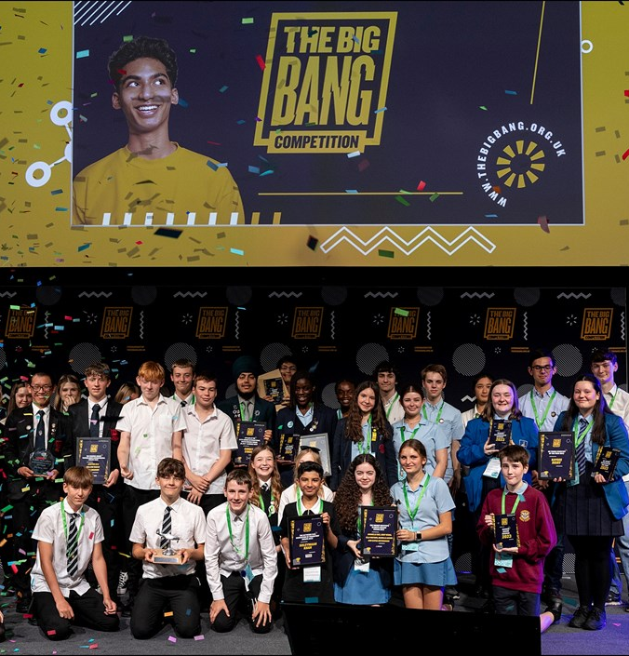
Next Steps
If you are interested in exploring robotics further you can try any of the following:
NOW
Complete one of the extension activities in this series:
Programe a Delivery Robot or Robotics for Good
Explore coding to put your computational thinking skills into further action.
If your school has some micro:bit this is a good place to begin, or you can
try some examples online
You could ask your teacher to organise for a STEM Ambassador who works
in robotics to come into your school to tell you more about it as a career
You could do a Big Bang Challenge or enter the Big Bang Competition and explore how robots can be used as a solution to explore real-world problems. There is a challenge perfect for this called ‘How can robots and AI help humankind?’
NEAR FUTURE
Choose qualifications that support the skills of robotics,
such as Design Technology, IT, Maths, Physics or Computing
If you are aged 14 to 18 you can have a free STEM Mentor via STEM Learning
to talk through your ideas and next steps for a career in this area
Plenary
Notes:
Next Steps:
- A game for an introduction to coding that is quick and targeted at 11 year olds is https://www.rodocodo.com/
- A website for links to coding activities for 11-16 year olds is https://www.computingatschool.org.uk/teach-computing/teaching-computing-secondary/learning-activities-for-secondary-students
- You can book a STEM Ambassador who works in robotics to come into your school here. Request a STEM Ambassador
- You can search on Neon https://neonfutures.org.uk/ for recommended activities to engage your students in coding or computing. Some of these may also be free of charge and have someone attending your school.

Slide 34
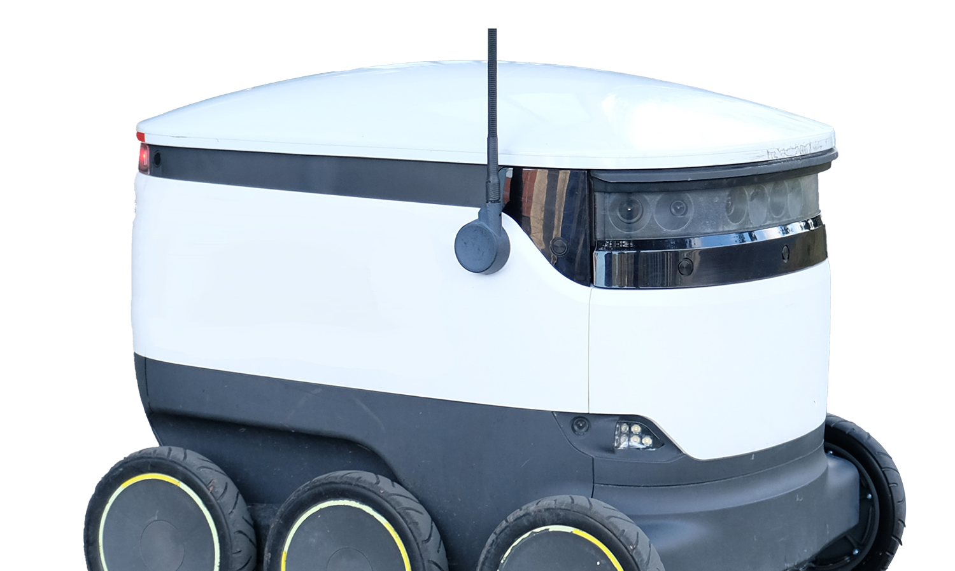
Extension activity 1 30 minutes
Extension: Program
a delivery
robot

Slide 35
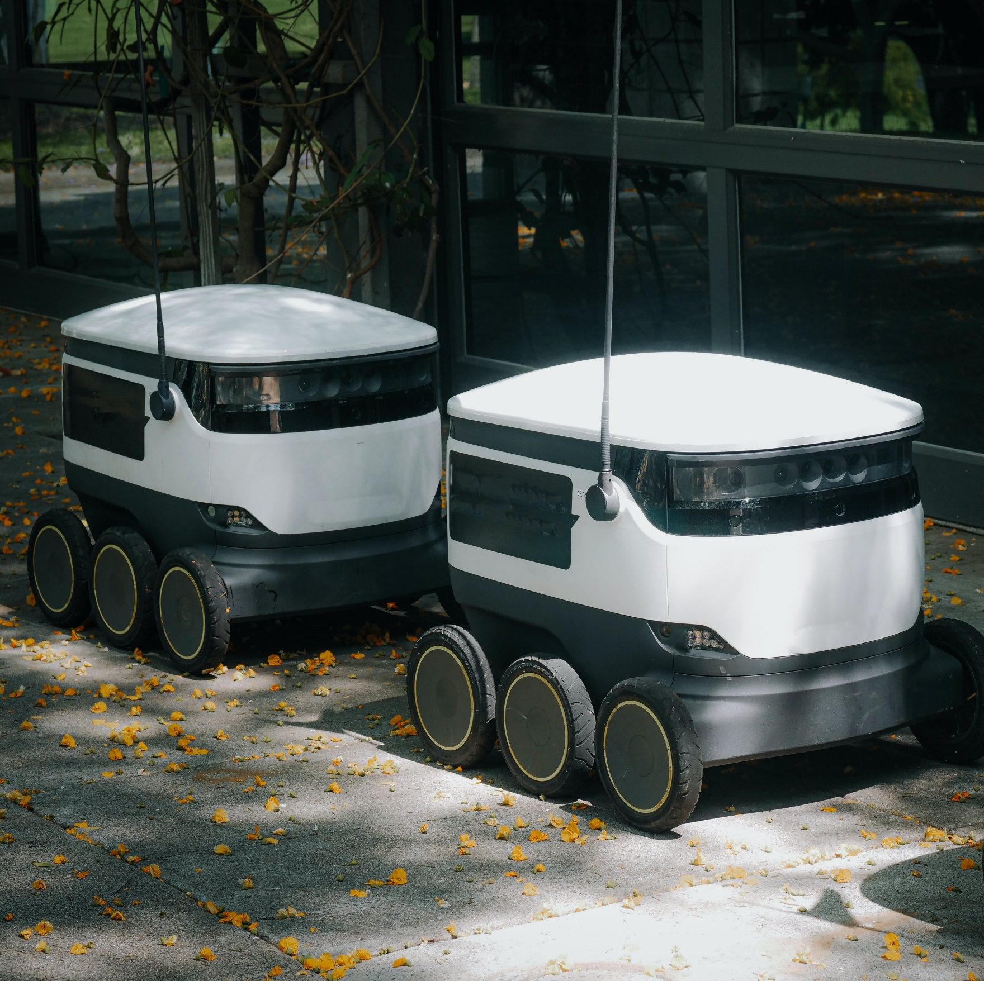

How can we control this delivery robot?
A shop assistant places items ordered online into a delivery robot.
The robot knows where the customer lives.
It has a very detailed map in its memory.
Your task
Create a set of rules and instructions for the robot to follow.
Real-life robotics
Delivery robots have been piloted in the UK.
Robotic fleets are able to reduce pollution, carbon emissions,
traffic congestion and packaging.
Extension activity 1
Notes:
Highlight that we are all so used to this sort of task that we are not particularly conscious of the different information and decisions we need to do it! We need a way to ‘unpack’ the task so we can think about it in a more helpful, structured way.
www.starship.xyz/business/
www.starship.xyz/press_releases/starship-technologies-introduces-delivery-robots-to-great-british-public/

Slide 36
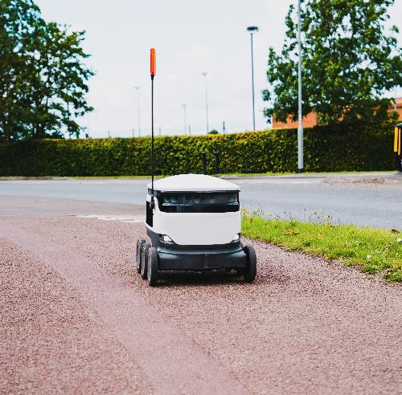
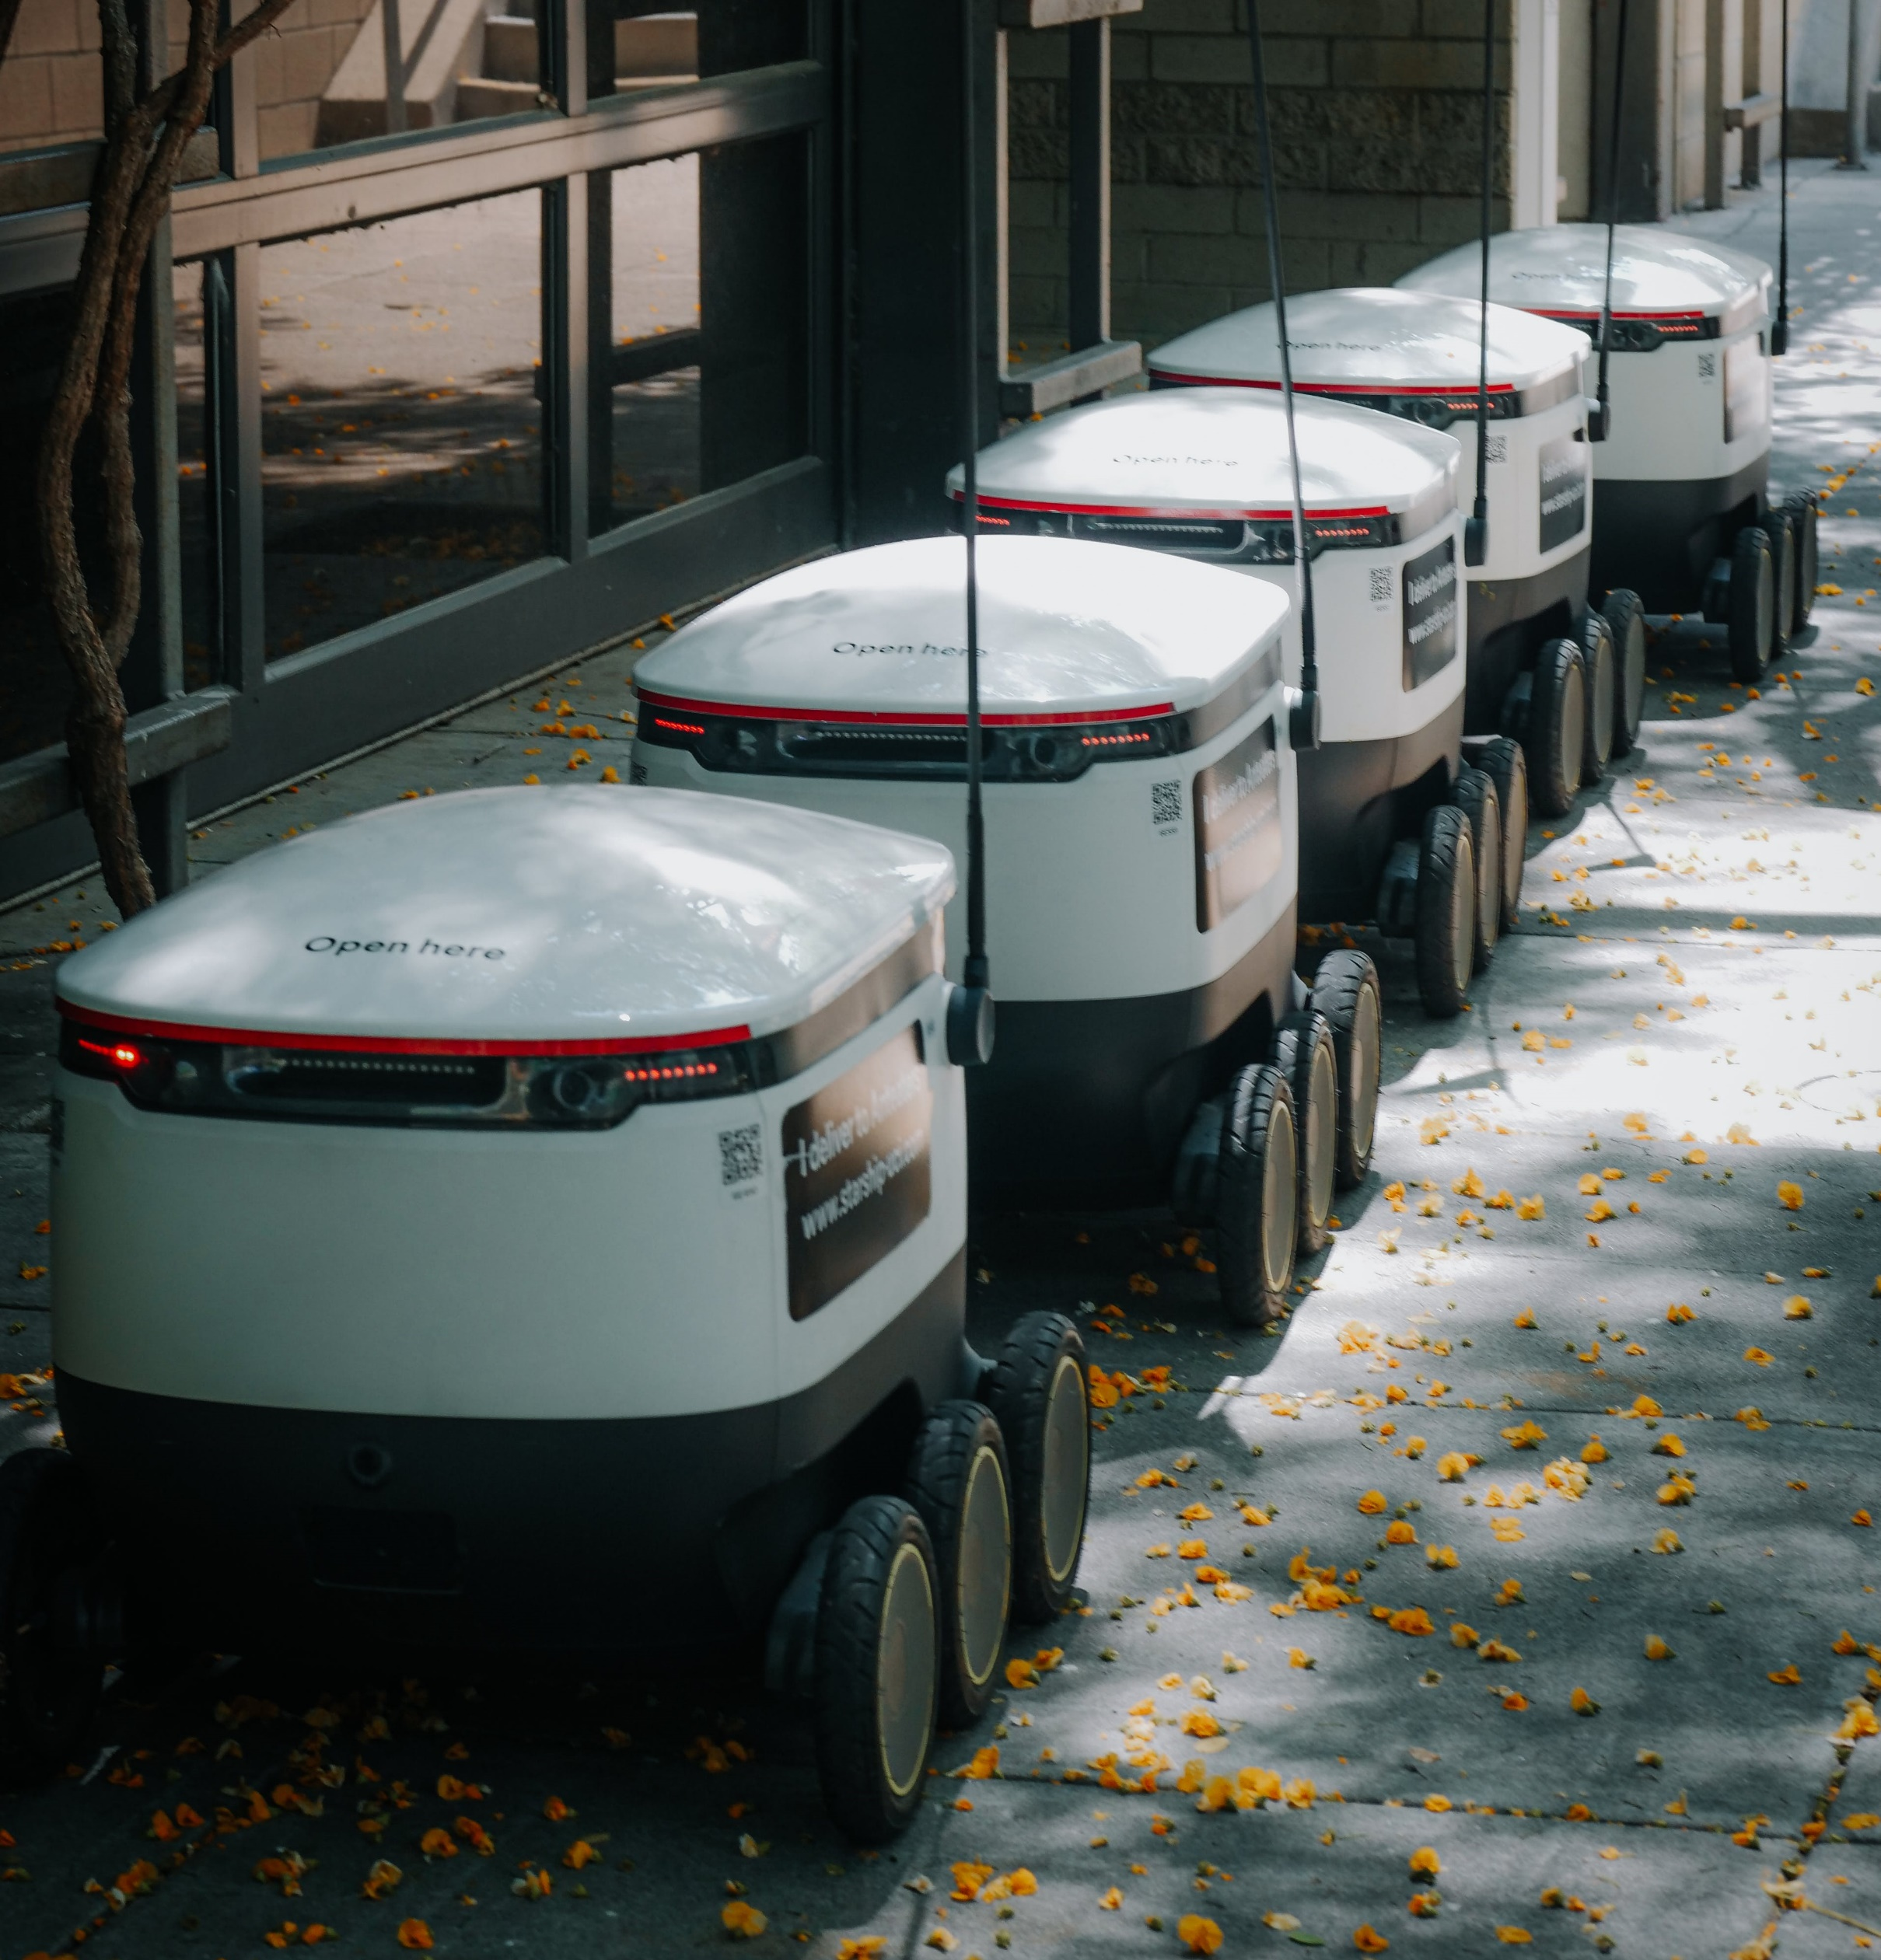

1. Break the problem down
What different things does the robot need to do?
How can you break down the robot’s task into small,
simple actions or decisions?
Engineer top tip:
Think about the steps involved when you walk
from place to place
What information do you need to start?
What decision must you first make?
What information do you need to gather as you walk?
What decisions do you need to make as you go?
Extension activity 1
Notes:
The first task is to break the problem down into smaller ‘chunks’ that we can think about and solve one at a time.
Ask each team to break down the task for the robot to get from the shop to the customer. Teams can list their ideas on plain paper or sticky notes, or use an online tool such as Google Jamboard. A later slide lists some possible tasks.
Teams don’t need to break the problem down into its very smallest constituents, just into the main elements. For example, ‘avoid people’ is a suitable chunk - students don’t need to break this down further for now - that happens at a later stage. But you may want to highlight that this process is ‘nested’ - some chunks (like ‘avoid people’) need to then be broken down themselves into smaller actions or decisions.

Slide 37
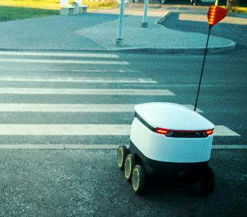
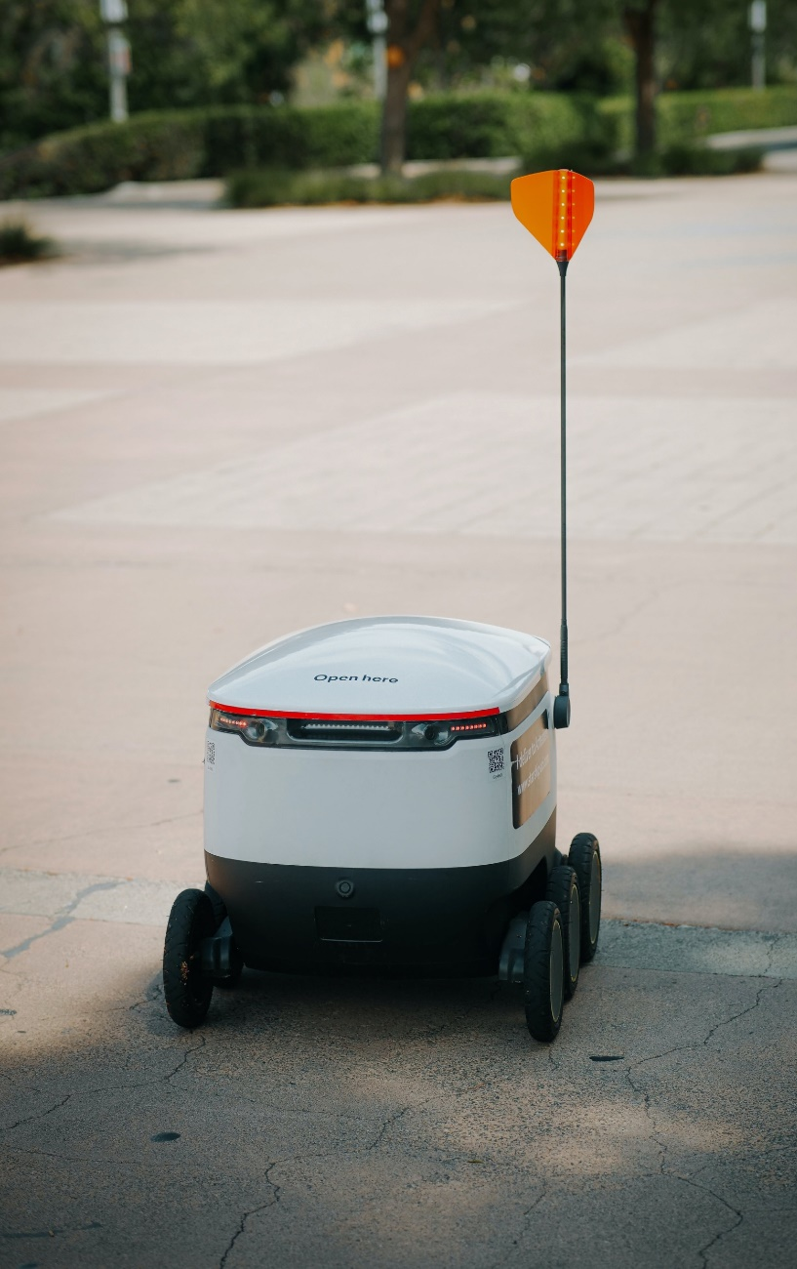

2. Focus on the important bits
Engineer top tip:
During the design process, consider what your priorities are.
Some parts of the problem will be really important while others won’t matter.
Think about one task the delivery
robot needs to do
What are the important bits?
What doesn’t matter?
Example: Boiling an egg
Task: Put egg in pan
Important
Type of egg (e.g. hen not robin)
Type of pan (e.g. one that works on an induction hob)
Amount of water
Not important
Pan size
Pan colour
Extension activity 1
Notes:
When we try to solve a problem, some parts of it matter while other parts are not so important.
Ask students to think about boiling an egg in a pan of water. What choices might be important, and which ones can we ignore? We might want the right sort of egg, like a hen’s egg rather than a duck egg. We might need the right type of pan, for example one that works on an induction hob. And we need to put the right amount of water in the pan. But in terms of cooking the egg properly, the size of the pan doesn’t really matter (though for one egg a smaller pan is better) and it definitely doesn’t matter if the outside of the pan is coloured or not.
Ask students to think about one of the smaller problems they have just listed.
What parts of this problem are important?
What parts don’t matter?
Add support: ask students to think about ‘avoiding people’. A later slide lists some possible examples.
Add challenge: ask each team to think about one of the tasks on your list.

Slide 38
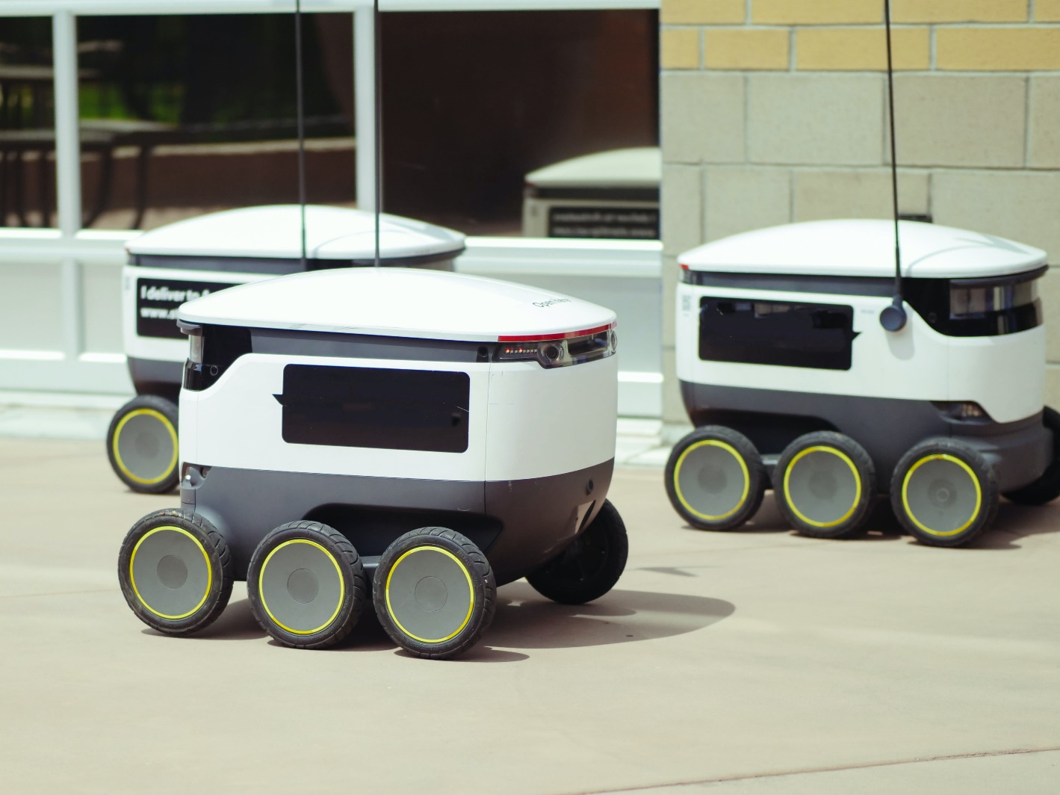
3. Write clear rules or instructions
What clear rules or instructions can we write so the robot can make its own decisions?
What order should we write them in?
Engineer top tip:
You may find it helpful to use
IF… THEN… statements in your instructions, e.g.
IF the water is boiling,
THEN turn the heat to low
IF the water is not boiling,
THEN turn the heat to high
Extension activity 1
Notes:
Deliver this part of the lesson to suit how students will complete the second activity to program (or simulate programming) a simple robot to make it move. The example slide that follows uses simple plain text but you can also show how a graphical interface, pseudocode or a logical flowchart works.
Once we have broken a problem down into smaller, more manageable ‘chunks’, and we have identified what parts matter and which ones we can ignore, we can now focus on giving the robot detailed instructions on what to do.
Ask teams to break their important parts of the problem down into step by step rules or instructions. (You don’t have to introduce IF… THEN statements but you can do so if you prefer.) Teams can write their instructions on plain paper, use Google Jamboard or report back verbally.
Add support: students focus on an algorithm for avoiding people and write their answer in simple plain text.
Add challenge: students focus on any problem, create a logical flowchart and identify what input and output variables the robot might process and control.

Slide 39
Control a delivery robot
Break the problem down
Break the problem down
into smaller tasks
Focus on the important bits
Choose one task.
Which bits are important
and which don’t matter?
Write clear rules and instructions
Write some step-by-step instructions for your one
chosen task:
Now you’re thinking like an engineer!
Extension activity 1
Notes:
Students complete this Control a delivery robot activity sheet.

Slide 40


You’ve just used computational thinking
1. Decomposition
Break the problem down
Locate customer home
Work out directions
Follow directions
Stay on the pavement
Avoid people
Avoid vehicles and bikes
if crossing the road at a pedestrian crossing
2. Abstraction
Focus on the
important bits
Avoid people:
Distance from robot
Angle from robot
Speed
Height
Clothing
3. Algorithm
Write clear rules and instructions
Collect data from sensors. If a person is detected:
Calculate their distance, angle,
speed - the path they are taking
Calculate the path of the robot,
staying on pavement
If a collision is likely, then change direction to pass behind person, staying on pavement
If not, then keep going
Start again every 0.1 seconds
Extension activity 1
Notes:
Explain that students (if they did not realise already) have been using a specific way of thinking about problems, called computational thinking, or CT.
CT is helpful because it’s hard to solve complicated problems where lots of things are going on at once (something our own brains are actually really good at!). But when re break down a complex problem into lots of smaller ones, we find that these are much easier to solve. It’s a formal way of saying that we’re doing one thing at a time!
Review the three stages of decomposition, abstraction and algorithm (for this age group it’s not necessary to also consider pattern recognition and generalisation) and the example answers.
Decomposition: The robot might follow rules when choosing directions, for example the shortest distance, the fastest route, just like phone navigation does. It might also avoid certain spaces that are really busy or uneven, like a shopping parade or park.
Abstraction: Can students think of anything else we might notice about a person that the robot can safely ignore? What matters is just where the person is, how they are moving and whether, based on its current path, the robot is likely to collide with them. Of course, people can rapidly change their minds and direction!
Algorithm: An algorithm is just a set of rules or instructions to follow. This just one suitable answer and some teams might have broken these steps down into more detail. For example, changing direction to avoid the person would include calculating how many degrees to the left or right to turn, and making sure that did not take them towards another obstacle or the edge of the pavement.

Slide 41
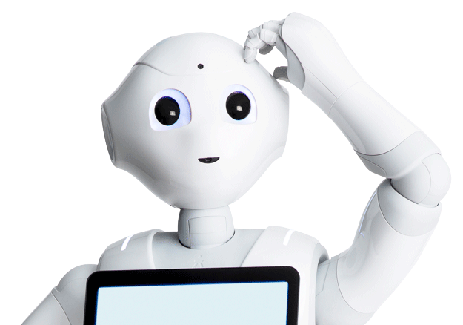


Extension activity 2 30 minutes
Extension:
Robotics
for good

Slide 42

How could you use computational thinking to program
a robot to…
Decompose the problem
…spot fallen branches on a railway line?
…refuel a car or plane?
…fill a pan with water for an elderly person at home?
…hit a table tennis ball back to you?
Identify what matters
Write a step-by-step algorithm
Extension activity 2
Notes:
Emphasise that it’s not just for students who are already interested in computing or robotics - it’s for everyone, and students can enter in teams of friends.

Slide 43
www.thebigbang.org.uk/big-bang-at-school/
@BigBangUKSTEM

