Slide 1
BIG BANG AT SCHOOL

Slide 2
Teacher overview
Our research shows that when schools outline what their event will include and why they are doing it, the students get more from it.
You can use this slide deck to introduce your Big Bang at School event. It includes:
a video and two overview slides
An introduction to STEM jobs
Information about engineering
You can show it before the event in an assembly or during form time, or on the day in the first workshop the students are taking part in

Slide 3

Big Bang at School - Introduction
Notes:
Video link is here https://www.youtube.com/watch?v=vrWE4jmWzJg

Slide 4
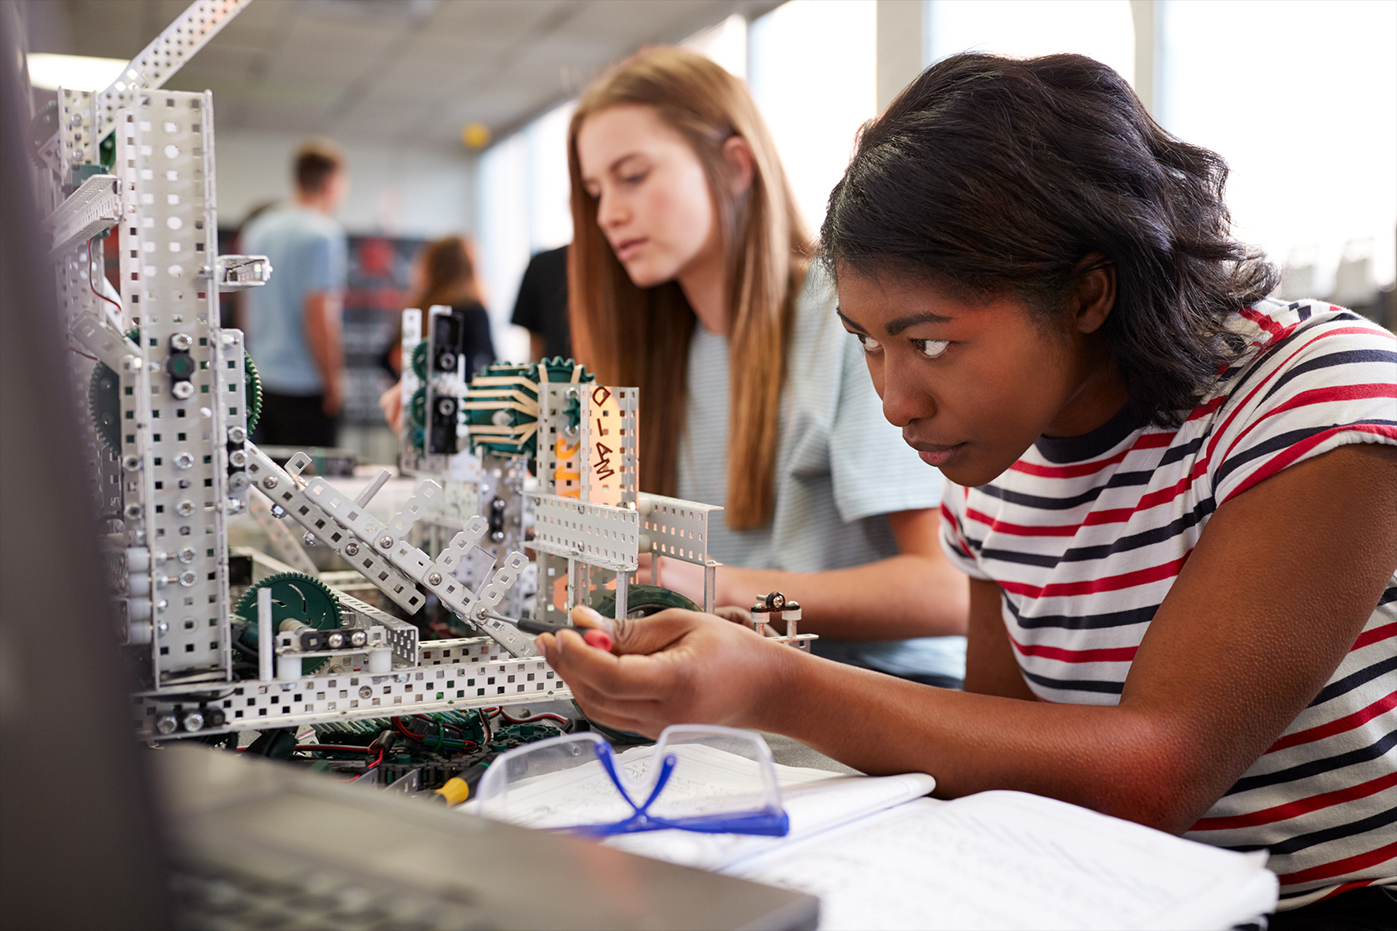
Your Big Bang at School
This exciting day has been designed to show you all the amazing possibilities in science, technology, engineering and maths (STEM)
It will include:
Fun, practical, hands-on activities
Exciting topics and subjects
Discovering your skills
Meeting experts
Ways to find out more about what interests you
The benefits a future in STEM has for you
Why you are wanted in STEM
Exploring STEM jobs, including those near you
Reflecting on your experience of the day

Slide 5
Big Bang at School – your day (to be edited)
Time | Group A (30 students) | Group B (30 students) | Group C (30 students) | Group D (30 students)
9.00 - 10.00 | Introduction to the day and Science Show (Main Hall)
10.00 - 11.00 | Medical University (Room 3A) | ZooLab (Room 1C) | Big Bang Challenge (Room 1B) | STEM Skills (Room 3B)
11.30 - 12.30 | Zoolab (Room 1C) | Big Bang Challenge (Room 1B) | STEM Skills (Room 3B) | Medical University (Room 3A)
13.15 - 14.15 | Big Bang Challenge (Room 1B) | STEM Skills (Room 3B) | Medical University (Room 3A) | Zoolab (Room 1C)
14.15 - 15.15 | STEM Skills (Room 3B) | Medical University (Room 3A) | Zoolab (Room 1C) | Big Bang Challenge (Room 1B)
15.15 - 15.30 | Reflection (Room 3B) | Reflection (Room 3A) | Reflection (Room 1C) | Reflection (Room 1B)
(This slide is editable for you to show students what the event includes . We have included an example to show you what this might look like for 120 students on a rotation-based workshop day)

Slide 6





Discover your skills at your Big Bang At School event
  These skills are all essential for STEM and jobs in it. How do you already demonstrate these in your life? Which would you like to develop further?
  communicating ideas
  creativity
  determination
  innovation
  open-mindedness
  problem finding and solving
  social conscious
  teamwork
Notes:
Teacher Notes:
Encourage students to see that they already have a lot of these skills already in their daily lives, and these are very transferable to STEM. Further short definitions and where they are applicable to both their lives and in STEM are below to support this discussion.
You can also do the pre and post skills reflection piece before and after the day to support with this slide.
Examples are below for each skill:
Communicating ideas: speaking, listening, writing, drawing.
Everyday examples – they are good at drama, they are the captain of a team, they are a good listener to their friends
STEM example - When engineers have to present their solution to a problem to encourage others to support it.
Creativity: using their imagination
Everyday examples – they create art, they write stories, they use to play pretend a lot when they were younger.
STEM example – When engineers have to imagine what a future problem will be to consider that into their solution.
Determination: not giving up
Everyday examples – if they are losing a game or match they carry on playing, if they retake a test or redo a piece of work.
STEM example – when scientists do tests and something doesn’t go to plan. They try it again and learn what to do differently next time.
Innovation: doing things differently
Everyday examples – trying a different route, path or journey on a game, exploring different ways to learn or revise to see what is best for them.
STEM example – when technologists think of completely new products, such as AI or the smartphone.
Open-mindedness: trying something new
Everyday examples – learning a new subject or topic, trying a new recipe, learning a new skill like rock climbing.
STEM example – when engineers test their prototypes and are open-minded that they can try something new and learn from any failures.
Problem finding and solving: finding the root of the problem and creating the best solution
Everyday examples – when to complete homework to fit in with life outside of school, the best route using public transport to get somewhere.
STEM example – engineers really investigate the root of the problem thoroughly before moving onto the best solution for that problem.
Social conscious: caring about the impact of your actions
Everyday examples – changing your language according to your audience, changing behaviour to help the planet.
STEM example – engineers and technicians think about how a person will use their solution and make sure that they have a positive outcome.
Teamwork: working well with others
Everyday examples – playing a team sport, cooking with others, groupwork at school
STEM example – engineers and technicians work together to create and test a solution. Engineers create it, then technicians build and test it and report back to the engineers.

Slide 7
Did you know?
There’s a job for everyone in science, technology and engineering no matter who you are or your interests. They want you and your skills in problem solving, creativity, determination and teamwork!
Engineers are in demand, both in the UK and around the world.
Pick the route in to engineering that suits you! Many subjects are valued, you don’t need top grades, and there are T level, apprenticeship and degree routes in to suit everyone.
Get paid well as an engineer! You have the potential to earn £80,000+ as you get more experience.
Notes:
Teacher Notes:
The opening statement is about jobs in STEM and can be used to start a discussion around what jobs do they already know in STEM.
The facts in text boxes are to help myth bust about engineering and jobs in it. By introducing these at the start of your event we hope that students will then enter the day knowing that there is something for them and that they would be valued in a future in it.

Slide 8

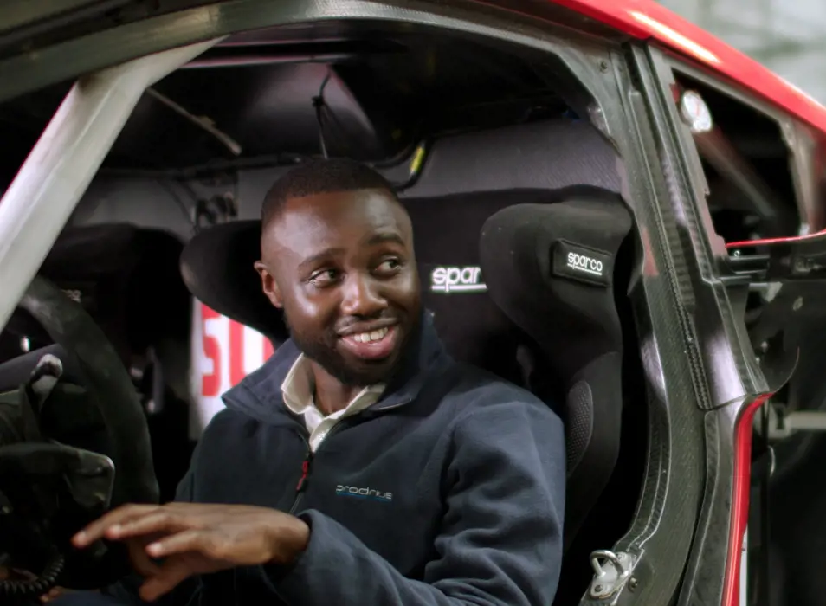
Daniela Paredes-Fuentes: A design engineer and co-founder at Gravity Sketch who designs software which uses virtual reality (VR) to create 3D designs of models, art and scenes for companies like Ford and Disney.
What is an engineer?
Engineers solve problems, design and create.
They transform people’s lives from tackling climate change, helping people’s health, to making food easier to grow. They work in sport, TV, gaming, fashion, transport, wellbeing, and even more, so whatever your interests there’s a job for you!
We need many different people to become engineers, so that the solutions they create meet everyone’s needs. We need you!
George Imafidon: A performance and mechanical engineer who designs Extreme-E race cars with Sir Lewis Hamilton’s electric racing team, to make race cars faster and better for the planet.
Notes:
Teacher Notes:
This slide is included to support awareness and understanding of what an engineer is, does and the impact they make.
You can draw out the difference between engineers and technicians here as well. Put simply - engineers design, and technicians build and test those designs.
You can mention how engineers and technicians use their skills to create more exciting, impactful, inclusive and sustainable ways for us to make the most of our free time, health and future.
Engineers are also future thinking, so think of future problems that might occur to help create solutions that will be long-lasting.
You can also mention the Sustainable Development Goals and ask young people what types of challenges engineers and technicians are working on.
More information on each individual case study can be found here:
Daniela Paredes-Fuentes: https://thisisengineering.org.uk/people/daniela-paredes-fuentes/
George Imafidon: https://thisisengineering.org.uk/people/george-imafidon/
Other examples are:
Mimi-Isabella: https://neonfutures.org.uk/case-study/civil-engineer-mimi-isabella-nwosu/
Joshua Firmin: https://neonfutures.org.uk/case-study/electrical-engineer-joshua-firmin/
Patty Srinath: https://neonfutures.org.uk/case-study/sports-engineer-patty-srinath/
Other case studies can be found here https://neonfutures.org.uk/case-study/

Slide 9
Your Big Bang at School
Discover where STEM could take you in your future
Take the opportunity to reflect on your Big Bang at School event to understand what it has meant for you and what you can do next to continue exploring STEM.
Notes:
Teacher Notes:
We recommend time for reflection to help to embed the meaning of the day for each student. One of our tasks include a pre task to do anytime before the day, and for them to come back to after the event to see the impact of it. You may then wish to do that pre task here.

